Slide 1
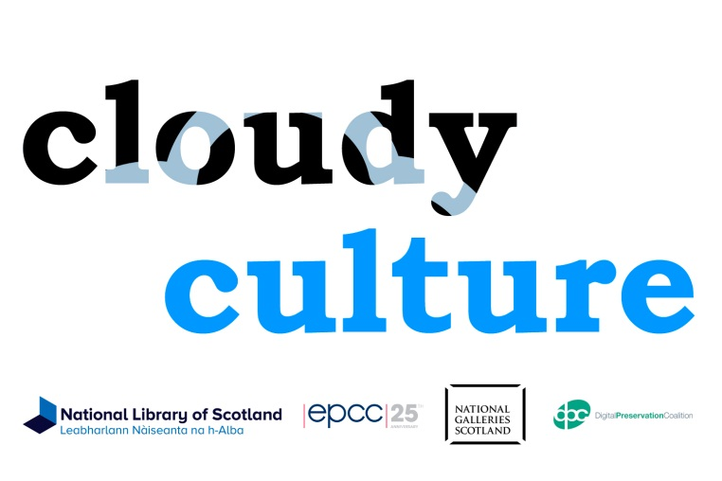
Cloudy Culture cloud-like services to improve the preservation of digital cultural heritage

Slide 2
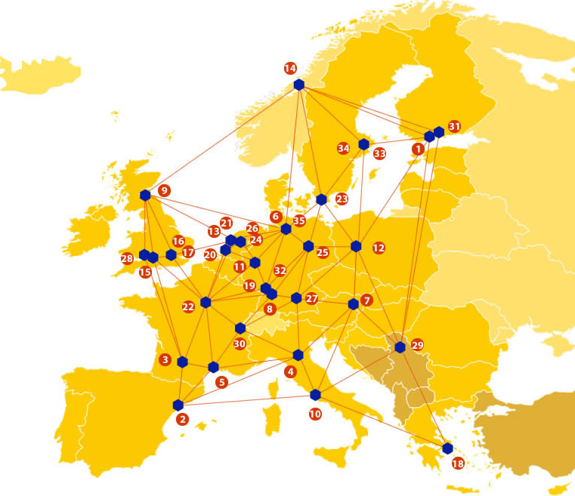

EUDAT: A truly pan-European Infrastructure
EUDAT offers common data services to both research communities and individuals through a network of 35 European organisations.
EUDAT wants to enable European researchers from any discipline to preserve, find, access, and process data in a trusted environment, as part of a Collaborative Data Infrastructure.
European infrastructures
Technology Providers
Research Communities

Slide 3

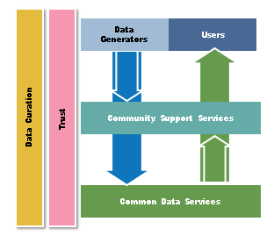
EUDAT Vision & Mission
Vision: Data is shared and preserved across borders and disciplines thereby enhancing the value and quality of research at large.
Mission: To enable data stewardship within and between European Research Communities through a Collaborative Data Infrastructure, a common model and service infrastructure for managing data spanning all European research data centres and community data repositories.

Slide 4
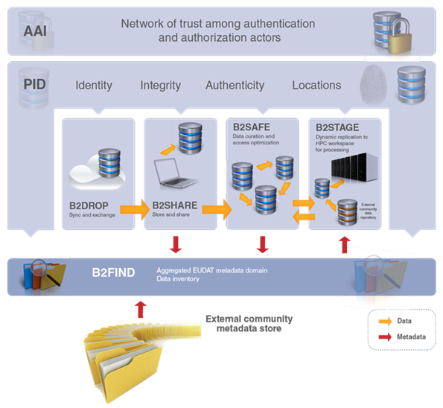














B2 Service Suite
Covering both access and deposit, from informal data sharing to long-term archiving, and addressing identification, discoverability and computability of both long-tail and big data, EUDAT services seek to address the full lifecycle of research data
https://www.eudat.eu/services
Notes:
B2FIND
stores metadata as well through other EUDAT services such as B2SHARE to provide access to data object within the EUDAT CDI
is used in inter-service use cases, e.g. to select links to data to be transferred to HPC platforms through B2STAGE

Slide 5






Building solutions with the communities
EUDAT services (B2 Service Suite) are designed, built and implemented together with user communites.
Common Language Resources and Technology Infrastructure (CLARIN)
European Network for Earth System Modelling (ENES)
Distributed infrastructure for life-science information (ELIXIR)
European Plate Observing System (EPOS) - Solid Earth sciences Research Infrastructure
Integrated Carbon Observation System (ICOS) to quantify & understand greenhouse gas balance
Long-Term Ecosystem Research (LTER) in Europe

Slide 6

The Challenges
“The National Library of Scotland will collect, preserve and make available a range of materials that capture Scotland’s memory and contribution to world knowledge”
Preserving Scotland’s digital culture
Need to cheaply store a 3rd copy of data
More data same amount of staff
Computational power and read/write speed for preservation actions. e.g. changing image format, health checks
Lack of case studies of cloud use does not make decisions clearer

Slide 7




Cloudy Culture Pilot: the partners
Edinburgh Parallel Computing Centre

Slide 8
Cloudy Culture Pilot
Purpose: The pilot wishes to use EUDAT to hold a safe preservation copy of data to allow for locally held access copies to be repaired if they change over time.
Pilot’s activities:
  Commissioning phase: Simple transfer tests, security, encryption/decryption during transfer and rest. Fixity checks, file characterisation with basic reporting
  Data Uploads optimisation and bulk tests, file management & performance metadata. Bulk upload.
  Data download optimisation and bulk tests, file management & performance metadata. Bulk download.
  Fixity checks optimisation & reporting.
  File Characterisation optimisation & reporting. Sample file characterisation.
  Dissemination and assessment

Slide 9
EUDAT service uptake
The Cloudy Culture Pilot will rely on the following EUDAT services:
  B2SAFE & B2STAGE
Cloudy Culture will integrate local tools with those developed by EUDAT and use B2SAFE, B2STAGE, iRODS, storage and computing power at the EUDAT facility at the Edinburgh Parallel Computing Centre (EPCC) to:
  Automate the managed transfer of digital content and metadata between the National Library of Scotland and EUDAT
  Automate and report on preservation actions undertaken in the EUDAT environment such as fixity checking and file format characterisation, accelerated by the availability of large amounts of computing power.

Slide 10

For additional information
http://www.eudat.eu/
Lee Hibberd
National Library of Scotland
L.Hibberd@NLS.UK

