Slide 1
B2FIND
Integration and Usage
Heinrich Widmann (DKRZ)
EUDAT Fundamental Training
5th February 2016
This work is licensed under the Creative Commons CC-BY 4.0 licence

Slide 2
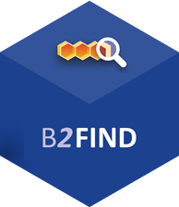

What is B2FIND?
B2FIND
is the metadata and discovery service of EUDAT
is based on a comprehensive joint metadata catalogue of research data collections stored in EUDAT data centres and other repositories
provides a powerful and user-friendly discovery service on metadata covering a wide range of research communities
Find Research Data
b2find.eudat.eu

Slide 3

Data from a huge selection of subjects
B2FIND has a truly cross-community approach
Metadata are harvested from a wide range of research areas
  From Climate Research to Social Sciences
  From Biodiversity to Linguistics
  From Archaeology to Seismology
Find Research Data
Notes:
Possible examples
climate research & social sciences
Biodiversity & linguistics (someone talking about animals)
Archaology & seismology

Slide 4
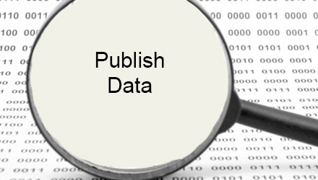
B2FIND Integration
Why should you publish your metadata in EUDAT B2FIND ?
Make your research data
  search-, view-, and accessible to the public
  popular in a cross-disciplinary and international scope
  Improve interoperability and
    re-use of data
Allow feedback and annotations on your research output
Benefit from validation, quality assurance and added value of your meta data
Integration

Slide 5
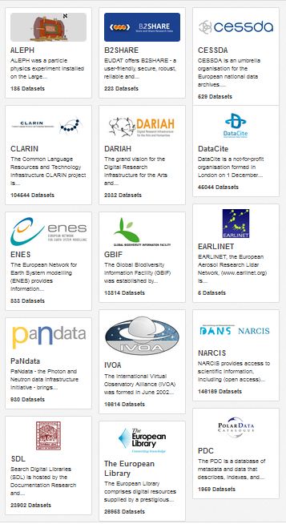
B2FIND communities
B2FIND comprises initially communities in the EUDAT registered domain of data, which provide a well-described and stable metadata offers.
EUDAT is extending the service to other reliable data and metadata providers
The list of currently integrated communities is available at http://b2find.eudat.eu/group/

Slide 6
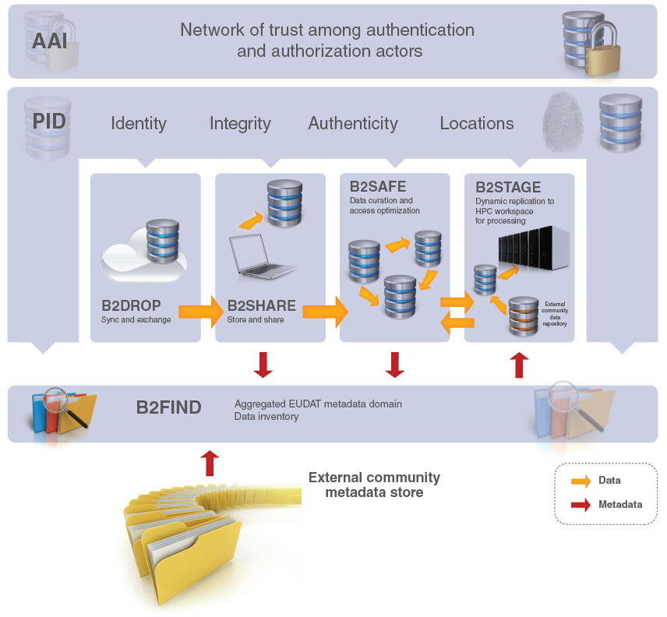
Where is B2FIND in the EUDAT suite?
B2FIND
stores metadata through other EUDAT services such as B2SHARE to provide access to data object within the EUDAT CDI
is used in inter-service use cases, e.g. to identify data to be transferred then by B2STAGE to HPC platforms.

Slide 7

The MD Ingestion Roadmap
MD Generation
Data
Provider
on
Community site
Integration
MD Repository and Provider
MD Harvesting
Service Provider
on
EUDAT site
MD Mapping and Validation
MD Uploading and Indexer

Slide 8

Metadata Generation
has to be done in close proximity to the data production
should be part of the data management plan
benefits from quality control at an early stage
should be based on common ontologies and metadata formats
Integration

Slide 9

Metadata repository and provider
To be set up on community site to allow harvesting
The standard protocol OAI-PMH is to be used as a preference
But as well other data transfer techniques are supported, if necessary
EUDAT offers support for the installation
Integration

Slide 10
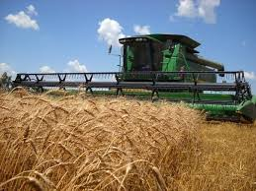
MD Harvesting
B2FIND harvests regular and incrementally from OAI endpoints
Initially the B2FIND team will do a first harvest try on a given and accessible OAI endpoint
The frequency and the harvested sets have to be negotiated with the community
Integration

Slide 11
MD Schemas (excerpt)
Name | Specification | Description | Used by B2FIND to harvest from Communities
Dublincore | Specification: See at http://dublincore.org/specifications/ and in the following standard documents: IETF RFC 5013 ISO Standard 15836-2009 NISO Standard Z39.85 | The Dublin Core Schema is a small set of vocabulary terms that can be used to describe web resources (video, images, web pages, etc.), as well as physical resources such as books or CDs, and objects like artworks. The full set of Dublin Core metadata terms can be found on the Dublin Core Metadata Initiative (DCMI) website, see left. | DataCite NARCIS PanData TheEuropeanLibrary SDL DARIAH IVOA PDC
ISO 19115 | http://www.iso.org/iso/home/store/catalogue_tc/catalogue_detail.htm?csnumber=53798 | ISO 19115-1:2014 defines the schema required for describing geographic information and services by means of metadata. It provides information about the identification, the extent, the quality, the spatial and temporal aspects, the content, the spatial reference, the portrayal, distribution, and other properties of digital geographic data and services. | ENES Earlinet
MarcXML | http://www.loc.gov/standards/marcxml/ | MARC (MAchine-Readable Cataloging) standards are a set of digital formats for the description of items catalogued by libraries, such as books. It was developed by Henriette Avram at the US Library of Congress during the 1960s to create records that can be used by computers, and to share those records among libraries. | B2SHARE ALEPH
CMDI | http://www.clarin.eu/content/component-metadata | CMDI (Component MetaData Infrastructure) was initiated by CLARIN to provide a framework to describe and reuse metadata blueprints. Description building blocks (“components”, which include field definitions) can be grouped into a ready-made description format (a “profile”). | CLARIN
DDI | http://www.ddialliance.org | DDI (Data Documentation Initiative) is an effort to create an international standard for describing data from the social, behavioural, and economic sciences. | CESSDA

Slide 12
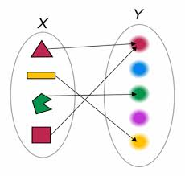
Metadata Mapping
The community specific ‘raw’ metadata are processed and homogenized to B2FIND schema in the following steps
Parse harvested XML records and select entries by MD format specific XPATH rules
Analyse and parse values and map onto key-value pairs (JSON) vs. given controlled vocabularies
Use (community specific) ontologies and thesauri
This results in JSON records satisfying the specification of the B2FIND schema
Integration

Slide 13
B2FIND MD Schema (excerpt)
Metadata Type | B2FIND Field name | Semantic definition | Allowed values / CV | Level of Obligation | Occurrence
General information | Title | A name or title a resource is known | Free text | Mandatory | 1
 | Description | All additional textual information | CKAN2.0 only supports plain text | Recommended | 1
Data Access | Source | URI of the related resource | Valid URL | Mandatory | 1
 | PID |  | Persistent Identifier | Recommended | 1
 | DOI |  | Digital Object Identifier | Recommended | 1
Provenance data | Creator | List of the main researchers involved in producing the data | Text field (‘;’ list of citied names, separately indexed) | Recommended | 0-n
 | Discipline | Field of research | List of values from controlled vocab B2FIND_cv_disciplines.txt | Recommended | 0-n
 | Publisher | The person or institution publishes the data | Text field (‘;’ list of citied names, separately indexed) | Recommended
 | PublicationYear | The year when the data was or will be made public | YYYY | Recommended | 1
Data coverage | TemporalCoverage | Relation to or Coverage of a specific interval in time. | Interval between two UTC Date Timestamps : [ BeginDateTime , EndDateTime ] | Optional | 1
 | SpatialCoverage | The spatial limits of a place. | A spatial point or box specification, CKAN representation : spatial={"type":"Polygon","coordinates":[[[minlat,minlon…]]} | Optional | 1

Slide 14

Metadata Validation
Examinate each field for coverage, consistency and validity
Semantic validation by using
  controlled vocabularies
  standard libraries, e.g. iso639 library for ‘Language’
‘Technical’ checks, e.g.:
  Conformance of date-time fields with UTC format
  Test spatial coverage by geonames.org and consistency of lat/lon coordinates
  online checks of URL’s to the data objects (‘Source’, ‘PID’ and ‘DOI’)
Integration

Slide 15
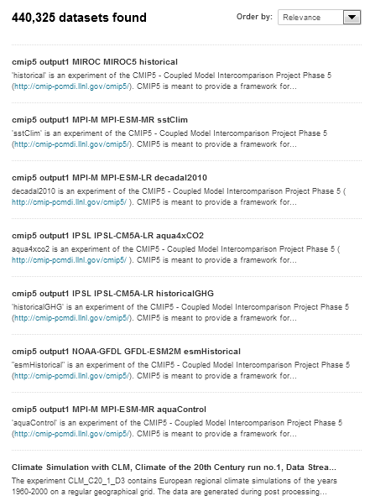
Metadata Uploading
Finally the mapped and checked JSON records are uploaded as datasets to the MD catalogue, which is based on the open source code CKAN.
CKAN
provides a rich RESTful JSON API and
uses SOLR for dataset indexing
That enables to query and search in the catalogue

Slide 16

B2FIND Usage
With B2FIND you can...
Browse through the huge amounts of data that EUDAT stores from a broad range of disciplines
Search in the whole catalogue, which comprises collections of scientific data, irrespective of their origin, discipline or community
Carry out faceted search for
  geospatial or temporal coverage and
  textual properties as ‘Creator’ or ‘Publisher’ and many other facets
Get access to related
  scientific data objects
Usage

Slide 17
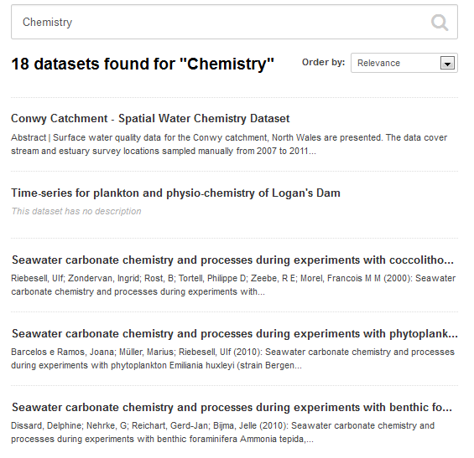
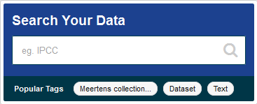
Search and browse datasets
Search and browse all data sets via Keyword searches
Results displayed in easy to read format and listed in order of relevance to your search

Slide 18
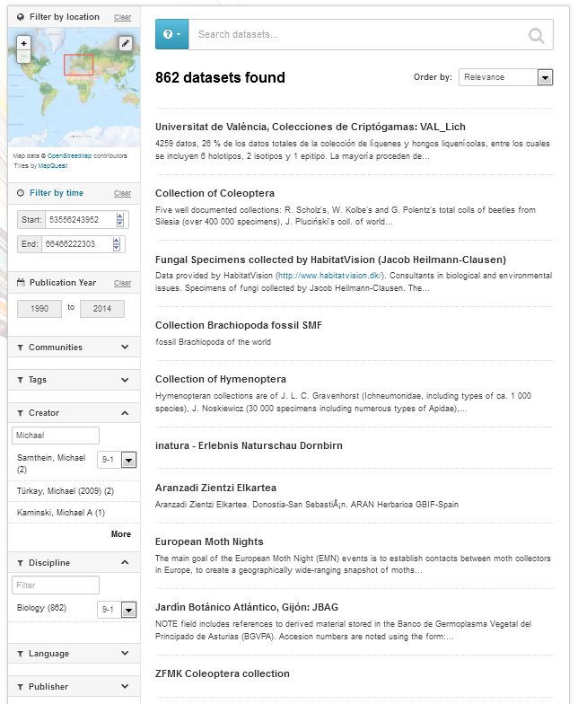
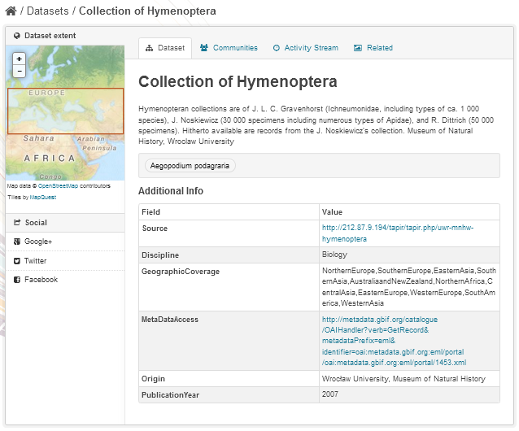
B2FIND Discovery Portal - Faceted Search
B2FIND provides ‘faceted’ search for
Free text
Geo spatial
Temporal coverage
Publication year
Textual facets as
  Communities
  Tags
  Creator
  Discipline
  Publisher etc.
Dataset view provides
display of metadata
Spatial extent
Title and abstract
Selected tags
Table of field-value pairs
Links to data resources

Slide 19

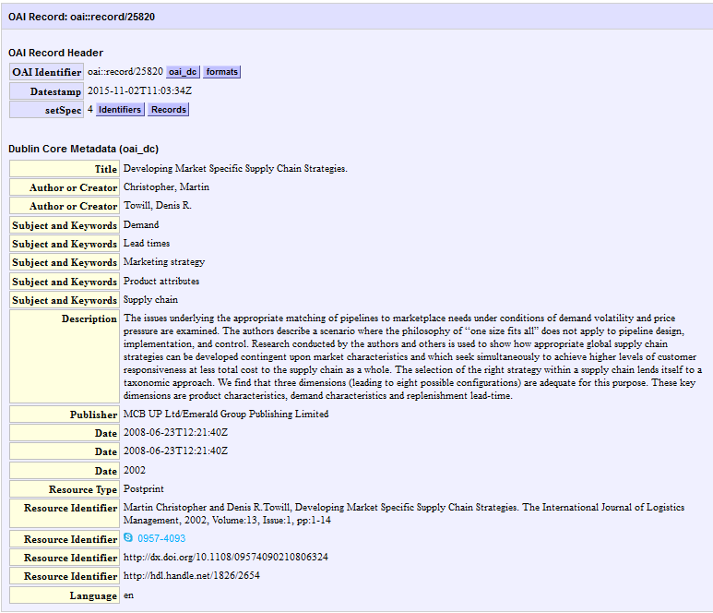
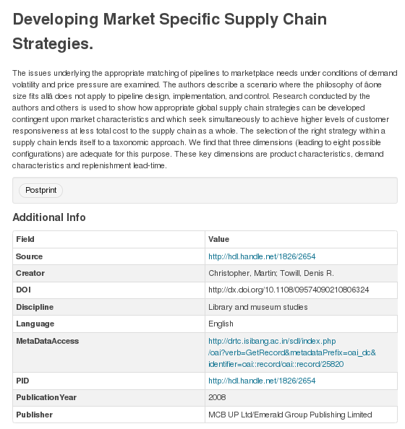
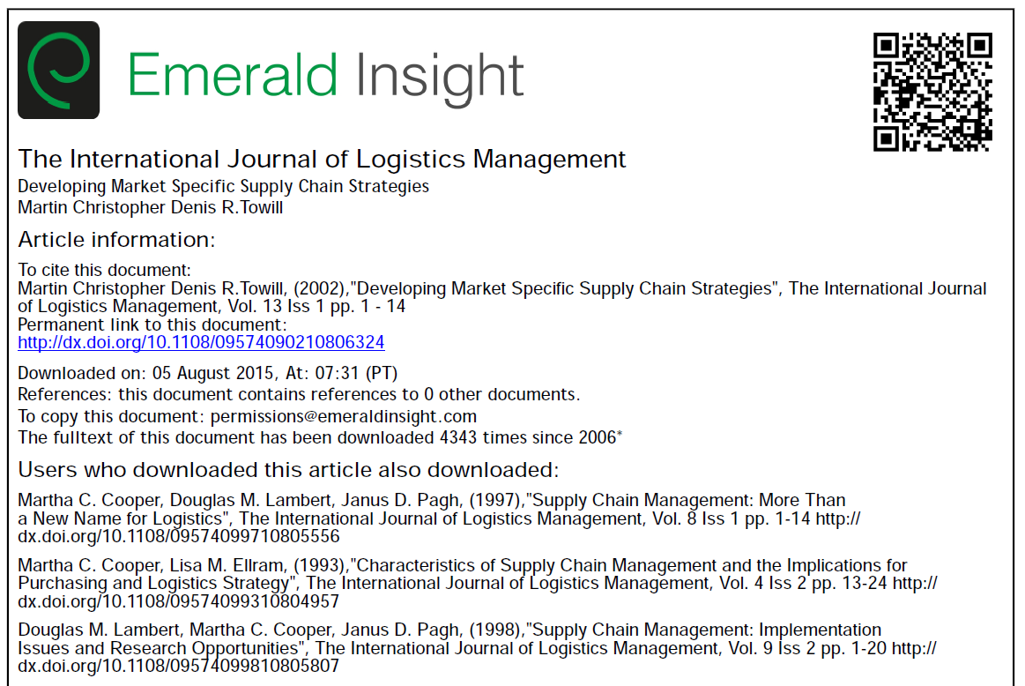
Data Access
Resolved link to
data object
View of originally
harvested metadata record
Link to (another landing page of)
the data object

Slide 20
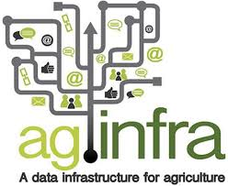








Upcoming Improvements
Address more communities and aggregators
Improve functionality of portal
  Include annotating function
  Taxonomies
Customisation
  Templates and extendable facets for specific community needs
  Usage of vocabularies and ontologies
  Individually adapted user interfaces
Improve Quality by
  enhancing mapping and validation
  Iterative exchange with and feedback from the communities

Slide 21

Thank you
b2find.eudat.eu
For more info: http://eudat.eu/services/b2find
User documentation: https://eudat.eu/services/userdoc/b2find-integration

