Slide 1

DataPublication@U.Porto
João Aguiar Castro, Nélson Pereira, João Rocha da Silva, Cristina Ribeiro
INESC TEC—Faculdade de Engenharia da Universidade do Porto
Infolab – Information Systems Research Group - FEUP/INESC TEC
“How EUDAT services support FAIR data” - Edinburgh, 20/02/2017

Slide 2
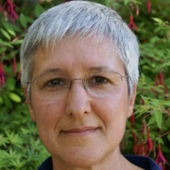
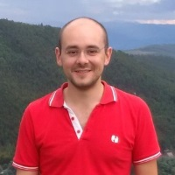
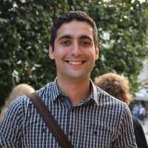
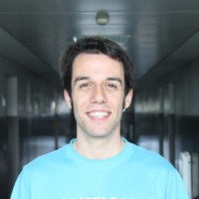
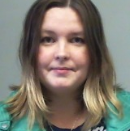
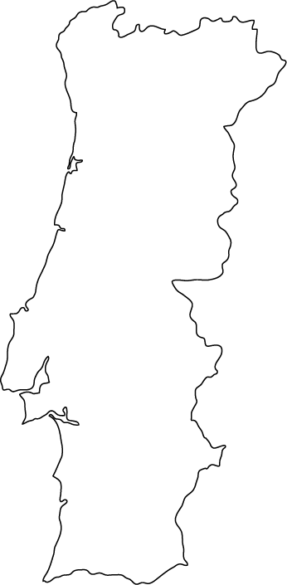

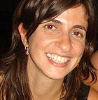
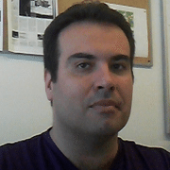
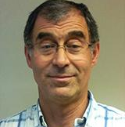
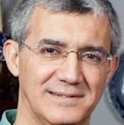
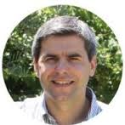
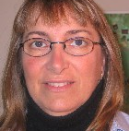
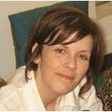
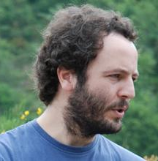
TAIL Team
Cristina Ribeiro
João Rocha da Silva
João Aguiar Castro
Ricardo Amorim
Yulia
Karimova
Porto
Carla
Lopes
Artur
Rocha
João
Correia Lopes
Gabriel David
Tito
Vieira
Eugénia
Fernandes
Ângela Lomba
João Honrado
Infolab – Information Systems Research Group - FEUP/INESC TEC
“How EUDAT services support FAIR data” - Edinburgh, 20/02/2017

Slide 3
Contents
DataPublication@U.Porto
Research Data Management: challenges and opportunities
RDM workflow: Researchers, tasks and tools
Curator workflow
Dendro: ontology-based organisation & description
Integration with B2Share
Infolab – Information Systems Research Group - FEUP/INESC TEC
“How EUDAT services support FAIR data” - Edinburgh, 20/02/2017

Slide 4

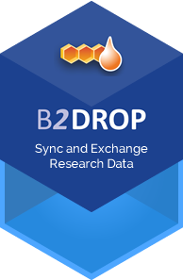
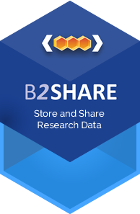

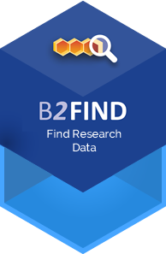
Collaboration RDM@FEUP - EUDAT
  DataPublication@UPorto: multi-disciplinary data description and deposit linking the Dendro staging platform with the EUDAT European Infrastructure
https://eudat.eu/communities/datapublication-uporto
Infolab – Information Systems Research Group - FEUP/INESC TEC
“How EUDAT services support FAIR data” - Edinburgh, 20/02/2017

Slide 5
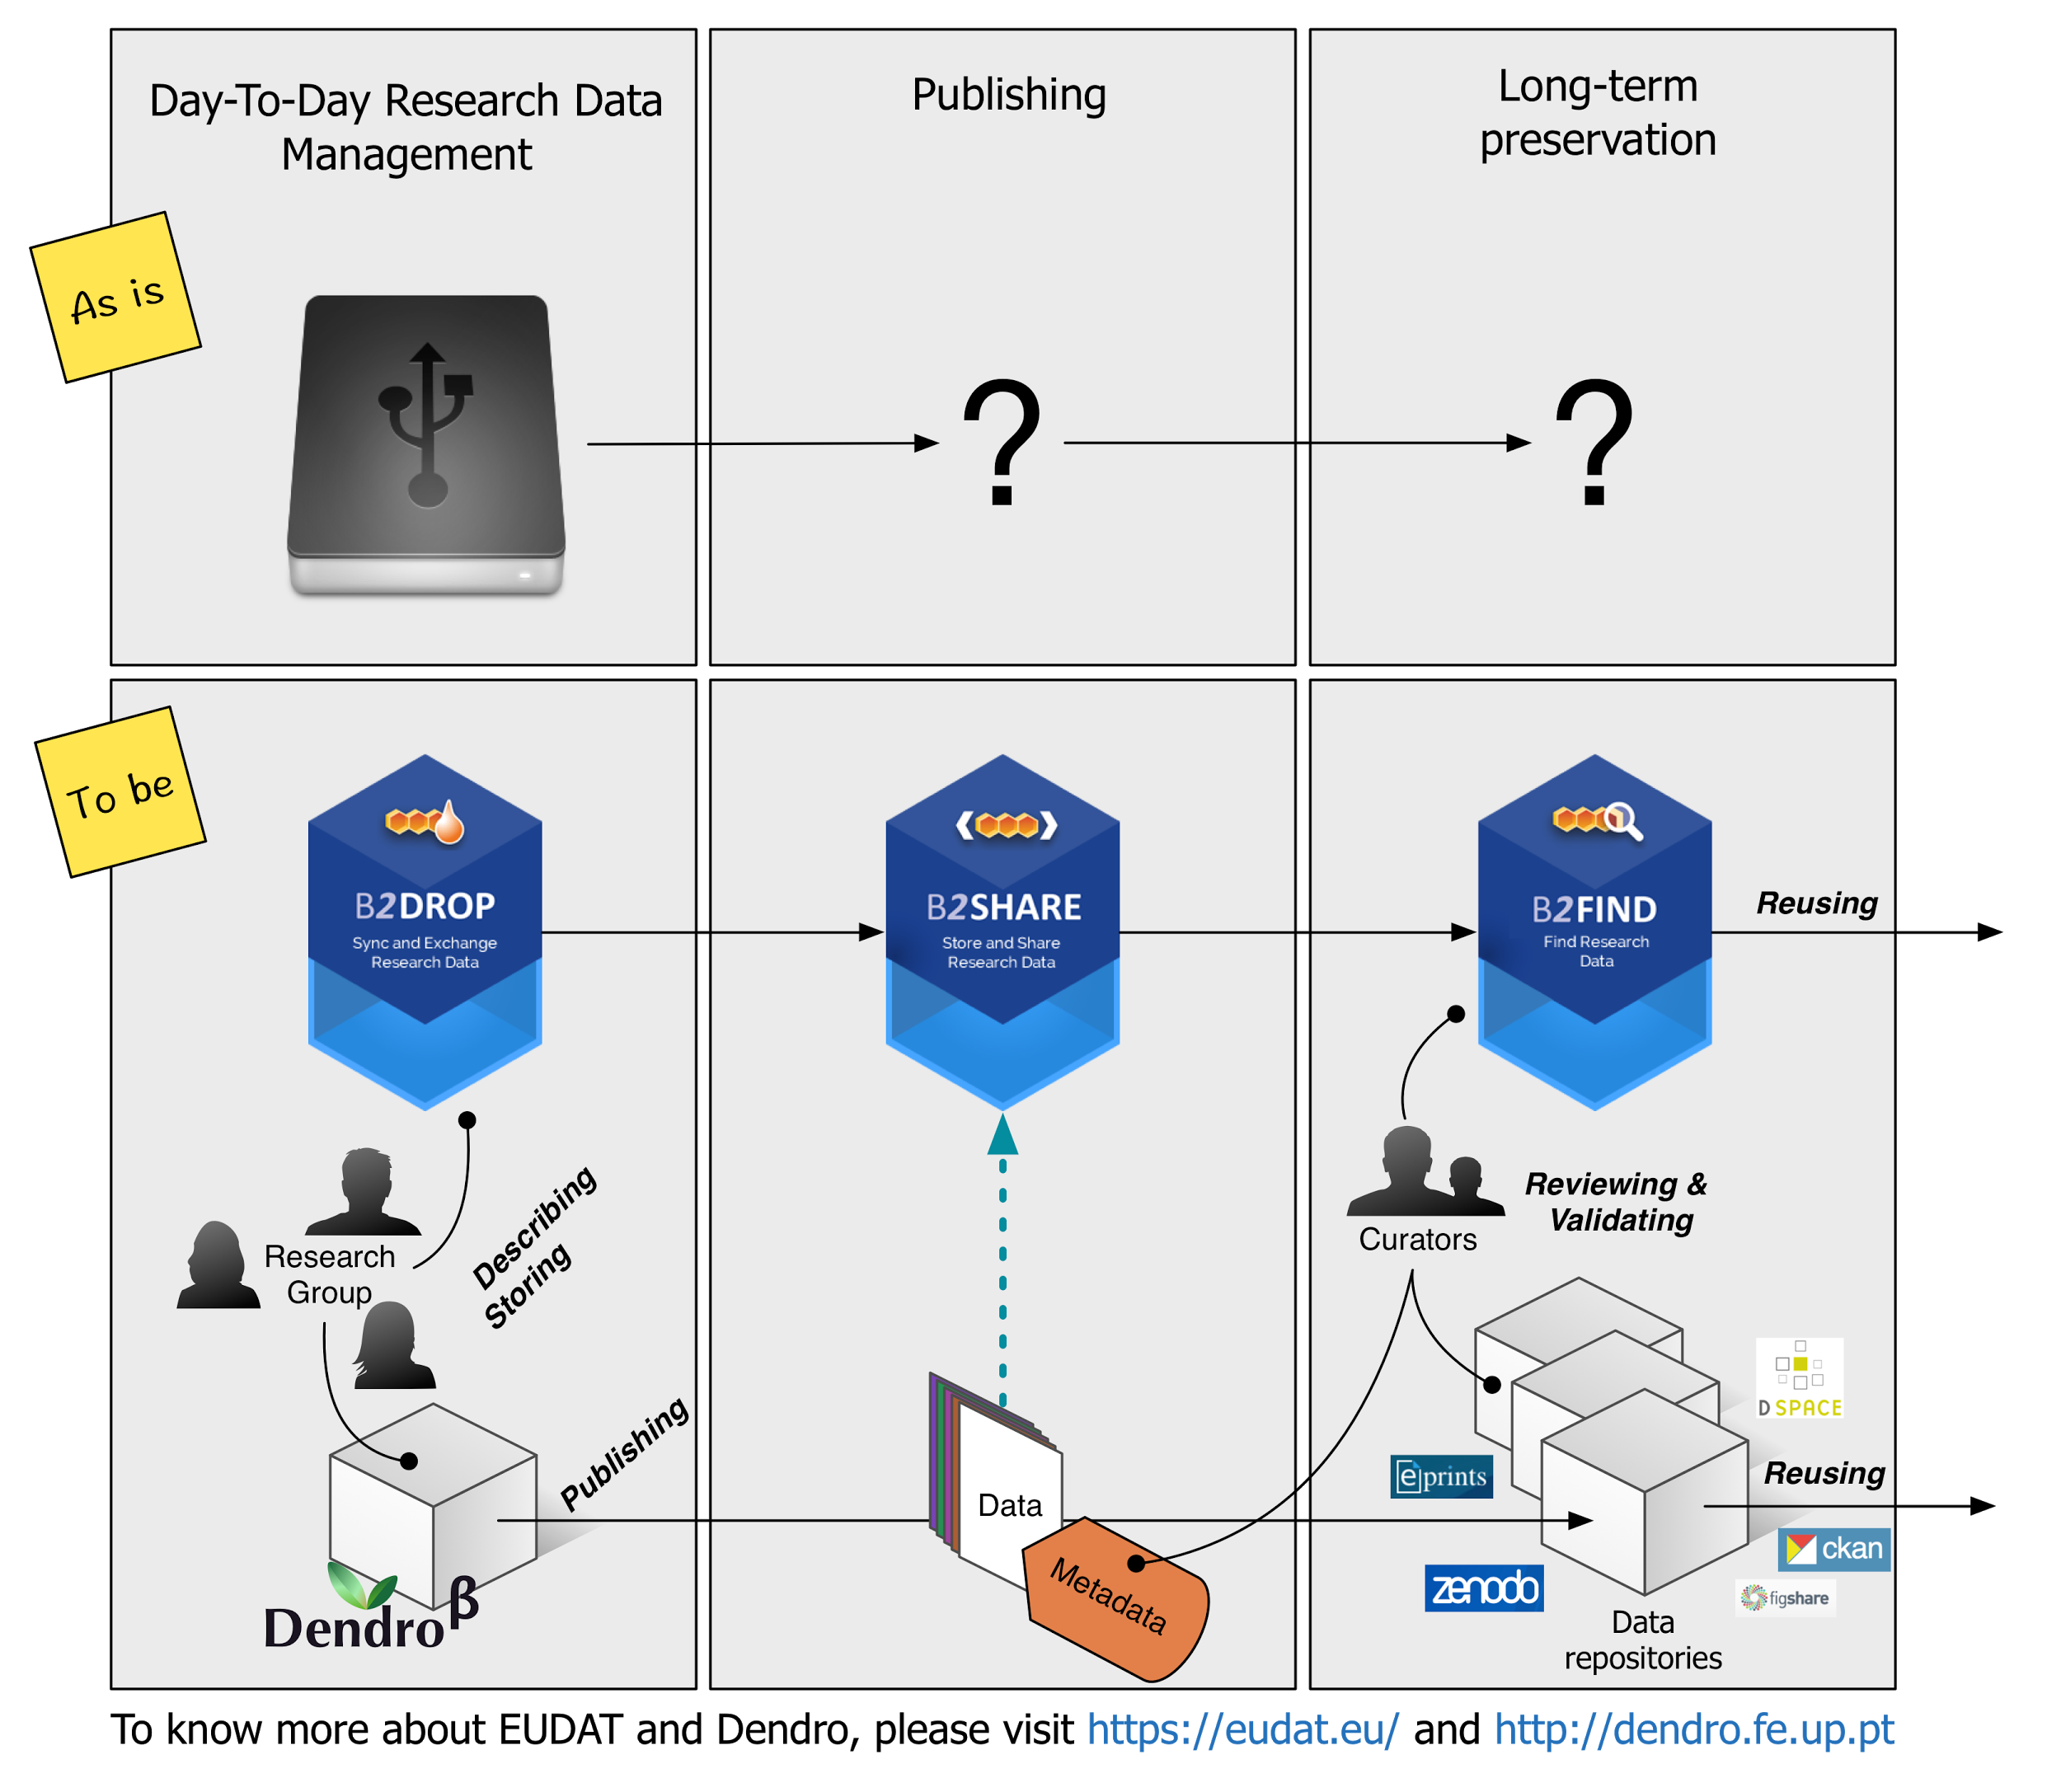

Slide 6
Research Data Management
Challenges
Data management required by funding agencies
Institutions compelled to implement RDM infrastructures
  Issue (1) traditional publication workflow
  Issue (2) One curator for too many domains (too many requirements)
  Issue (3) Researchers, usually, unfamiliar with data description
Infolab – Information Systems Research Group - FEUP/INESC TEC
“How EUDAT services support FAIR data” - Edinburgh, 20/02/2017

Slide 7
Research Data Management
Opportunities
Institutions benefit from timely disclosure of data
Credit to researchers
Promote interoperability: RDM platforms compliant with metadata exchange protocols.
Promote reuse: domain-specific metadata models
Infolab – Information Systems Research Group - FEUP/INESC TEC
“How EUDAT services support FAIR data” - Edinburgh, 20/02/2017

Slide 8







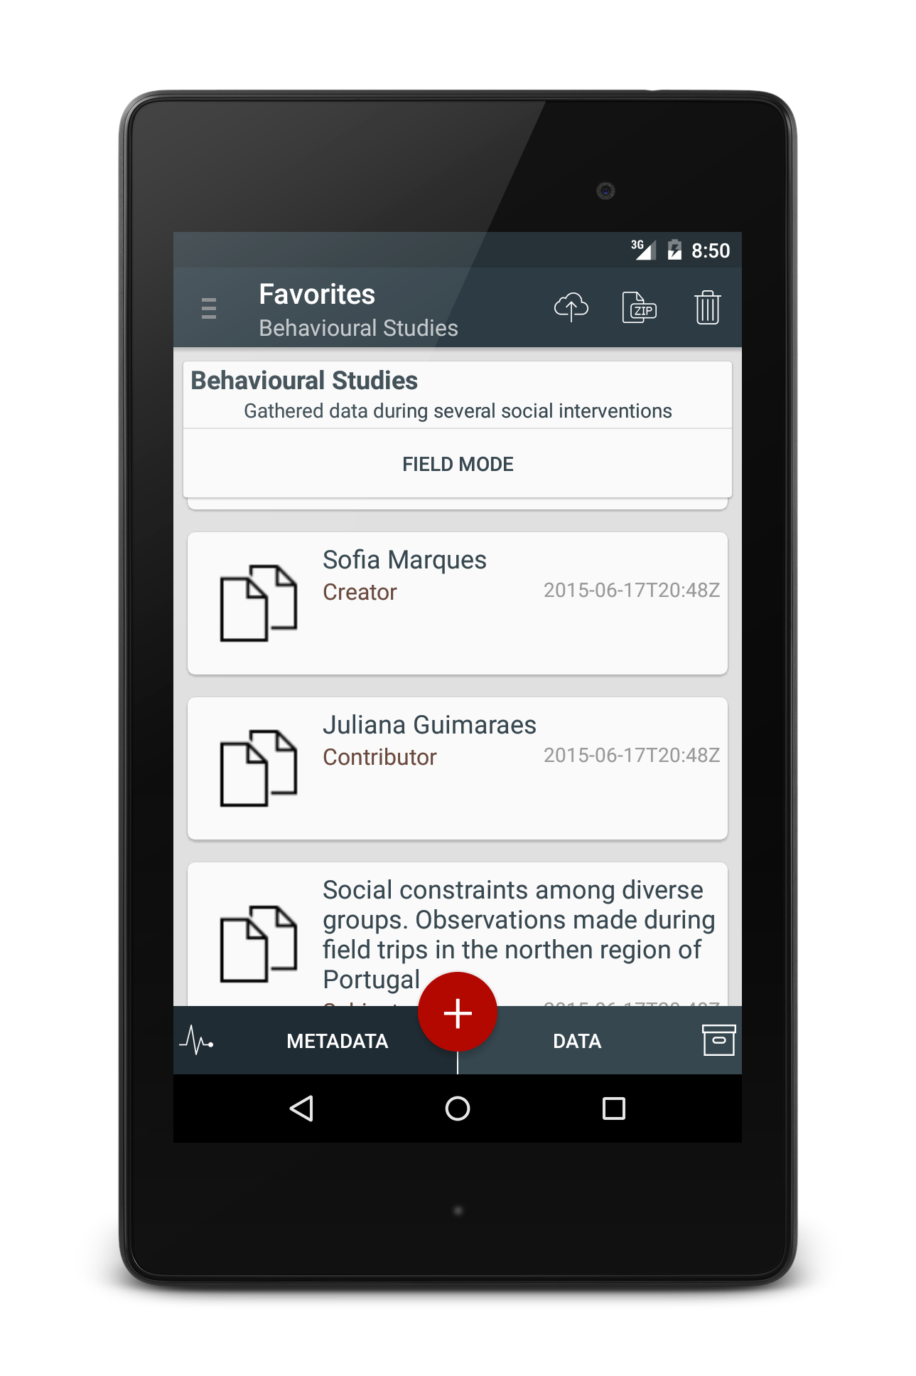

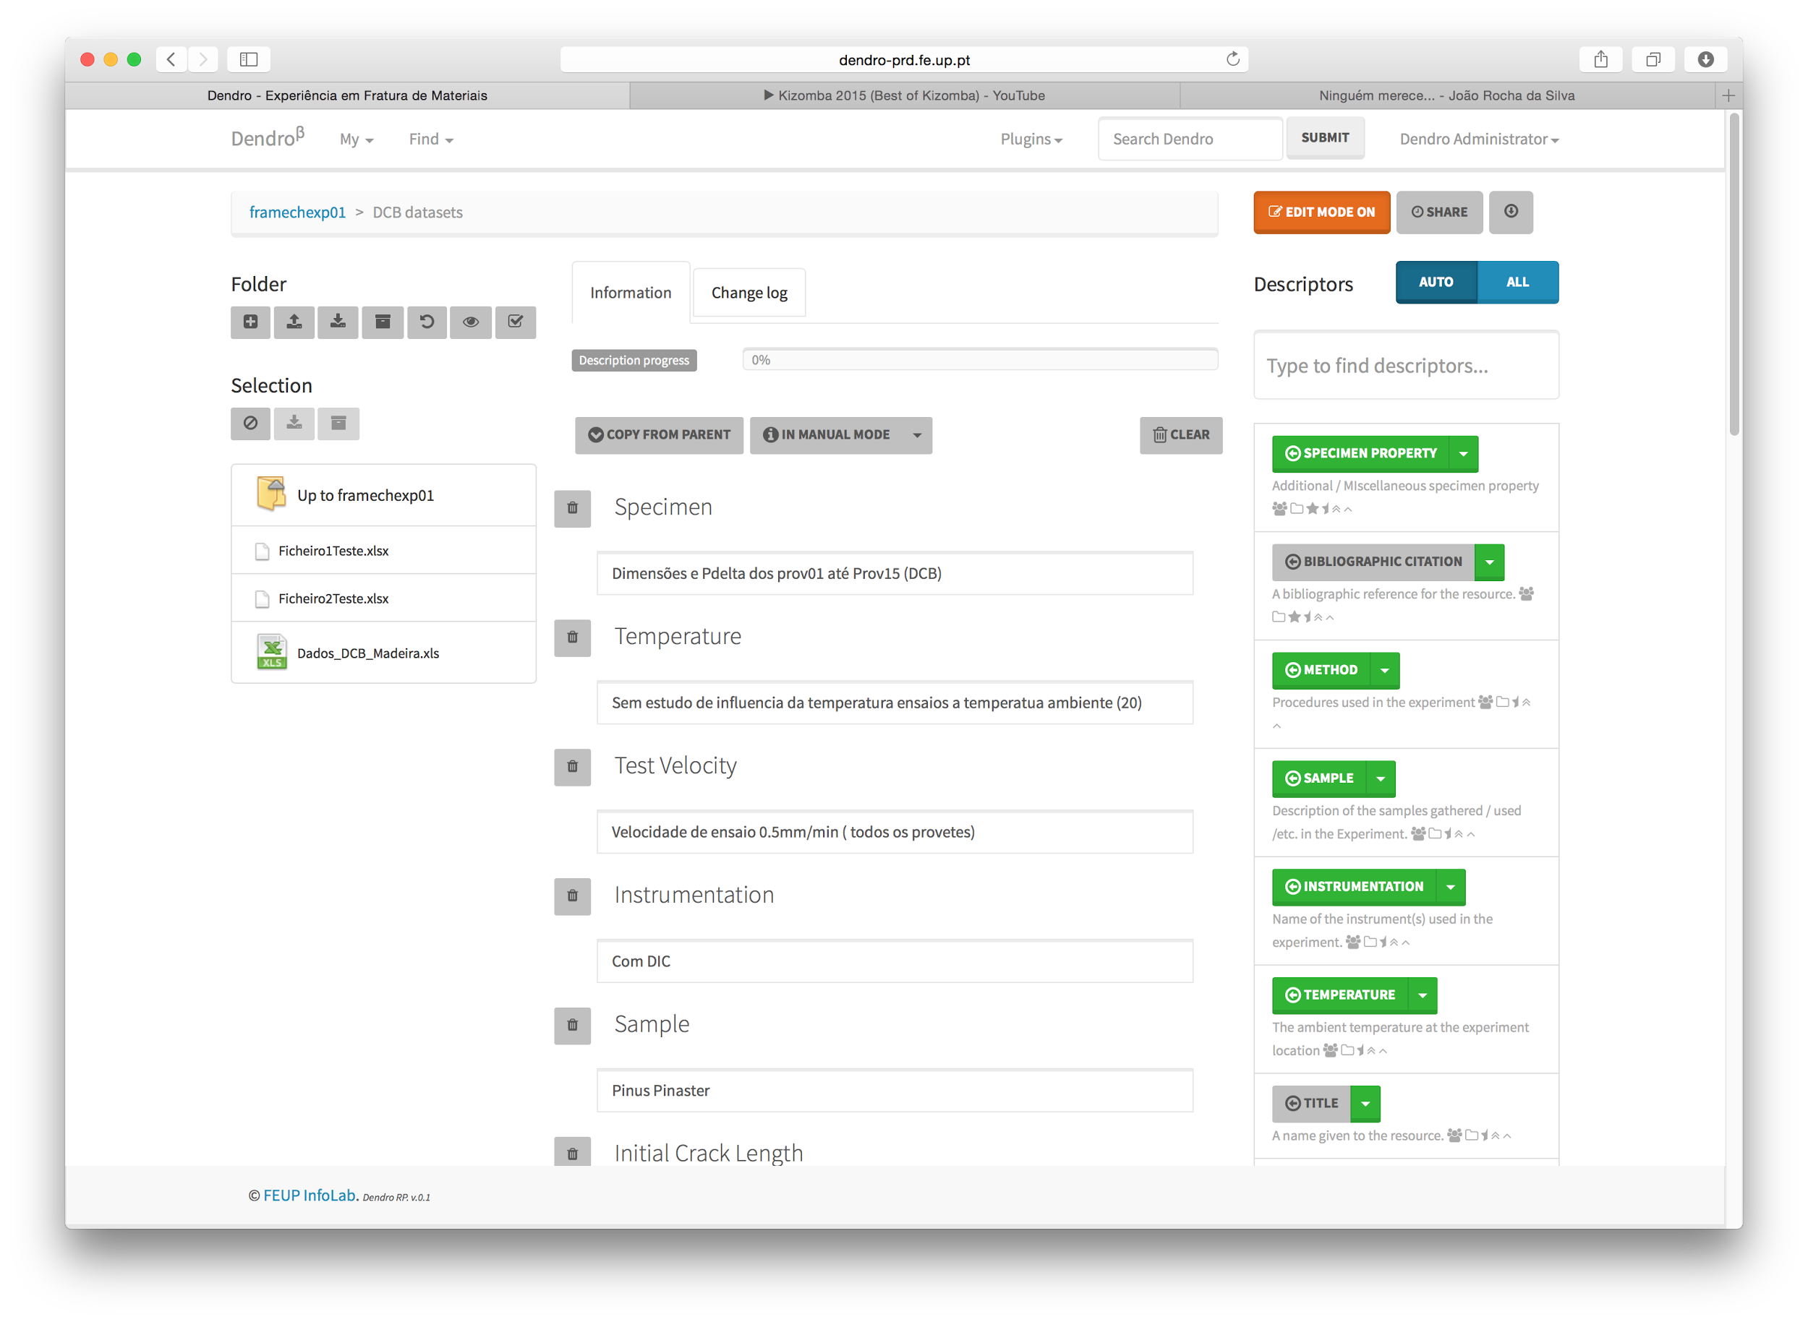

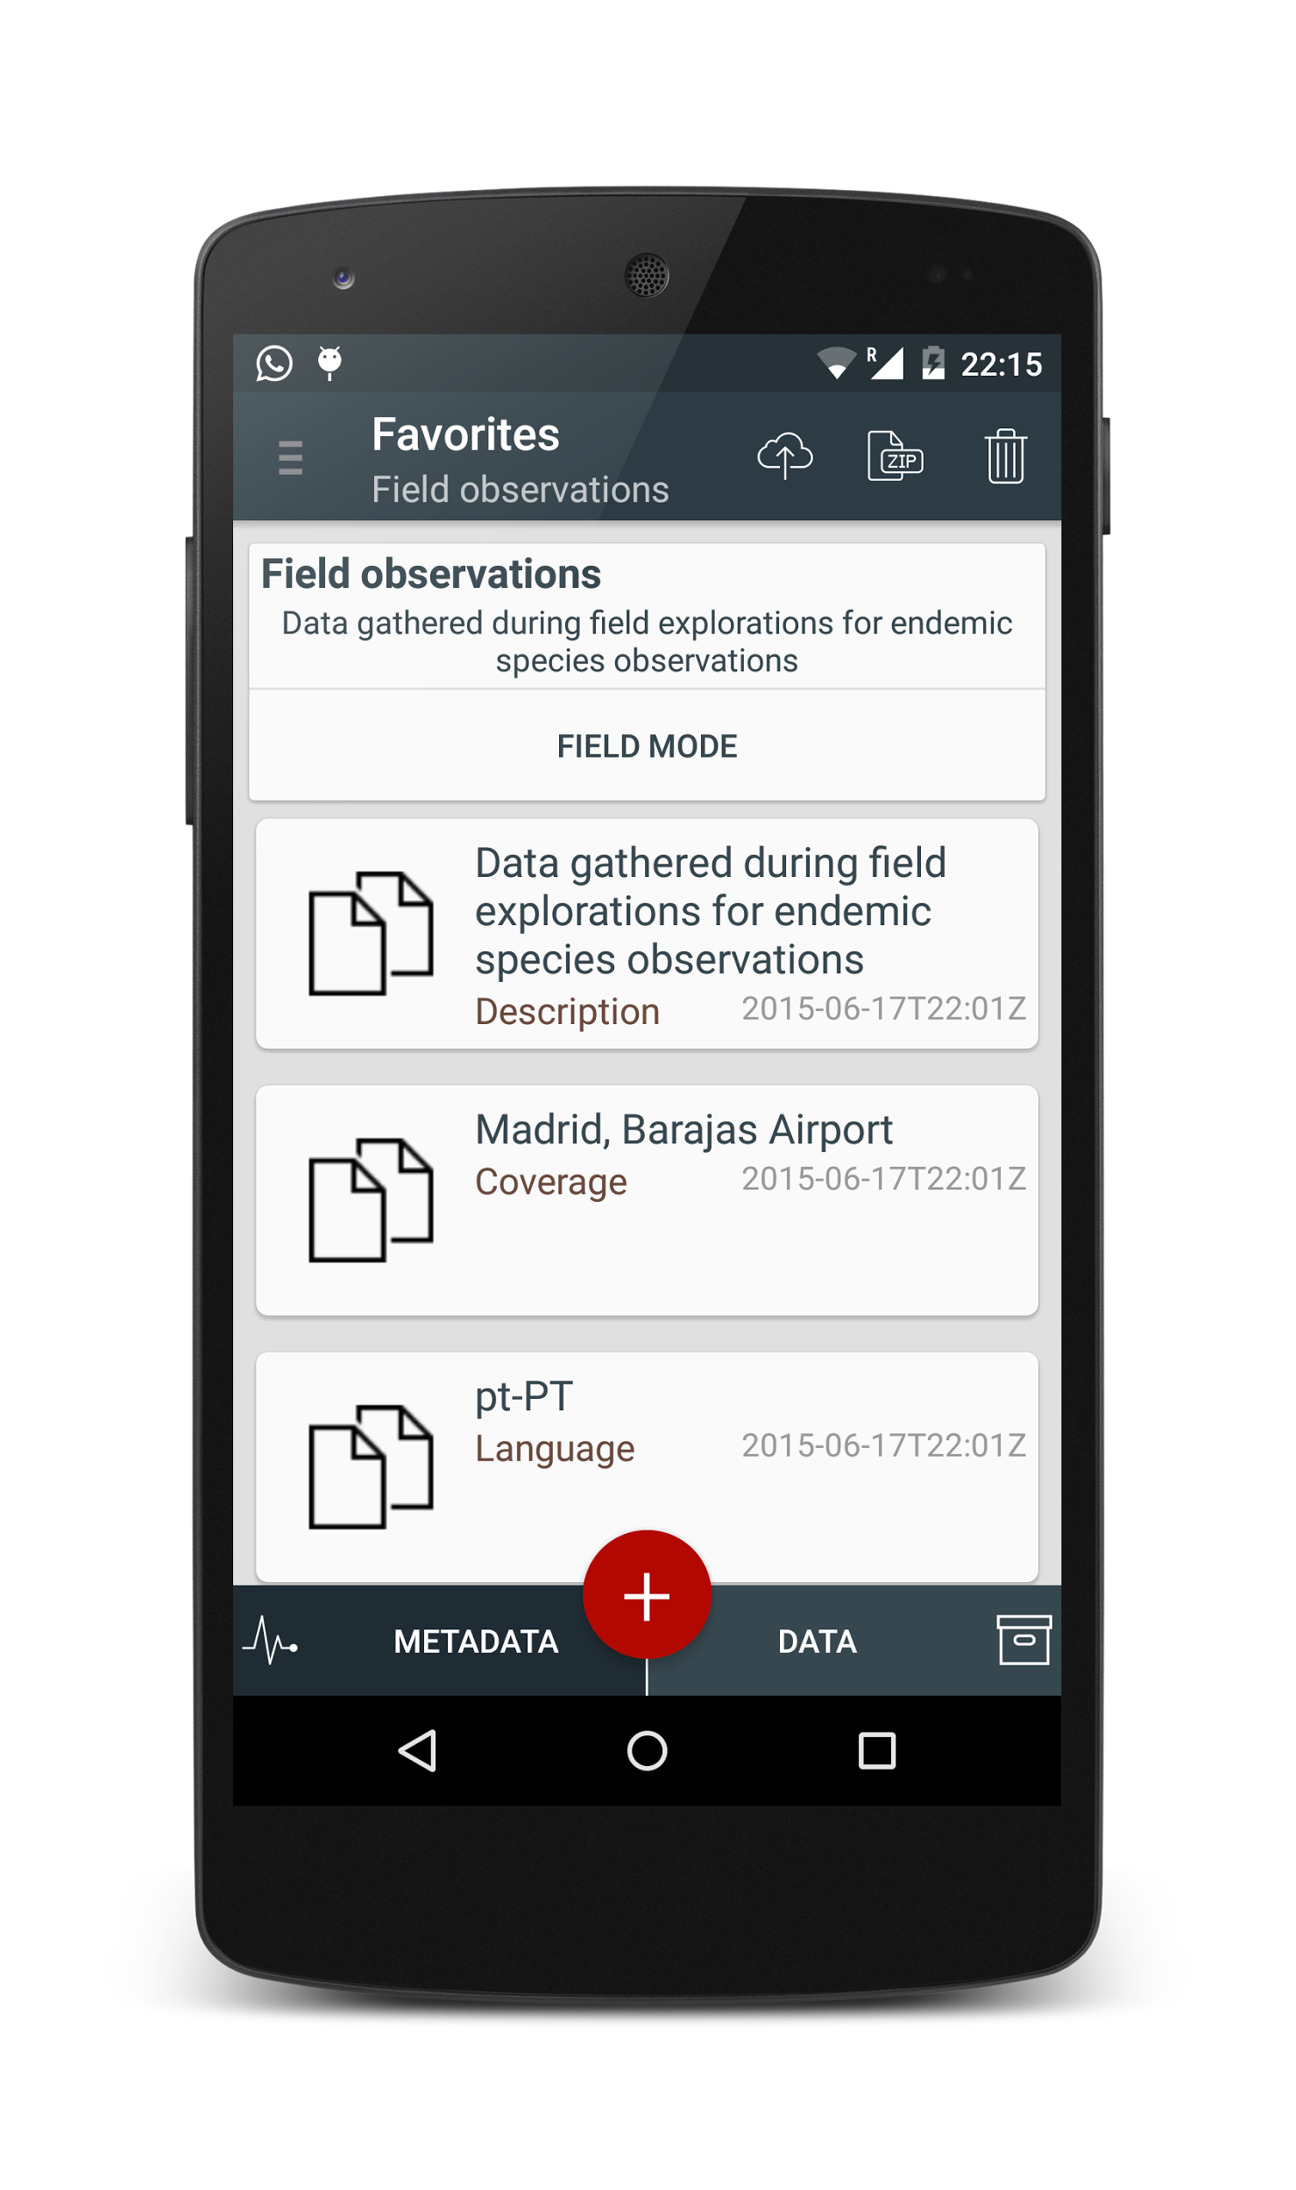



Researchers
Curators
Science Managers
Data Providers
Collection
Description
Processing
Publication
Funders
LabTablet
Developers
dendro.fe.up.pt
Institutions

Slide 9
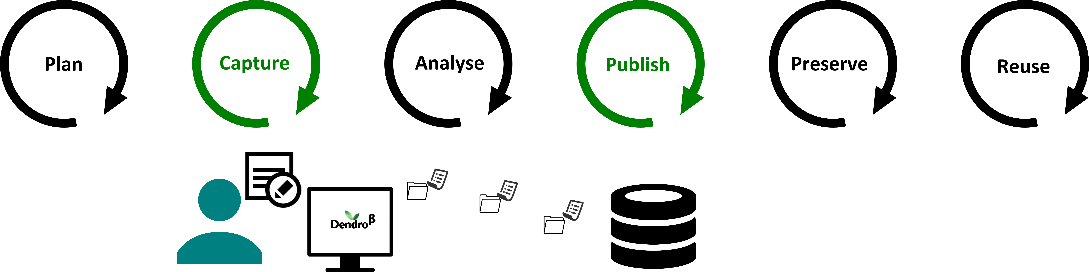
Curator workflow
Infolab – Information Systems Research Group - FEUP/INESC TEC
“How EUDAT services support FAIR data” - Edinburgh, 20/02/2017

Slide 10
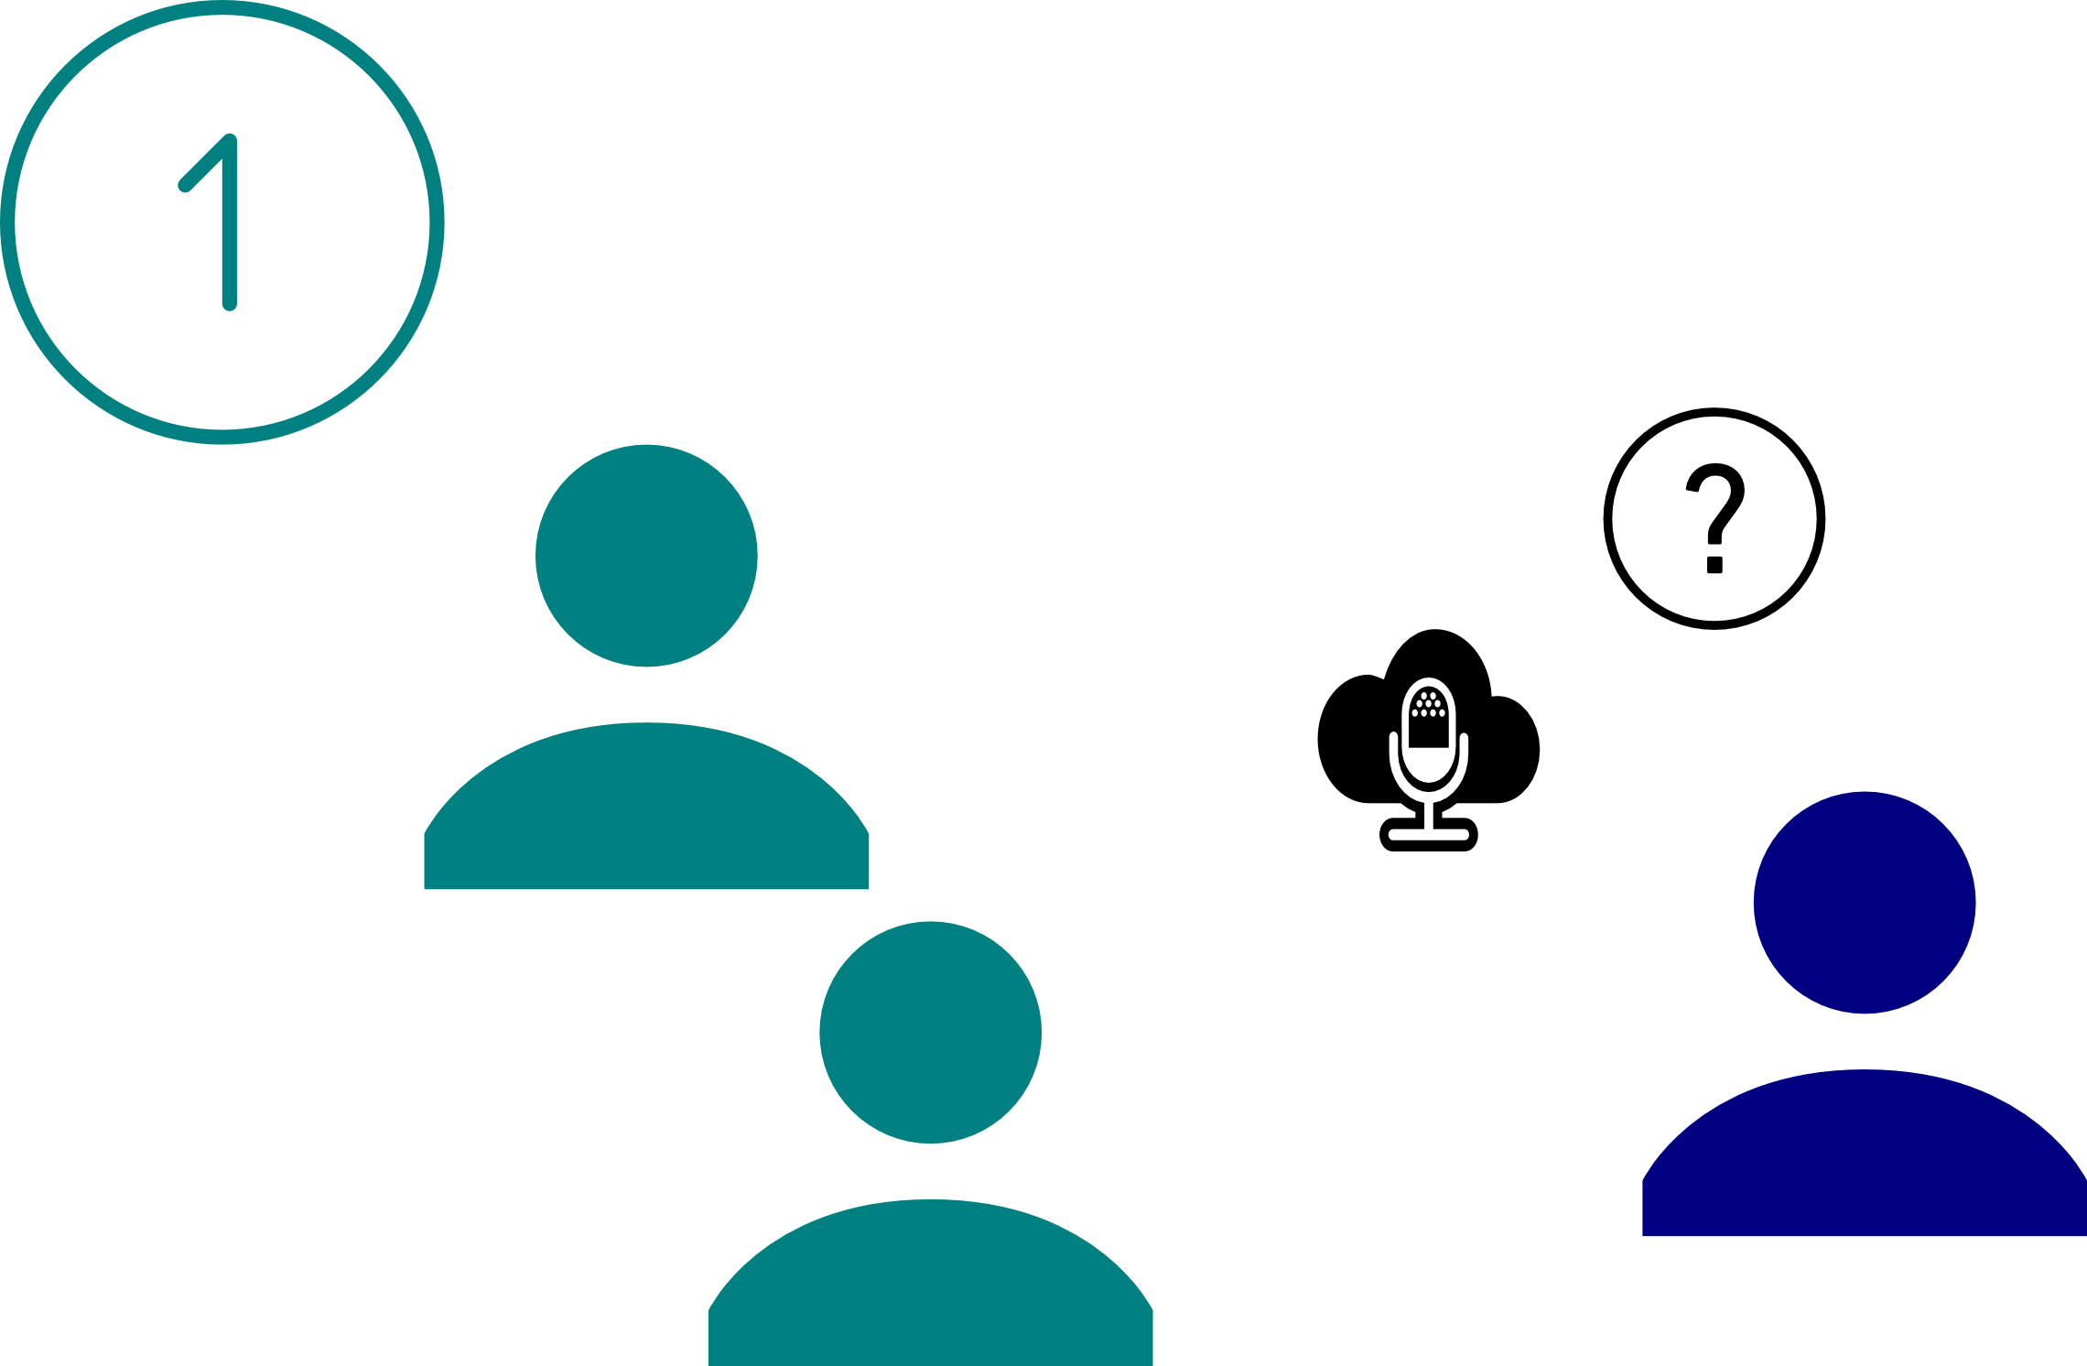
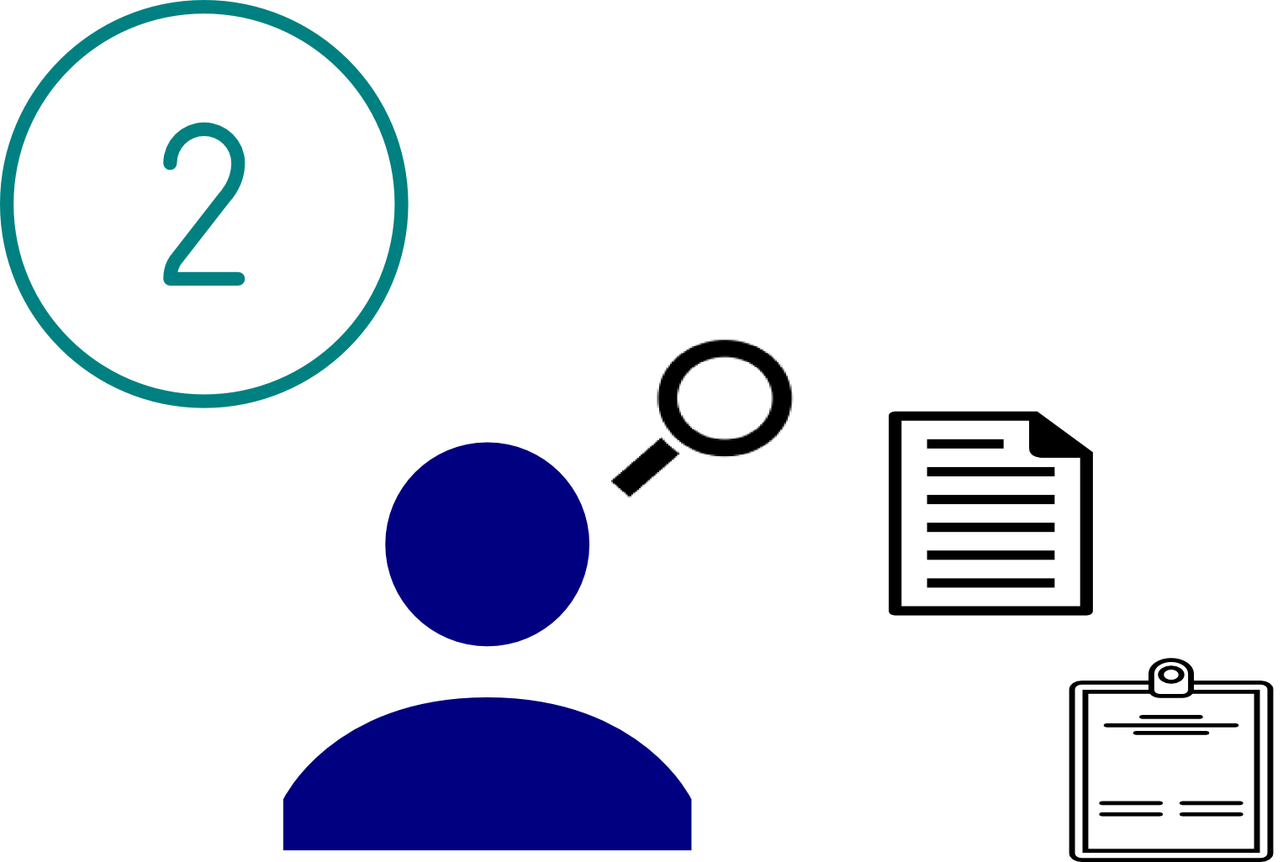
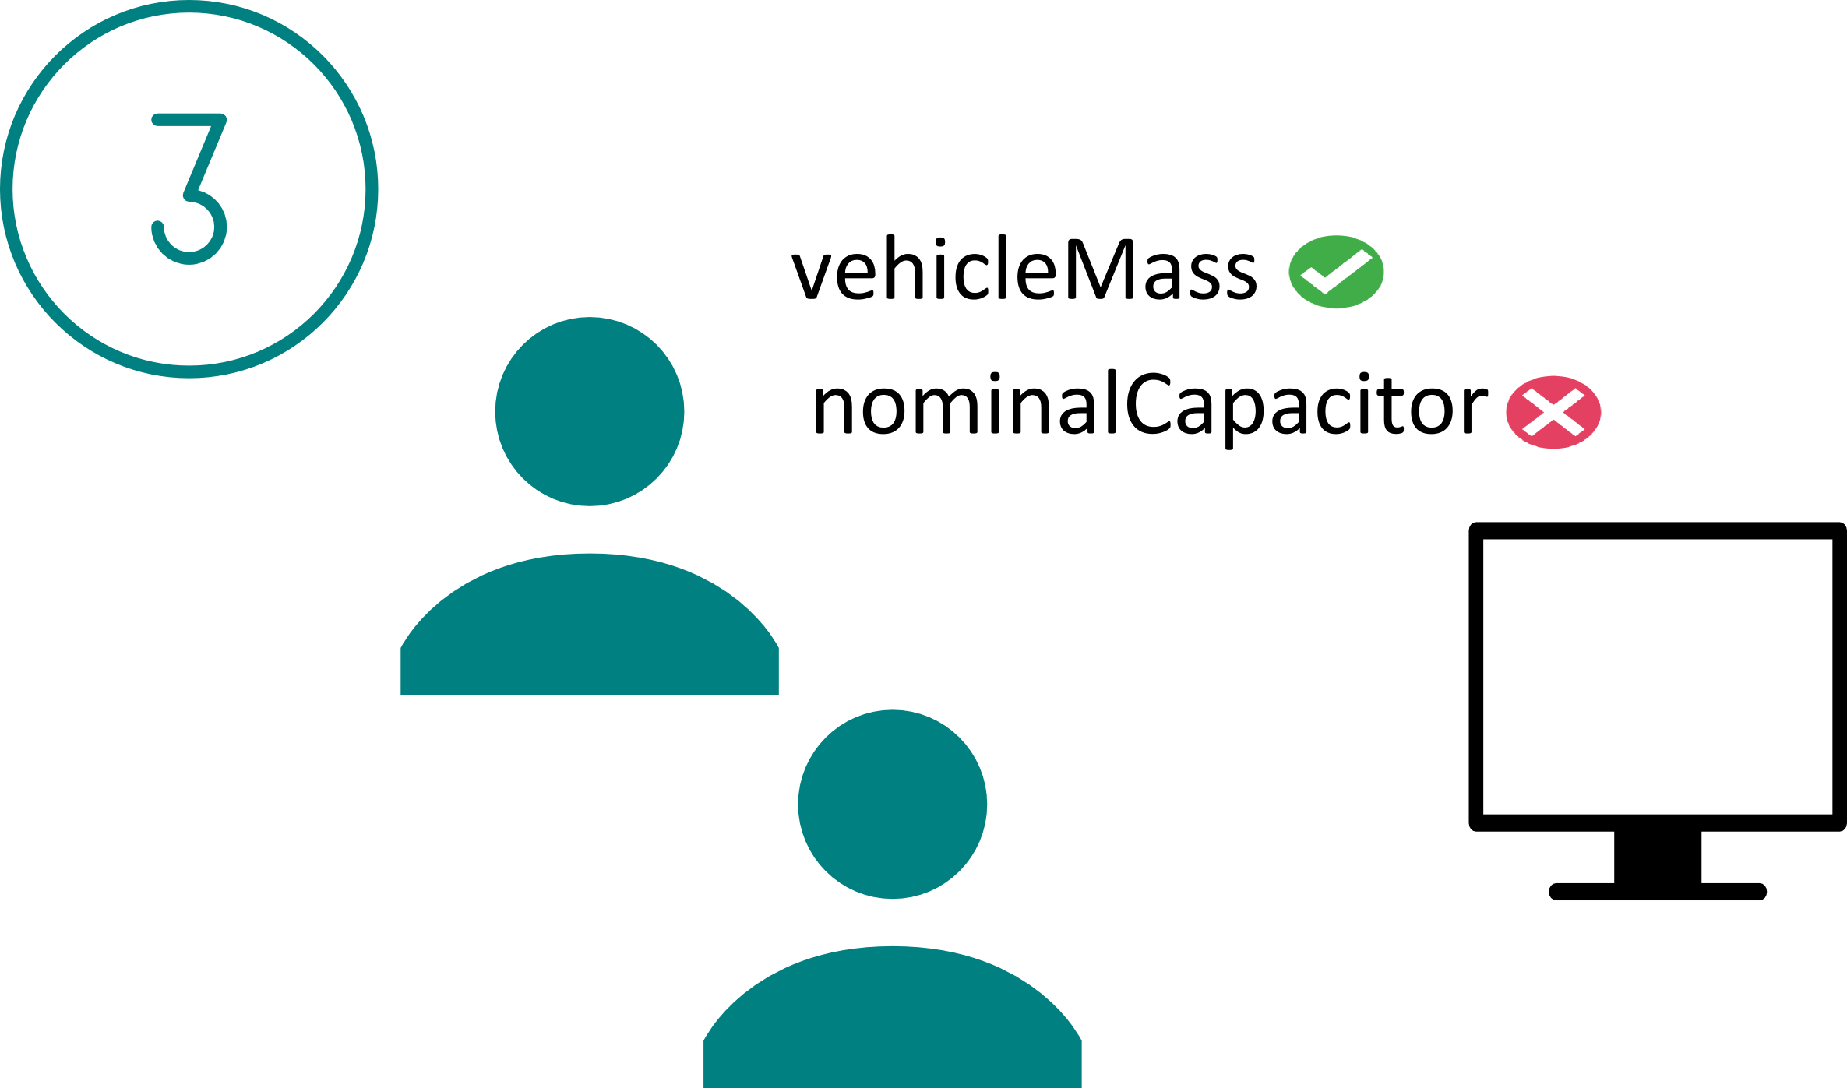
Curator workflow
Domain Data Type
Fracture Mechanics | Experimental
Hydrogen Production
Analytical Chemistry | Experimental | Observational
Gravimetry
Biological Oceanography
Biodiversity | Observational
Social and Behavioural Sciences
Cutting and Packing | Simulational
Vehicle Simulation
Computational Fluid Dynamics
Infolab – Information Systems Research Group - FEUP/INESC TEC
“How EUDAT services support FAIR data” - Edinburgh, 20/02/2017

Slide 11
Dendro platform
Data organisation and description
  Early: from data creation
  Detailed, domain-specific description
Ontologies: loaded for each domain
  Metadata is ready to become Linked Open Data
  Preservation-friendly metadata models
Integration with long-term repositories
Infolab – Information Systems Research Group - FEUP/INESC TEC
“How EUDAT services support FAIR data” - Edinburgh, 20/02/2017

Slide 12
Demonstration
Dendro
B2Share TweeProfiles deposit
Infolab – Information Systems Research Group - FEUP/INESC TEC
“How EUDAT services support FAIR data” - Edinburgh, 20/02/2017

Slide 13
Dendro & EUDAT
Early data management practices
  From project day 1
  Involve researchers
Collaborative environment
  Data peer review
  Guidelines from senior researchers
Persistent identifiers
Data preservation
  Compliance with existing standards
Dissemination
  Automatic harvesting
  Dissemination protocols
Infolab – Information Systems Research Group - FEUP/INESC TEC
“How EUDAT services support FAIR data” - Edinburgh, 20/02/2017

Slide 14
Visit us
Publications and updates
http://dendro.fe.up.pt/
Dendro is open source on GitHub!
https://github.com/feup-infolab-rdm
Infolab – Information Systems Research Group - FEUP/INESC TEC
“How EUDAT services support FAIR data” - Edinburgh, 20/02/2017

Slide 15
Support slides
Infolab – Information Systems Research Group - FEUP/INESC TEC
“How EUDAT services support FAIR data” - Edinburgh, 20/02/2017

Slide 16
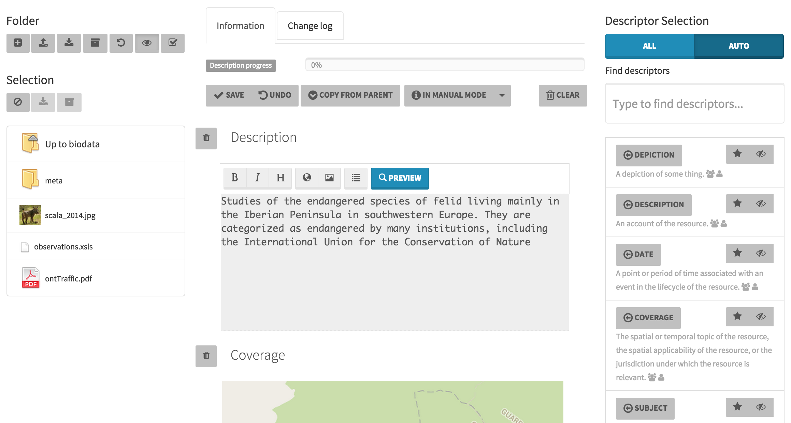
Dendro
Infolab – Information Systems Research Group - FEUP/INESC TEC
“How EUDAT services support FAIR data” - Edinburgh, 20/02/2017

Slide 17
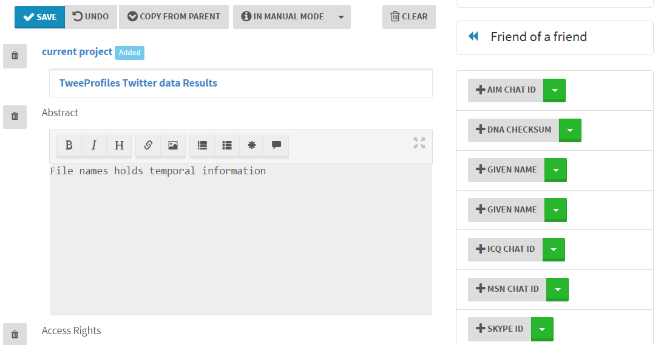
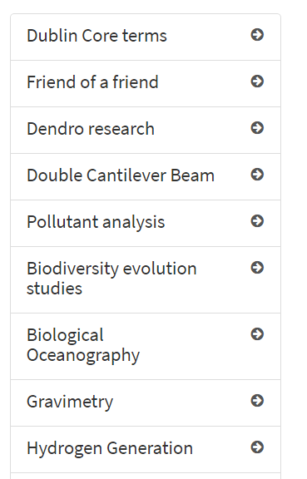

Slide 18
Related publications
TPDL 2016
  Usage-driven Dublin Core descriptor selection—A case study using the Dendro platform for research dataset description
UAIS, Springer 2016
  A comparison of research data management platforms: architecture, flexible metadata and interoperability
iPRES 2014
  The Dendro research data management platform: applying ontologies to long-term preservation in a collaborative environment
Digital Libraries 2014
  Creating lightweight ontologies for dataset description: Pratical applications in a cross-domain research data management workflow
Infolab – Information Systems Research Group - FEUP/INESC TEC
“How EUDAT services support FAIR data” - Edinburgh, 20/02/2017

Slide 19







Repositories and long-term preservation
Data repository
Data & Metadata
Cite
Reuser
Preserve
Infolab – Information Systems Research Group - FEUP/INESC TEC
“How EUDAT services support FAIR data” - Edinburgh, 20/02/2017

Slide 20
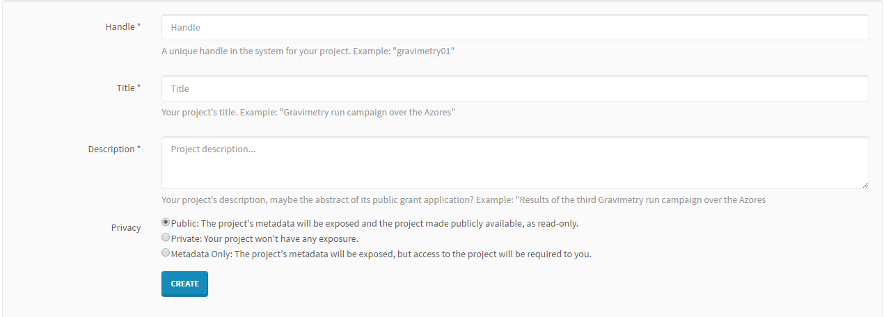
Dendro & EUDAT: exporting data
Access Levels
Infolab – Information Systems Research Group - FEUP/INESC TEC
“How EUDAT services support FAIR data” - Edinburgh, 20/02/2017

Slide 21
