Slide 1
B2SHARE
How to share and store research data using EUDAT’s B2SHARE
Version 8
December 2015
This work is licensed under the Creative Commons CC-BY 4.0 licence

Slide 2
B2SHARE is...
a user-friendly, reliable and trustworthy way for researchers, scientific communities and citizen scientists to store and share small-scale research data coming from diverse contexts

Slide 3
B2SHARE is part of EUDAT...
A pan-European initiative building a sustainable cross-disciplinary and cross-national data infrastructure providing a set of shared services for accessing and preserving research data
Supporting multiple research communities by working closely with them to deliver these technical services as part of the EUDAT Collaborative Data Infrastructure (CDI)

Slide 4
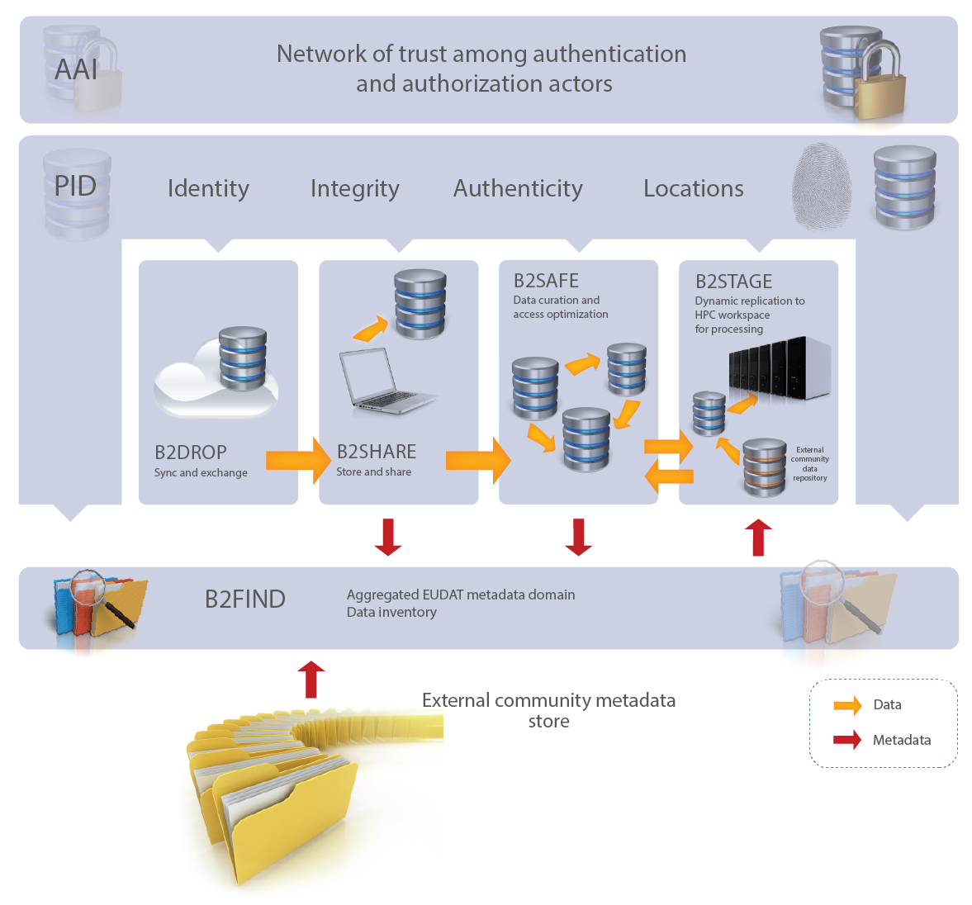
Where is B2SHARE in the EUDAT suite?

Slide 5
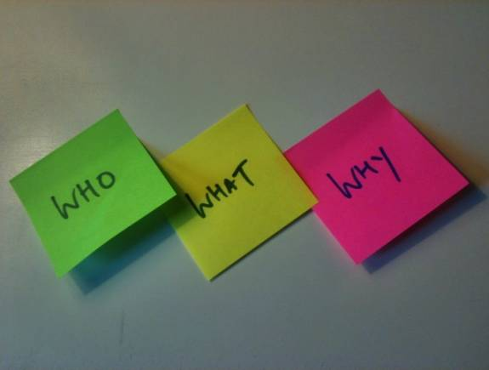
The Who, What, Why of B2SHARE
Who uses B2SHARE?
Researchers, students and even citizen scientists are creating small “long tail” data which is not stored safely or easily sharable.
Why use it?
To have that peace of mind that your data is stored safe and sound while reaping the rewards of sharing data with others.
What is B2SHARE?
B2SHARE is a user-friendly data repository
A place where small data sets can be safely stored and easily shared with others.

Slide 6
Whom is B2SHARE for?
Basically anyone!
From individual researchers, PhD and Postdoc students, to project coordinators and collaborators, and even schools and citizen scientists
Use the service as an individual user or as part of a specific research community
B2SHARE bridges the gap between citizen scientists and researchers to enable and stimulate research data collaboration and sharing
A winning solution to …
Store: facilitates research data storing
Preserve: guarantees long-term persistence of data
Share: allows sharing of data, results or ideas worldwide

Slide 7
B2SHARE added-value
Your data is …
Hosted so there are no hardware or network worries on the depositor side
Assigned a permanent ID and therefore is always retraceable to you
Stored alongside queryable & findable metadata and automatically available via the B2FIND metadata catalogue
Managed and stored by a trusted and certified data centre

Slide 8
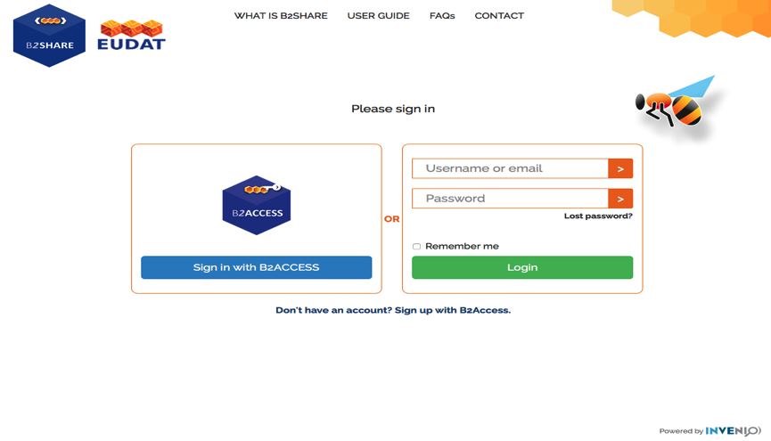
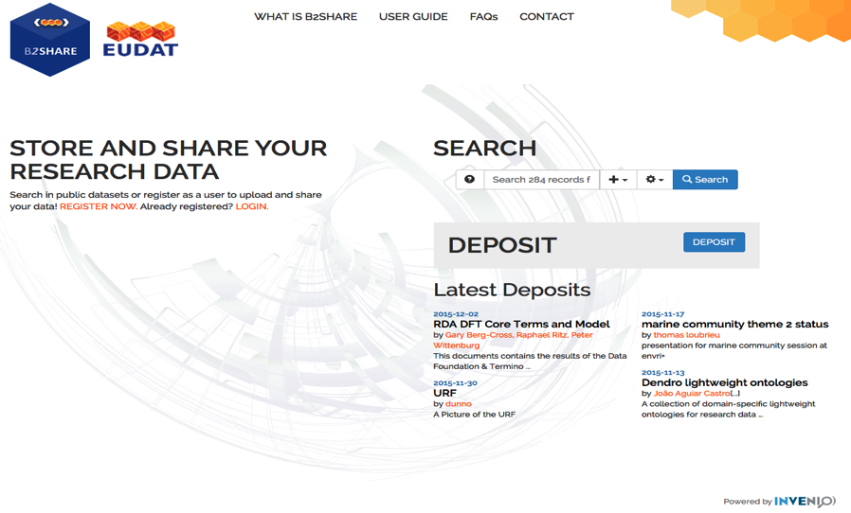
Registration process
Visit our homepage https://b2share.eudat.eu
Click on “Register now”
3. Click on “Don't have an account? Sign up with B2ACCESS”
This will enter the B2ACCESS domain!

Slide 9
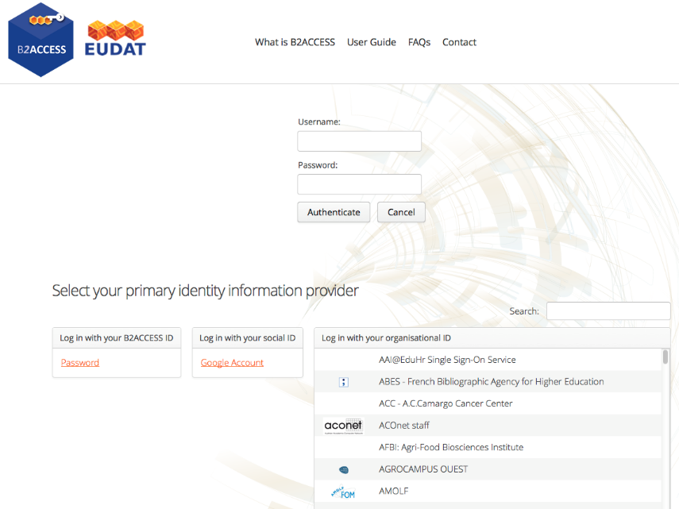
Registration process (2)
Register with your B2ACCESS, social or institutional account
Use search to find your institution in the list

Slide 10
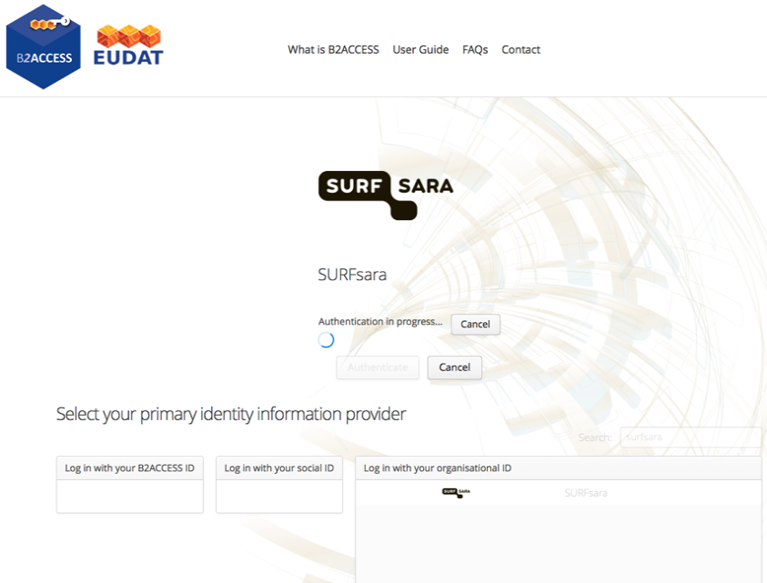
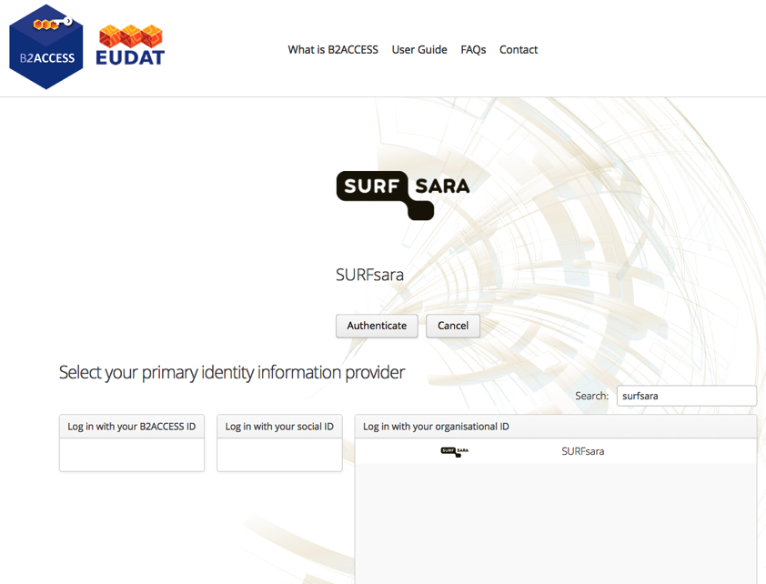
Registration process (3)
Select your institution and click on “Authenticate”
Await authentication…
Enter your credentials and confirm sharing of personal data

Slide 11
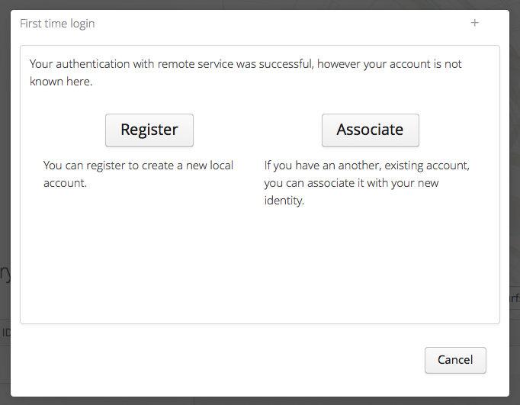
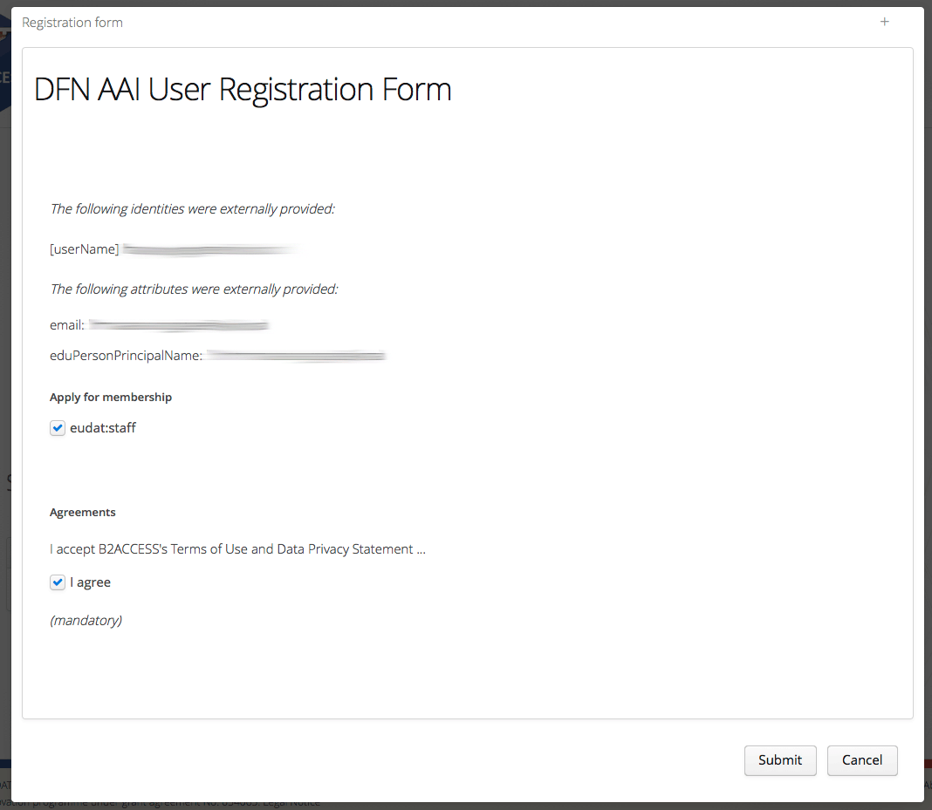
Registration process (4)
Select “Register” to create a new profile to associate with your institutional account
Optionally apply for memberships, accept agreements
Submit registration form

Slide 12
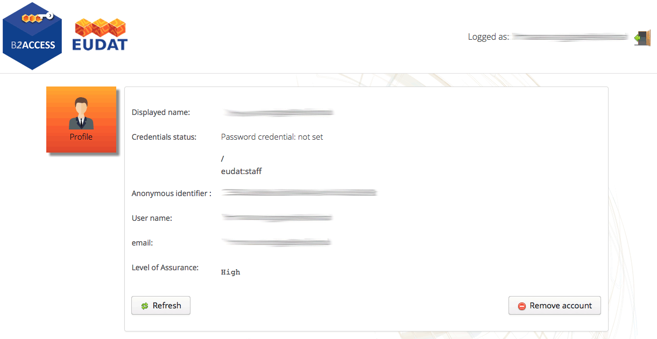
Registration process (5)
Your account details will be shown in B2ACCESS

Slide 13
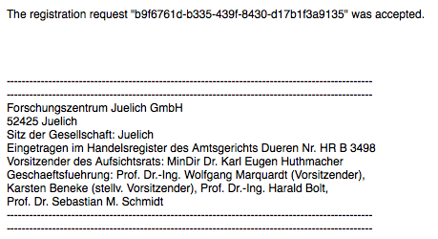
Registration process (5)
You will receive a confirmation email
No additional action required
Click on your name on the B2SHARE frontpage to go to your profile page

Slide 14
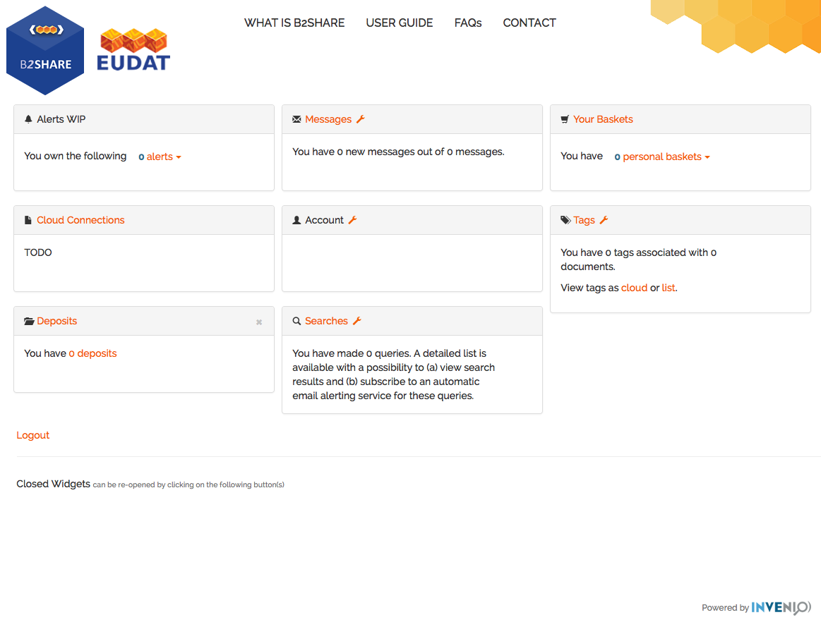
Account details page
Including all your tools and services:
Alerts
Account
Groups
Data deposits
Searches
Tags
Messages
Basket
Logout

Slide 15
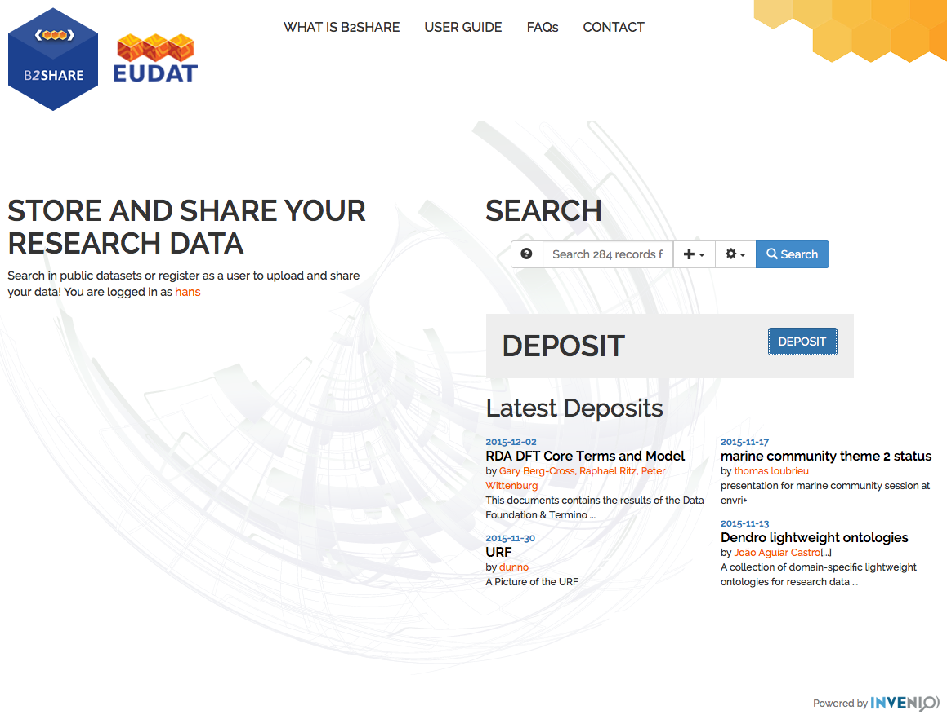
How do I deposit data? – step 1
Go to the homepage and click on “Deposit”

Slide 16
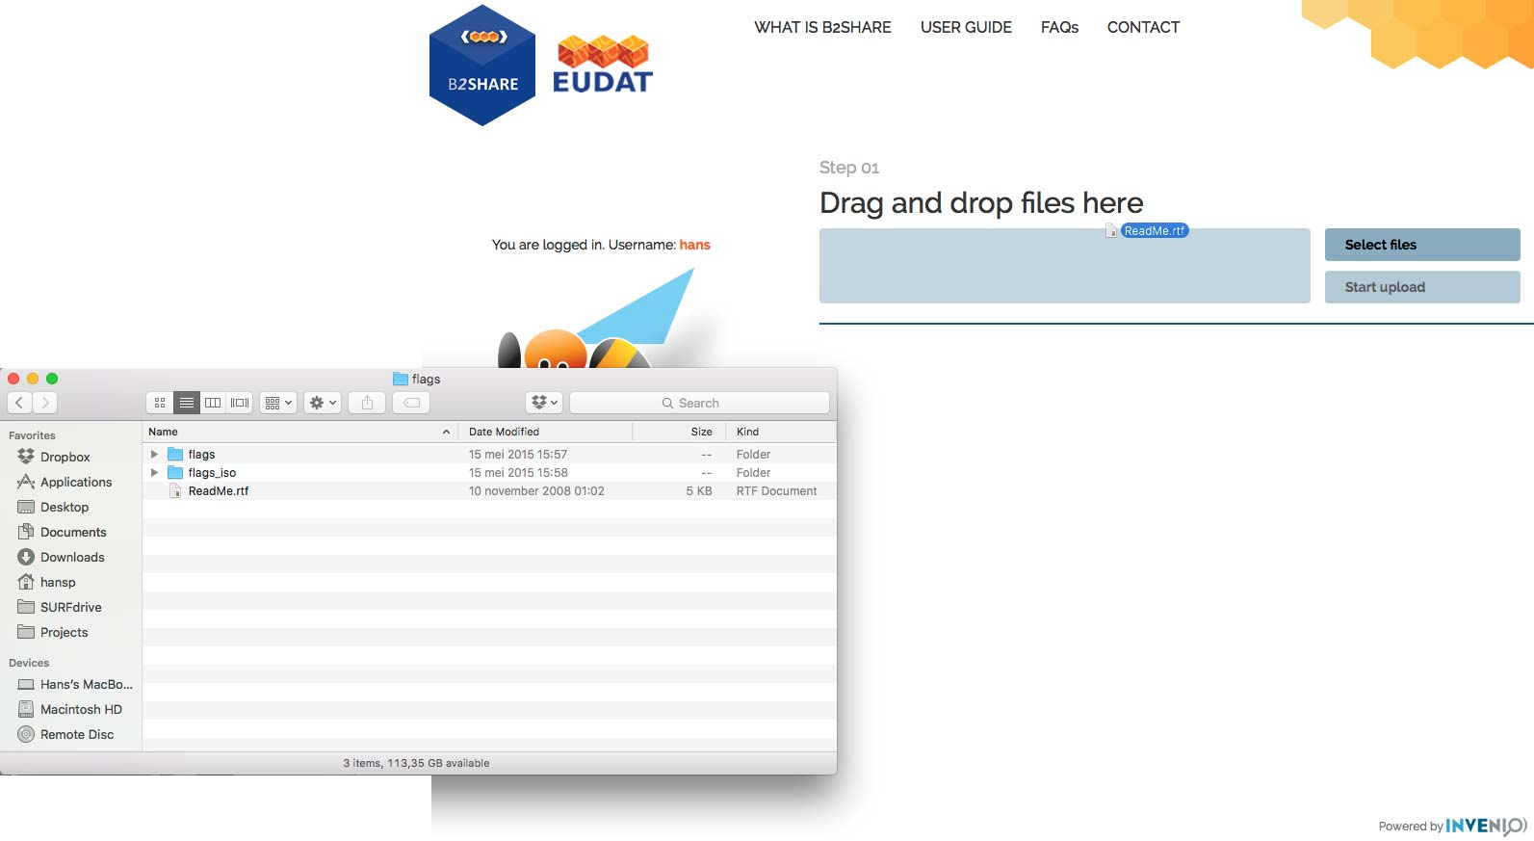
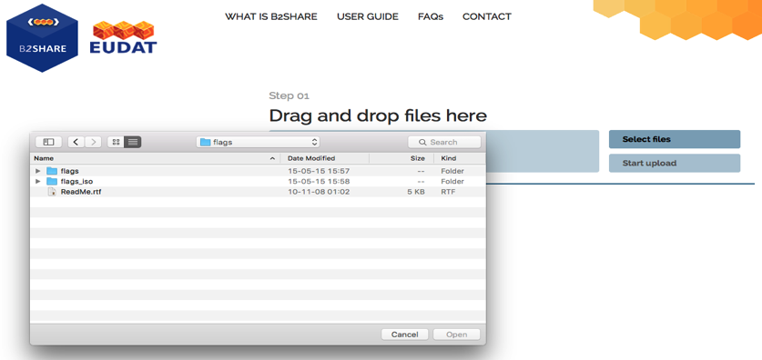
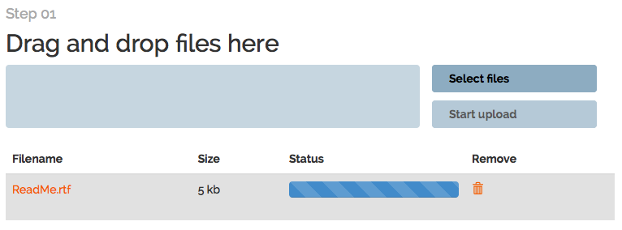
How do I deposit data? – step 2
Select and upload one or several data resources
Drag and drop to "Drag and drop files here”
When ready, click the button marked "Start upload“
Check the upload status
You can cancel uploads by clicking on the bin icon
OR…..Hit “Select files” and select from your pop-up file:

Slide 17
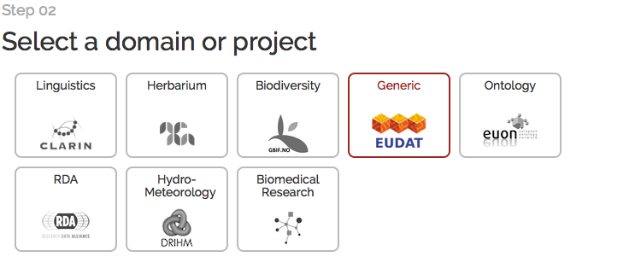
How do I deposit data?– step 3
Select an appropriate domain or project by clicking on one of the domain or project boxes.
Datasets will be annotated with the selected domain’s metadata schema

Slide 18
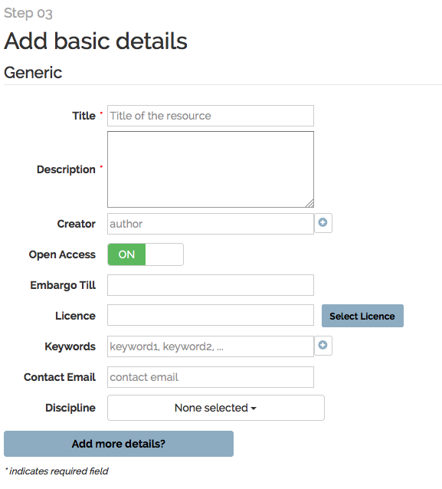
How do I deposit data? – step 4
Add basic metadata fields.
The more information you add the easier your data will be found by others
Open Access:
Select “ON” to make your data accessible to registered members only
Select “OFF” and everyone can see your data
License:
Add a license to your data to encourage fair usage
All metadata is visible to all!

Slide 19
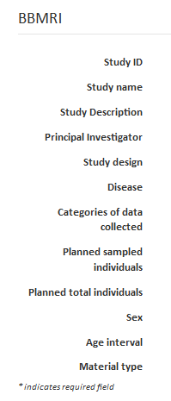
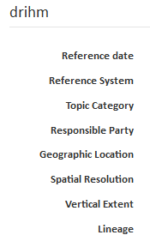
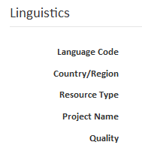
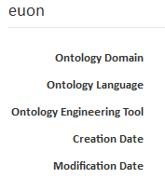
How do I deposit data? – step 6
After completing the general information, you should also complete the community specific fields
Each community has different fields to complete

Slide 20
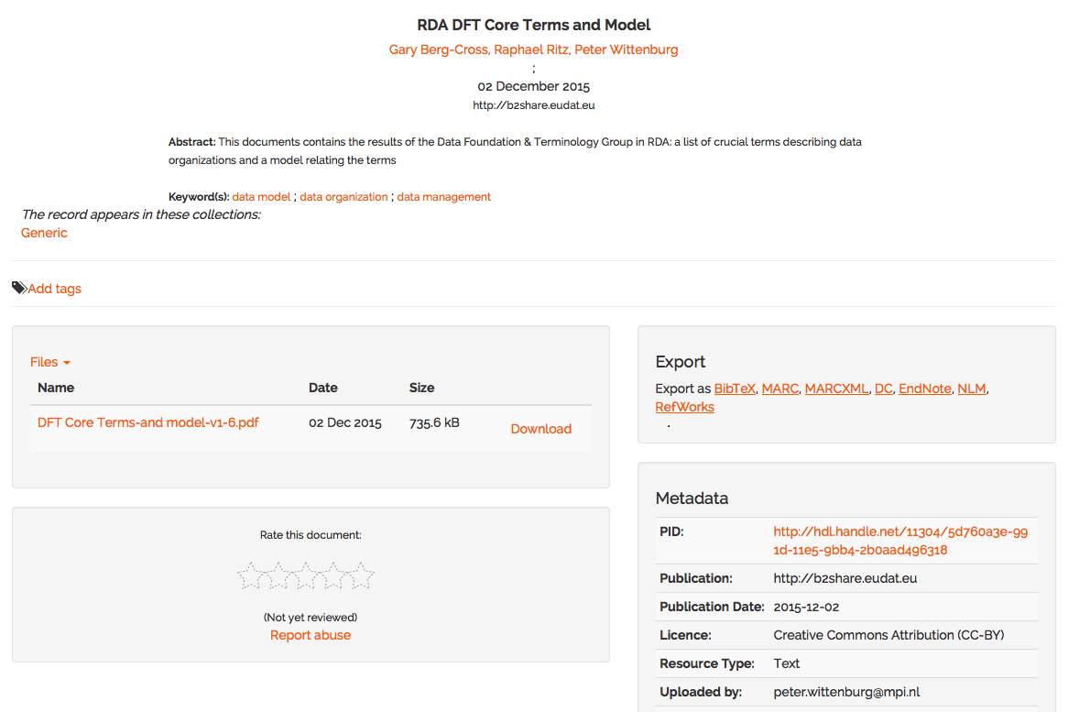
How do I deposit data? – step 7
Hit the deposit button to share your data and then see the records page for your data

Slide 21
What data can you upload?
Research data
Primary data
Processed data
Data as basis for a publication
Empirical data
Theoretical data
In virtually any kind of format….
Papers
Spreadsheets
Audio-visual media,
Data source or purpose of the data has a scientific background.
Just a note….
Make sure that you are allowed to upload your data. Data protection laws exist to protect sensitive data and restrictions exist on this data is stored. Always check if your data has any such restrictions on where it can be stored.
Unrelated personal data should not be stored on B2SHARE

Slide 22
What data can you upload?
Are there any limits on how much I can upload?
The number of files you can upload is unlimited
Maximum file size is currently 2GB per file
If you want to upload larger files contact b2share@eudat.eu

Slide 23
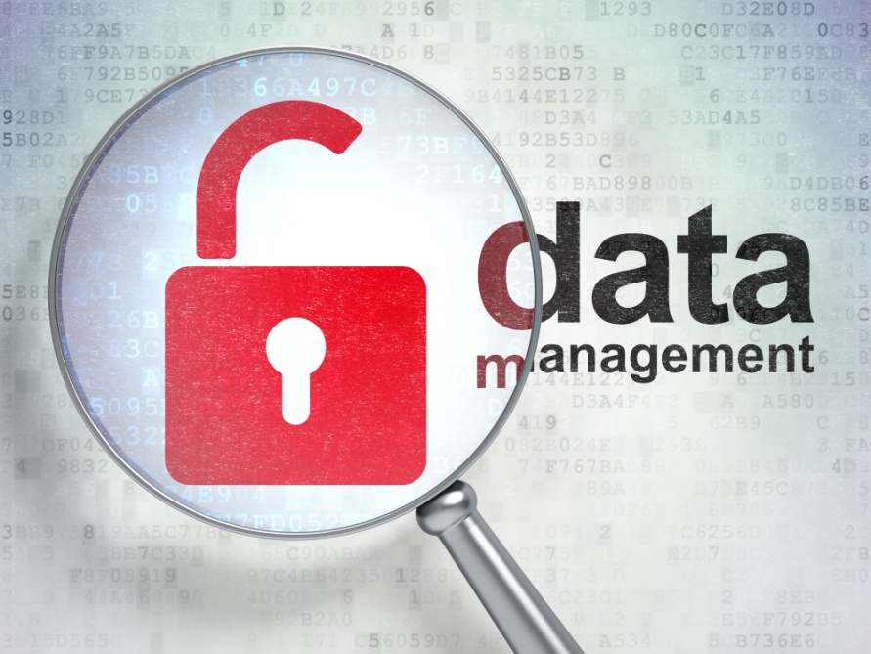
Can I restrict access to my data?
You can choose if you want your data to be open to anybody or be restricted.
All metadata stored in B2SHARE, except private information such as email addresses and phone numbers, are made publicly available.
As the service is dedicated to research data, the names and affiliations of the data owner and/or the data depositor are publicly available.

Slide 24
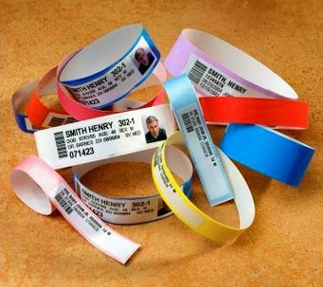
Identifying data
The B2SHARE service provider will respect the user’s access restrictions, assign PIDs to each object (and by this way, register them to the EUDAT domain of registered data) and store the data according to the B2SHARE service statements.
For the most common data types – such as text, audio and video files – custom players will be available so that authorized users will be able to directly view the contents of the data files.

Slide 25
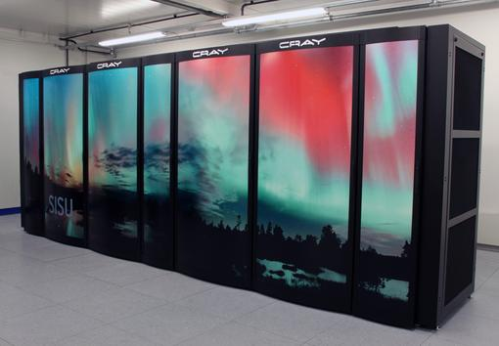
What happens to my data once I have deposited it?
EUDAT has no claim over the data deposited in B2SHARE and depositors remain entirely responsible for the data they deposit.
Data is stored on state of the art servers at the Finnish IT Center for Science, Kajaani, Finland
EUDAT retains the right of archiving, i.e. creating replicas at trusted centers to take care of long-term persistence.
In the next few months we plan to make it possible to users to choose their preferred storage provider from a selection of EUDAT centres in various European locations.

Slide 26
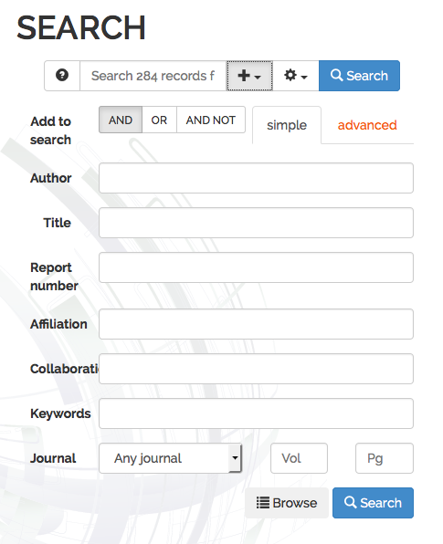
How do I search for data?
Basic search
Type in part of a title, keyword, abstract or other metadata and click on “Search”
Advanced search
Click on the plus next to “Search”
The Advanced search options drop down.
Specify search fields, use boolean methods in various indices and use regular expressions and other search operators (spans, refers to, cited by).
Click on search at the bottom of the drop down area.

Slide 27
How can I download data?
Once you have found the data you want, you can download easily by clicking on the download button

Slide 28
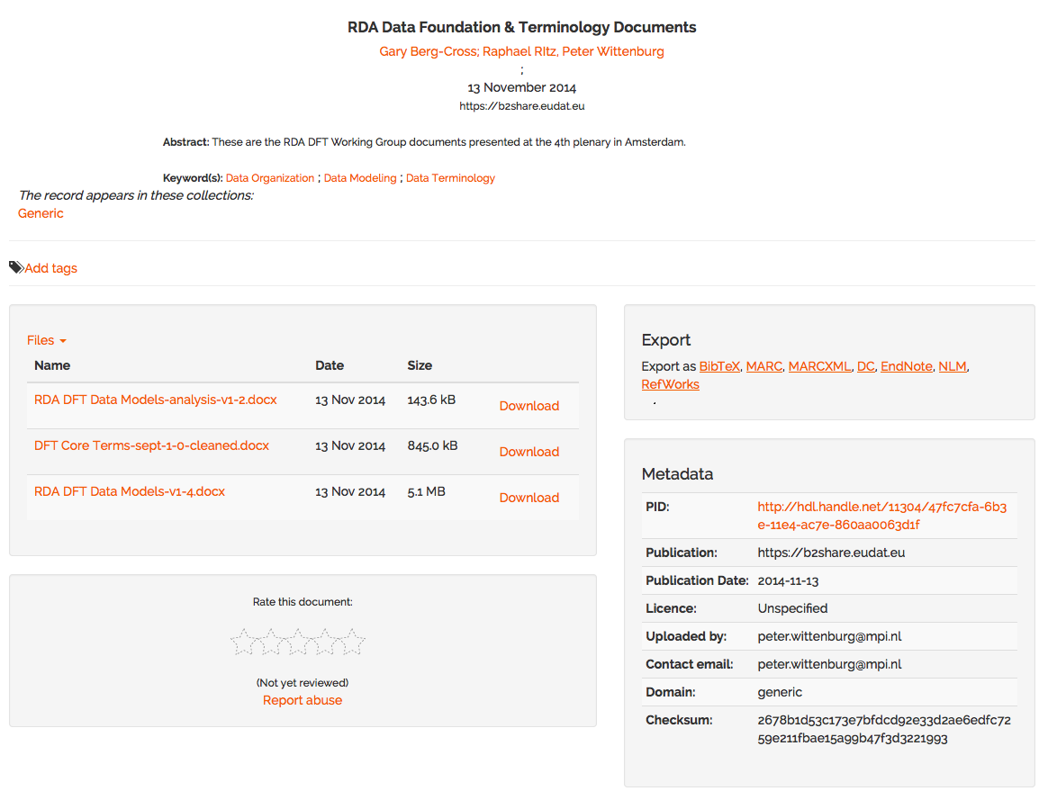
Data records page
Each data or data set has its own records page
Name, date & abstract
Download
Formats
Metadata

Slide 29
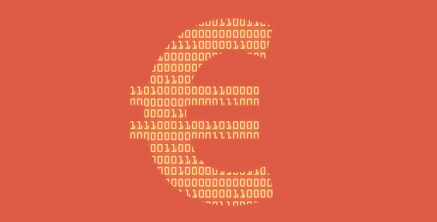
And how much does all this cost?
The B2SHARE service is free of charge for European scientists and researchers.
No comparable service currently exists to support EU research.
Services
Self-service registration
Free upload and registration of stable research data
Data access policy defined by data owner,
Metadata openly accessible and harvestable
Customized metadata handling and customized user interfaces (e.g. for metadata acquisition)
Data integrity ensured by checksums which are calculated during data ingest
Data is kept online
Services
Storage usage based on fair share principle
Professionally managed service: data is stored at Datacenter CSC Kajaani, certified by the ISO/IEC 27001:2005 standard for its information security management system
User support provided via EUDAT ticketing system
Service availability and usage of storage is monitored
Data and metadata remains accessible for two years if services is closed

Slide 30
What’s next for B2SHARE users?
We’re always looking to improve B2SHARE and the following additions will be made:
Provision of basic B2SHARE service by multiple service providers
Communities will be able to request a premium service providing larger storage capacity
Service provisioning based on SLAs
Users will be able to choose their own trusted service provider
B2SAFE repositories will be connected to the safe replication service
Sharing data with user groups
Introduction of social tagging

Slide 31
Thanks For more info: https://b2share.eudat.eu

