Slide 1

Store and Share using
EUDAT B2SHARE REST API
EUDAT B2SHARE training workshop
February 2016
Carl Johan Håkansson
EUDAT Service Area Manager for Data Access and Re-use
cjhak@kth.se
This work is licensed under the Creative Commons CC-BY 4.0 licence

Slide 2
B2SHARE training site
https://trng-b2share.eudat.eu

Slide 3
How to register and get an access token
Click ”Login” (DO NOT USE ”REGISTER NOW”)
Click ”Sign in with B2ACCESS” (Do not use login form)
Now your are in B2ACCESS – use federated login or create id in B2ACCESS for password login
When back in B2SHARE - click on your user name
Click ”Account”, then choose ”Application”
Under ”Personal access token”, click ”New token”
Name it and create it
Copy this token to use it

Slide 4
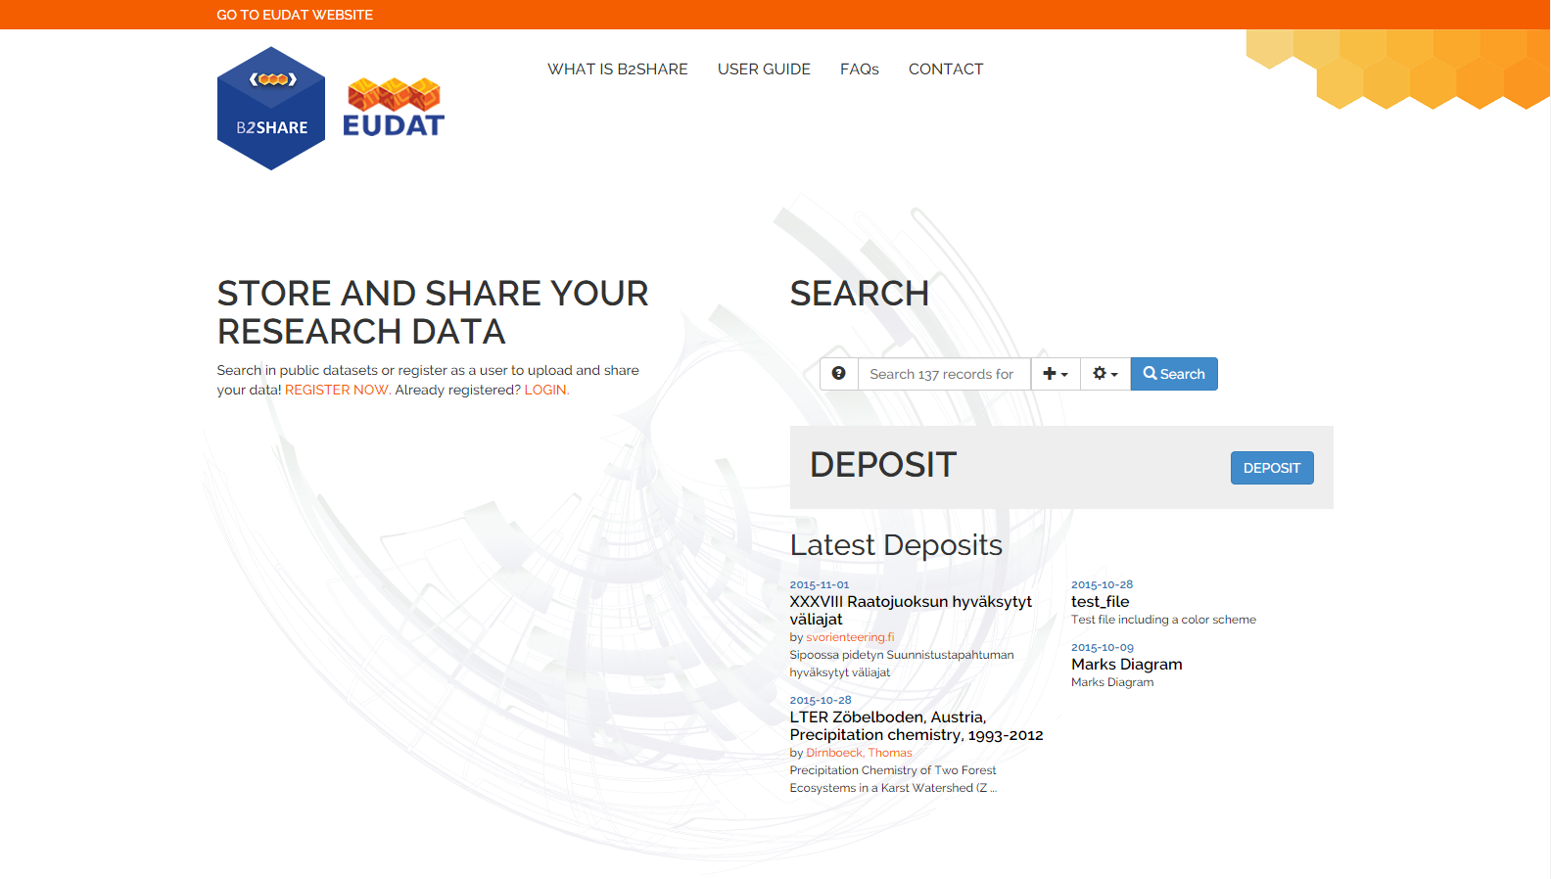
Click ”Login”

Slide 5
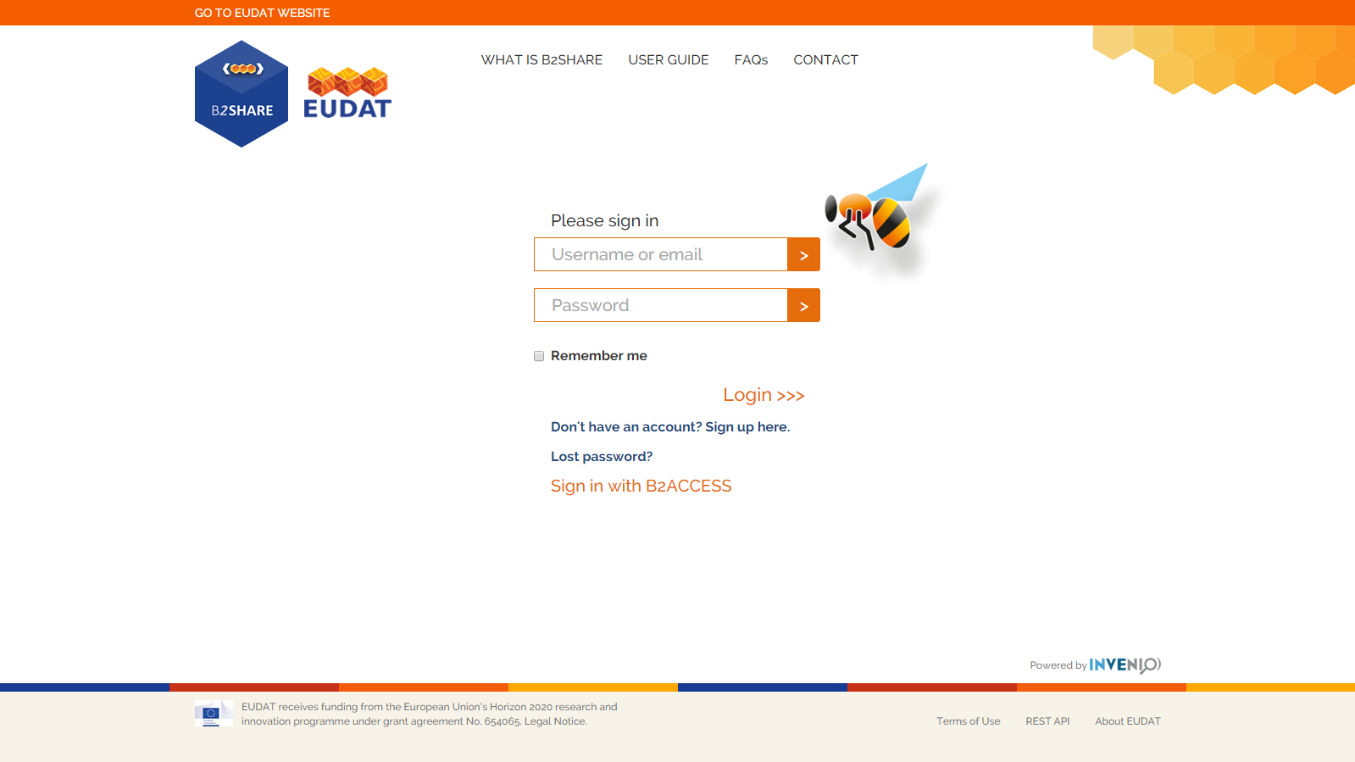
Click ”Sign in with B2ACCESS”

Slide 6
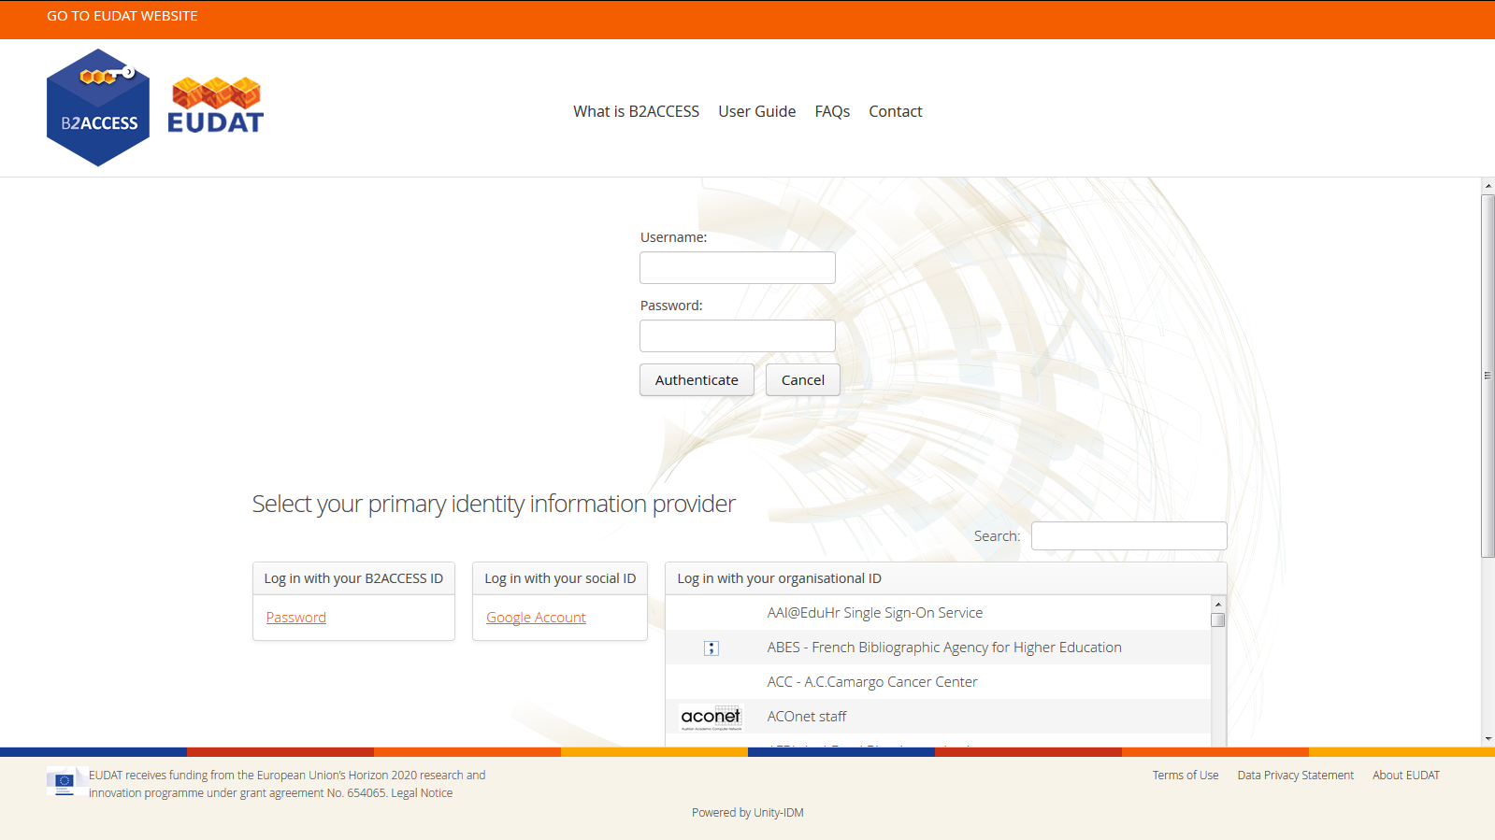
Login through B2ACCESS

Slide 7

Back in B2SHARE - click your user name

Slide 8
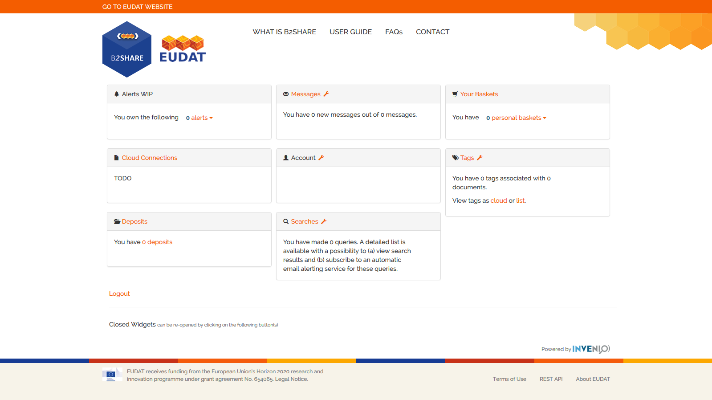
Click ”Account”

Slide 9
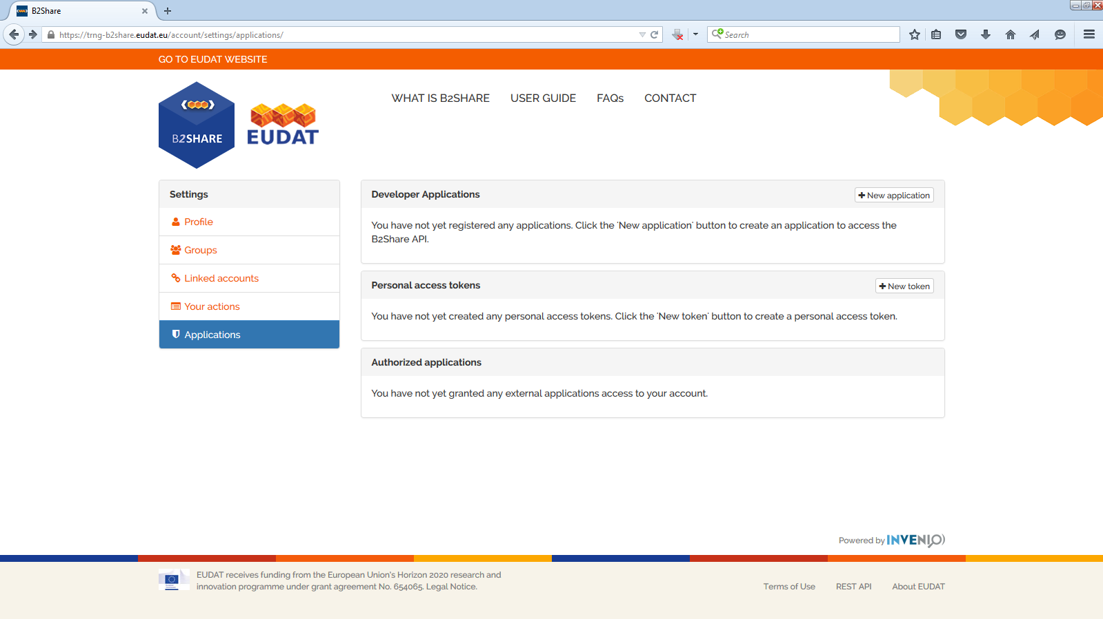
Choose ”Application” in left menu
Under ”Personal access token”, click ”New token”

Slide 10
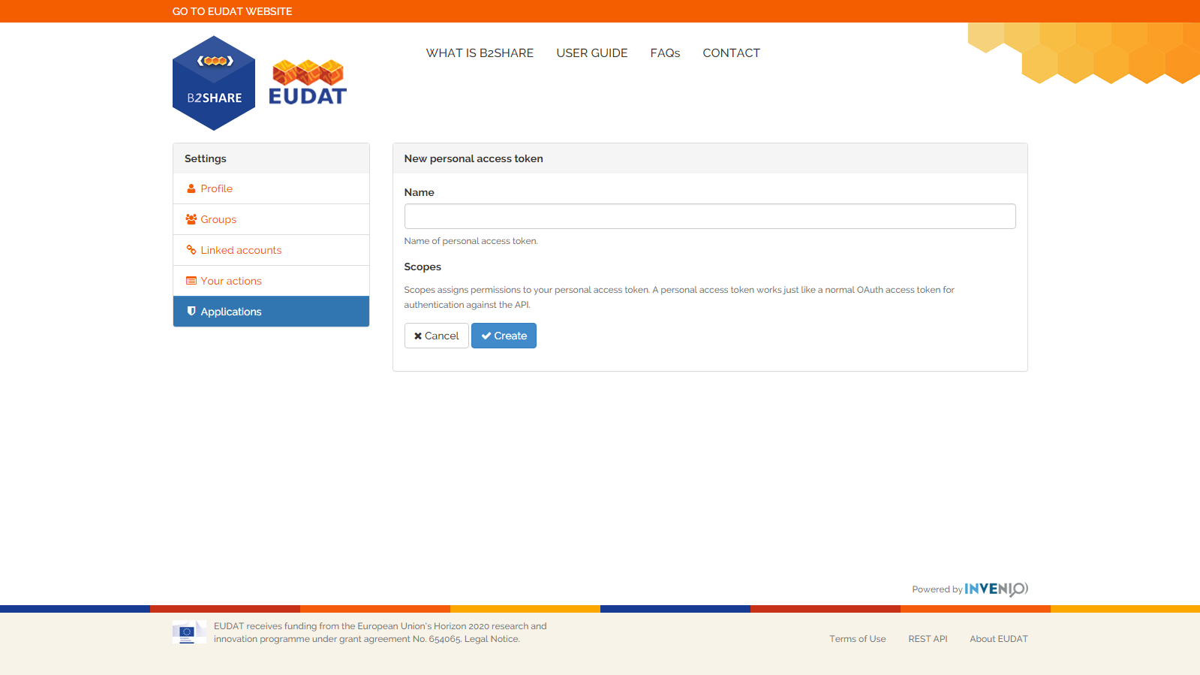
Name and create token

Slide 11
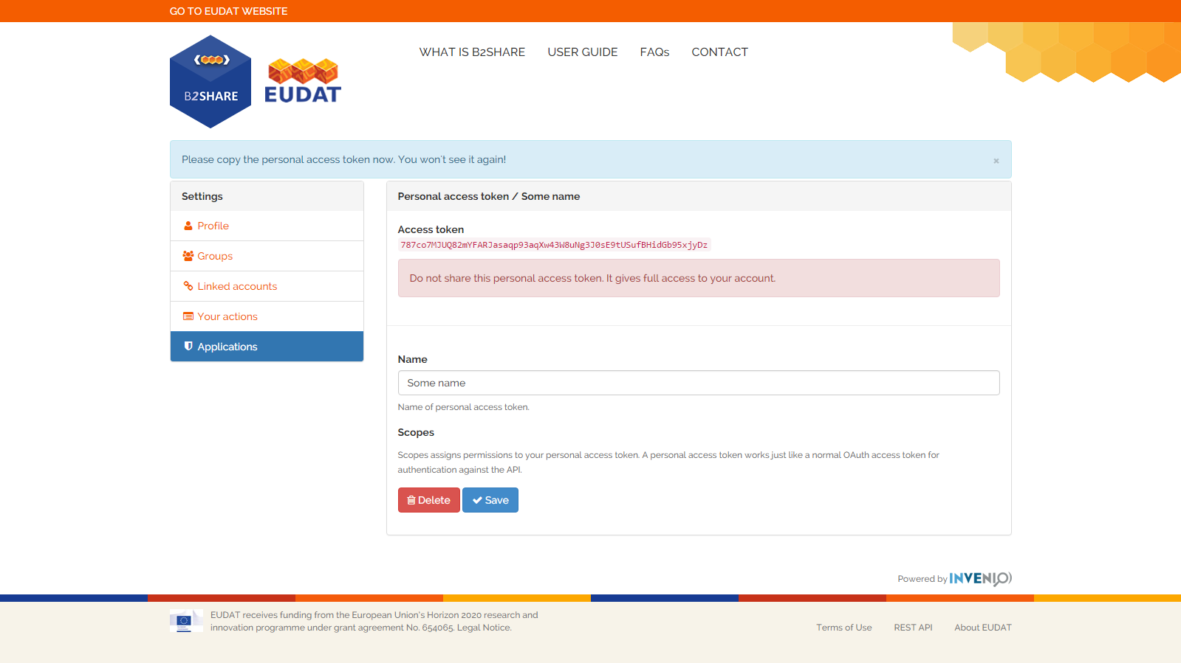
Name and create your token, copy it to use it

Slide 12
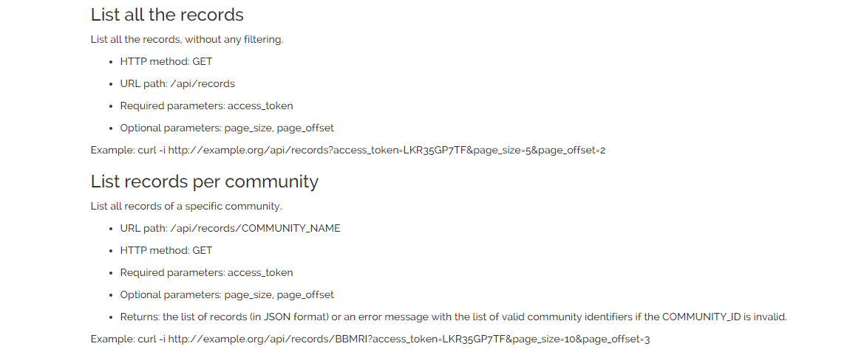
API Requests: list records

Slide 13
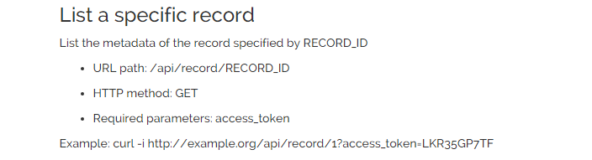
API: list a specific record

Slide 14
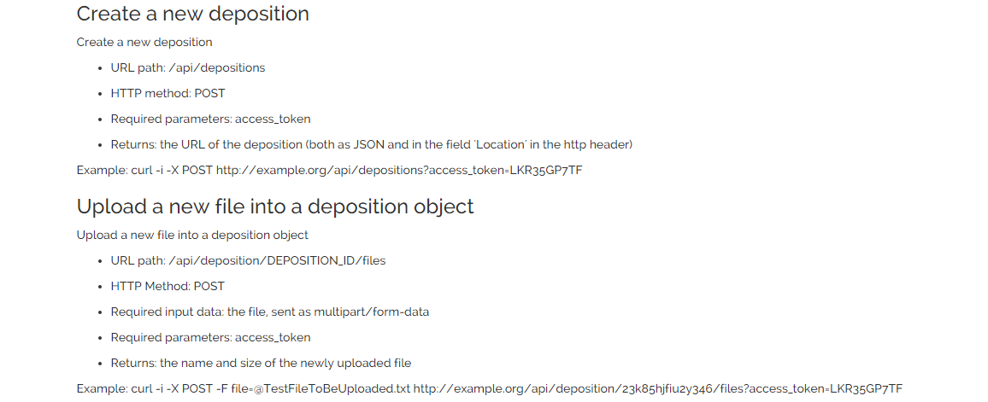
API: create a record and add a file

Slide 15
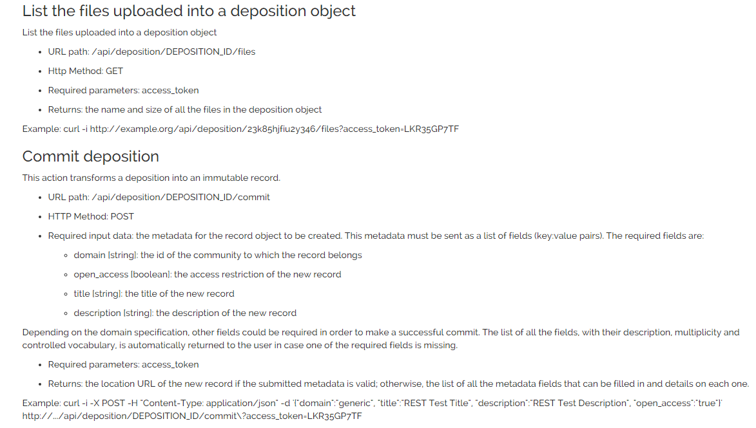
API: list the files and commit the record

