Slide 1
Engaging with Users
Daan Broeder
Meertens Institute & CLARIN ERIC
EUDAT User Forum, Feb 3,4 Rome

Slide 2

History of the EUDAT CDI
Common Services for heterogeneous communities
  Science data rates are exploding and will likely become continue to do so
  Building customized services for new communities is not cost effective
  Desire to leverage existing investments e.g. infrastructure of national science organisations
Initial Set of Services developed as result of community needs
  Beyond the original ‘core’ communities
  New services and specific
  community issues highlighted
Notes:
Not just ‘big’ experiments such as LHC and SKA, but the number of communities
Many align their ideas and birth with the Riding the Wave report from the HLEG 2010, but of course many discussions and collaborations went on before that
REMOVE THE LAST BULLET POINT

Slide 3

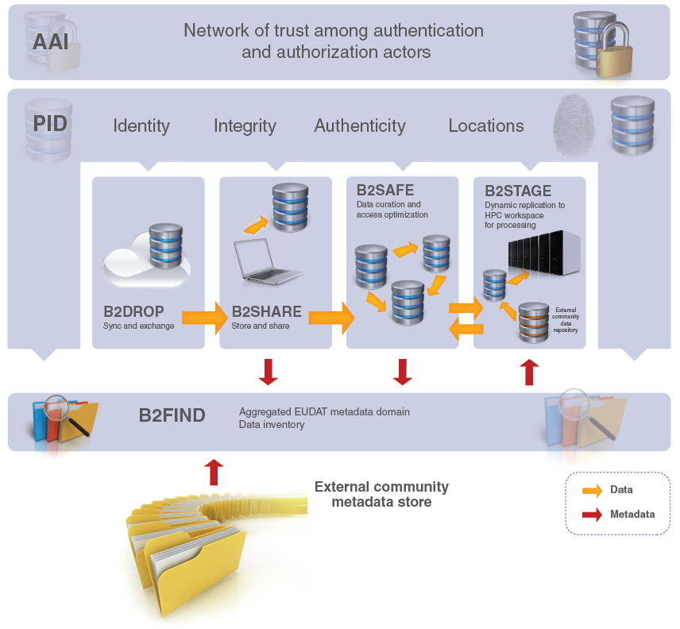






B2 Service Suite
B2ACCESS
B2Handle
Notes:
Note that this slide shows our ambition to integrate these services making it possible to migrate data deposited at B2DROP to B2SHARE, B2SAFE

Slide 4

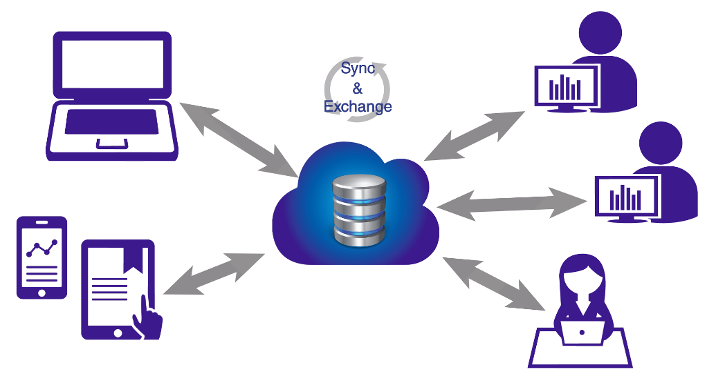
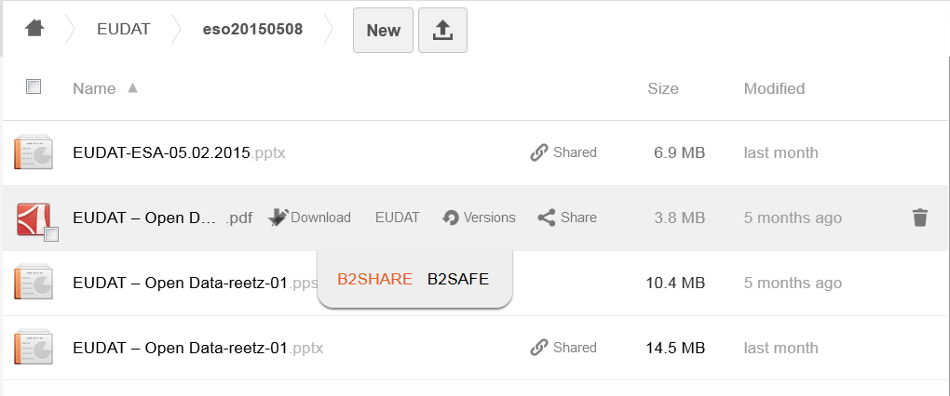

Who
  Citizens Scientists and small teams
What
  Store and exchange data
  Synchronize multiple versions
  Ensure automatic desktop synchronization
Why
  Ease of Use
  Trusted European Service
EUDAT2020
Further integration with EUDAT CDI (e.g. B2SHARE)
Integration with B2ACCESS to enable access by many different Identity Providers
Cloud Storage Federation, collaboration with GEANT in OpenCloudMesh
Assess B2DROP as workspace area to computing facilities
Notes:
Based on ownCloud, open source (GNU AGPLv3)
access and manage permissions to files from any device and any location, via browser, desktop, mobile apps and WebDAV
up to 20GB of storage space for research data
simple to use and open to all researchers, scientists (e.g. self-registration)
synchronize and exchange data with one or multiple users
users decide with whom to exchange data, for how long and how

Slide 5
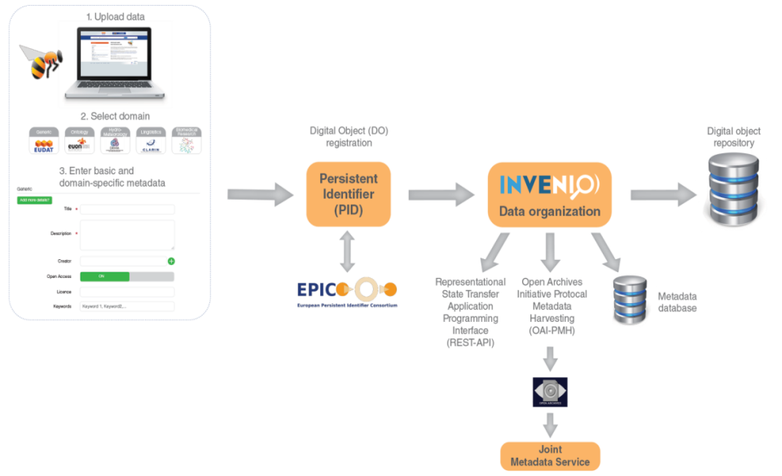
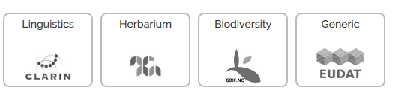
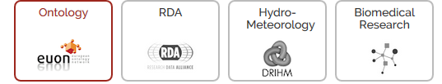
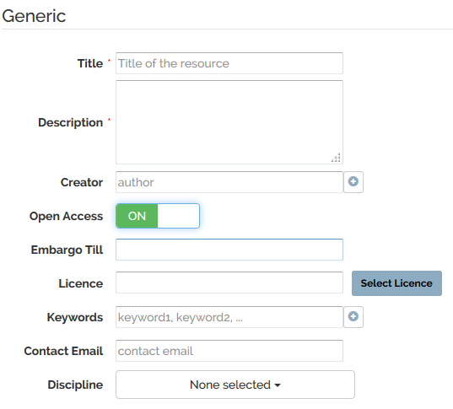

Who
  Small to Medium Teams
What
  Store data (incl. software) and add domain meta data
  Share registered research data worldwide
  Preserve (small-scale) research data for long-term
Why
  Register Data for Publications
  Make known to wider community
EUDAT2020
Further integration with EUDAT CDI (e.g. B2DROP, B2SAFE)
Integration with B2ACCESS (incl eduGAIN), focus on authorization
Embargo period
Editing of metadata
Data versioning and annotation
Extended HTTP Restful API interface
Easy installable software package
Notes:
Possibility to run separate instances for specific communities as for instance is done for ENES
Based on Invenio, open source (GPL v3)
Supports 8 community-metadata templates
Data assigned a persistent identifier and a checksum
Access via a HTTP Rest API
Open accessible, user self-registration
Data owner defines access policy
Open access license choose feature
Discipline choose feature
Open harvestable metadata, harvested by B2FIND

Slide 6

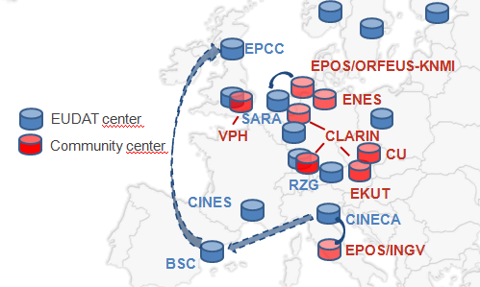
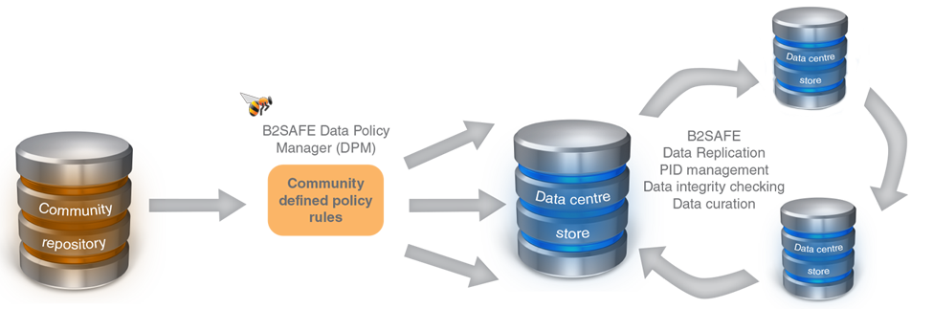
Who
  Community Data Managers
  ‘Sophisticated’ Organisations
What
  Provide an abstraction layer which virtualizes large-scale data resources
  Guard against data loss in long-term archiving and preservation
  Optimize access for users from different regions
  Bring data closer to powerful computers
Why
  Performance
  Replication between trusted sites
  Data Preservation
EUDAT2020
Support iRODS v4
Support metadata
Optimize and extend policies to support data curation and provenance
Further integration with B2ACCESS
Support authorization on basis of community access rules
Assess B2SAFE as workspace area to computing facilities
Notes:
Supports two modes of usage depending if you want to use or join
Current priority Support of metadata as a separate data-type

Slide 7

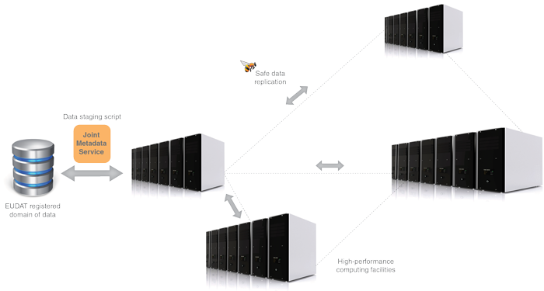
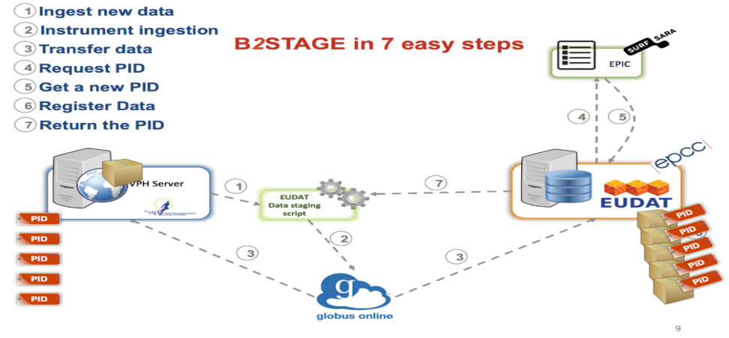
Who
  Users and Communities with Significant Computational Needs
What
  Transfer large data collections from EUDAT storages to external HPC facilities for processing
  Copy large data sets, ingesting them onto EUDAT storage resources
Why
  Integration/Collaboration with PRACE
  Simplify Data Transfer
EUDAT2020
Further develop HTTP to a mature interface and extend functionality to metadata
Native support PIDs within GridFTP transfers
Extend EUDAT client API library to other B2 services (e.g. B2SHARE, B2FIND, PID)
Further integration with B2ACCESS
Notes:
Extension of the B2SAFE and B2FIND services, which allow users to store, preserve and find data
Providing access via GridFTP and basic HTTP
data-staging script facilitates staging, ingestion and retrieval of persistent identifier (PID) information of transferred data
Start development of EUDAT client API library and command line tools
Integrated with EUDAT Federated AAI on basis of X.509 certificates

Slide 8

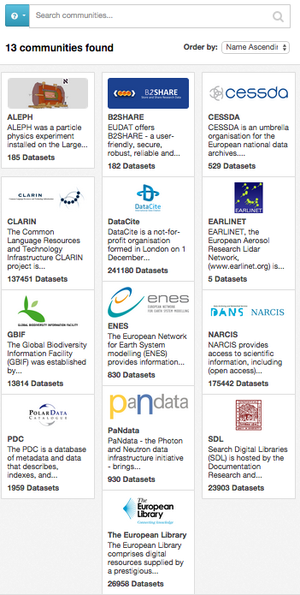
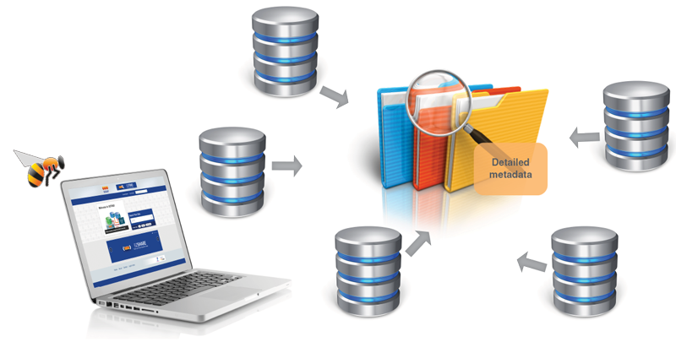
Who
  Anyone
What
  Find collections of scientific data quickly and easily, irrespective of their origin, discipline or community
  Get quick overviews of available data
  Browse through collections using standardized facets
Why
  Unique collection
  Ease of Searching
EUDAT2020
Harvesting of metadata stored in B2SAFE
Community customizations
Annotation of datasets
Further assess RDF and Linked Data
Further assess scalability and performance
Notes:
On the EUDAT1, MDTF/B2FIND community wiki page, harvesting 15 additional community repository services are planned or in enabling phase.
At the developers workshop Heinrich and Yann Le Franc talked about the the integration of the B2NOTE service with B2FIND.
We could consider running this technology as a separate instance for specific communities
Based on CKAN, open source (GNU AGPL v3)
Facetted search (e.g. 10 facets) and full text search, recently added timeline search
Focus on community recommended metadata
13 community repositories harvested, more lined up
Open accessible, no registration needed
Open harvestable metadata
Searchable via Web-based GUI and HTTP RESTful API

Slide 9
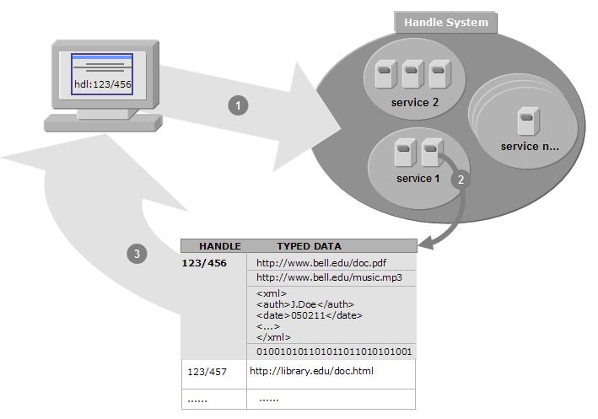
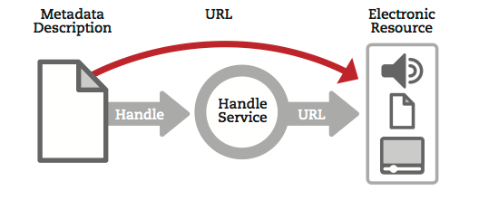
Who
  Groups or Communities who want to make their data citable
What
  Follows policies to register data and make it long term refer- and citable
  Reliability through mutual PID mirroring
  Provides abstraction layer between a globally unique persistent identifier and physical location of data objects
  Machine readable via HTTP RESTful API
Why
  Simple integration
  Technology Agnostic
Development plan
Develop the policies for the B2HANDLE service (e.g. PID namespace mngmt)
Migrate service from Handle v7 to v8
Define PID Information Types for data, metadata, collection records
Integrate with Data Type Registry service
Consolidate B2HANDLE API library with EUDAT API library
Notes:
Many communities are interested in using PIDs, and if not already having chosen a PID provider, they are interested in using EUDAT provided ones.
Currently brokering EPIC handles to end-users,
Can add some extra functionality as providing DOIs or providing Handle based PIDs to
Although the PIDs and AAI were originaly developed for internal use only connected to the the other services in the CDI, in our discussions with the communities we realised the opportunity to offer them as separate services B2HANDLE and B2ACCESS

Slide 10

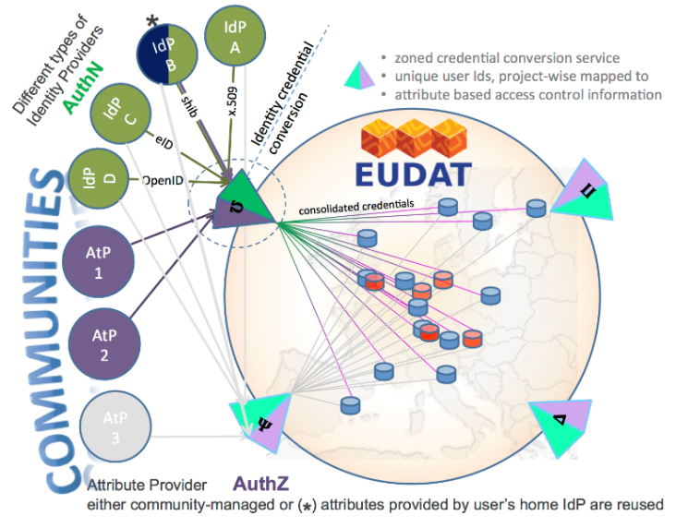
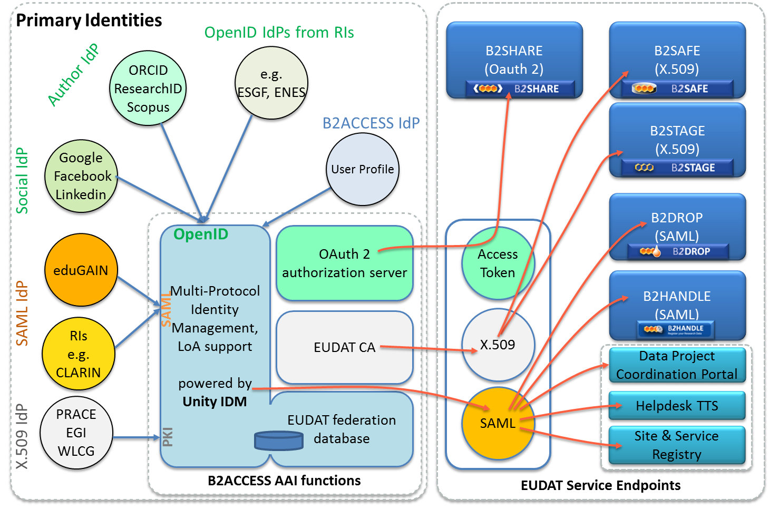
Who
  Anyone wanting to use the B2 Services
What
  Complies with community ownerships and access rights, basis of trust
  Credential conversion approach (e.g. SAML, OpenID, X.509, Username/password)
  Identity provider for citizen scientists
Why
  Use your own ID in federated environment
EUDAT2020
Integration with operational and all B2 services
B2SHARE B2DROP B2STAGE
B2SAFE B2HANDLE, DPM, CREG , TTS,
Integration with community IdP domains and portal environments
Enabling access via eduGAIN social IDs
enabling access via ORCID CLARIN IdPs
Focus on authorization
Collaborate on cross e-infrastructure access
(e.g. PRACE, EGI)
Extend European collaboration via AARC
(e.g. Geant, Terena)
Notes:
Some RI as EPOS need to develop an AAI also for their own services. Of course we should investigate if the EUDAT solution can be somehow leveraged for this purpose either by those services to the EUDAT B2ACCESS or by EUDAT providing a separate instance as a service.

Slide 11
Service Uptake by
EUDAT Partner Communities
Community | Service | Description
CLARIN | B2SAFE | Roll out B2SAFE use to ~10 CLARIN centers
ELIXIR | development new service ‘B2DISTRIBUTE’ | Developing “Data Distribution Service”
ENES | ENES B2SHARE inst. B2SAFE | Use for whole ENES Integrate BADC center
EPOS | B2SAFE | Integrate KNMI, GFZ centers
ICOS | B2SAFE | Integrate the Carbon Portal
LTER | B2SHARE B2SAFE | Integrate with DEIMS Distribute VMs
VPH | B2STAGE | continue EUDAT1 practice
Notes:
This table shows a summary of the work in the communities plans although some specific requests for ‘new’ services adjustment are left out. As there is for instance an interesting idea from EPOS for B2DROP, which played a role in the last TC discussion. And as for instance plans to make use of a EUDAT DTR by ICOS and EPOS.

Slide 12
EUDAT Data Pilots Effort
Continuous outreach to get new communities involved
Purpose:
  increase community outreach
  … and uptake of services
Looked for collaboration proposals from the communities that:
  Offered mutual benefits
  Injected new ideas
  Aligned with current research data management developments
Notes:
Contribution to Open Access and building on Research Data Alliance output as the DTR

Slide 13


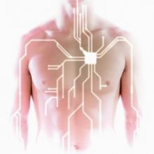


Biomedical & Life sciences
EUDAT core community – ELIXIR & VPH
  West-Life Data Pilot
  IST Data Rep
  Herbadrop Data Pilot
  EUDAT repository to store clinical trials in a secure and compliant way Data Pilot
  An EUDAT-based FAIR Data Approach for Data Interoperability Pilot
Notes:
Pilot plans are ranging from using B2SAFE and B2FIND to store and make data discoverable as IST, to ambitious plans as to see if EUDAT services can be adjusted to become a community standardized data provider as FAIR Data Approach.
Herbadrop is an interesting pilot using OCR technology also for biological specimens description in the BioMed Life Sciences as is also will be done in one of the CH pilots. Herbadrop will also be using B2SAFE to safeguard the data and make the discoverable with B2FIND

Slide 14






Earth Sciences, Energy & Environment
EUDAT core communities ENES, EPOS, ICOS & LTER Europe
  Support to scientific research on seasonal-to-decadal climate and air quality modelling
  DataPublication@Uporto Data Pilot
  Unified access to EISCAT radar
  Public access to fine-grained city air quality data from roving sensors
  Web Coverage Service for sharing of tailored global atmospheric composition model results
  Linked data service pilot for EUDAT
  DATA SPHINX Data Pilot
Notes:
Got in most (7) from the area where we were already well covered with 4 core-communities, but no reason to say no
We have a DataPilot from EISCAT for us a new community that will be chalenged
Linked Data Pilot that obviously fullfils our call for Pilots working with SemanticWeb/LD. The will annotate data (using B2ANNOT and make it available as LD

Slide 15


Physical Sciences & Engineering
  SIMCODE-DS Data Pilot
  Tokamak data pilot
  TURBASE-DNS Data Pilot
  NFFA-EUROPE Data Pilot
  Direct simulation data of turbulent flows Data Pilot
Notes:
5 Data Pilots were we were not covered at all, so this is good news
Some plan using a whole range of EUDAT services B2SHARE,B2SAFE,B2STAGE B2FIND to manage data as the Tokamak and NFFA-EUROPE data pilots

Slide 16



Social Sciences & Humanities
Core community – CLARIN
  Enriching Europeana Newspapers Data Pilot
  Cloudy Culture Data Pilot
  Aalto Research Data Management Suite Pilot
  Ancient OCR Data Pilot
  Research data repository Data Pilot
Notes:
Going into Cultural Heritage with Cloudy Culture and Europeana
Also linking up with organizations that themselves need to provide DM services for a data from a wide variety of disciplines such as Aalto University needing solutions for storing a variety of data types using B2DROP and B2SHARE

Slide 17
Data Pilot Service Interests
Data synchronization & exchange (11/24)
Data repository and (long tail) data sharing (18 / 24)
Data replication and preservation (13/24)
Data staging for analysis and processing (12/24)
Data discovery and search (16/24)
Data typing & visualization (9/24)
New services or tools in the area of Big Data Analytics (5/24)
New services or tools in the area of Semantic web (5/24)
Notes:
B2DROP, B2SHARE, B2SAFE, B2STAGE, B2FIND, DTR &?, BDA,
Most pilots chose for more than one single area, integrated complete solutions Emphasis on run of the mill DM,
We asked for pilots with an interest in new developing technologies as Semantic Web/Linked Data and Big Data Analytics, 20% of the proposals did that, so quite good although the big majority is about classical storage & preservation B2SHARE & B2SAFE

Slide 18
Our Expectations
Learn more about the challenges providing for such a large variety of projects
Not only technical aspects but also the organizational ones
More insight in the different disciplines
Increase our efficiency and have better ideas what we do well and where we can improve
Most Data Pilots were asking for existing and/or planned services
  We hope also for creative ideas for new ones
  Collaboration in new projects to develop these
Notes:
Next to of course our expectations of our services being used by more communities & projects

Slide 19
Who will be involved, what is required?
Servicing the Data Pilots needs efficient planning and communication
  EUDAT Data Pilot Interfaces: knowledgeable EUDAT people with an solid overview of EUDAT services and the EUDAT organization
  EUDAT technical experts: project enablers
  Data Pilot managerial & technical contacts
Data Pilot Descriptions, depending on the complexity of service use we need solid implementation plans

Slide 20
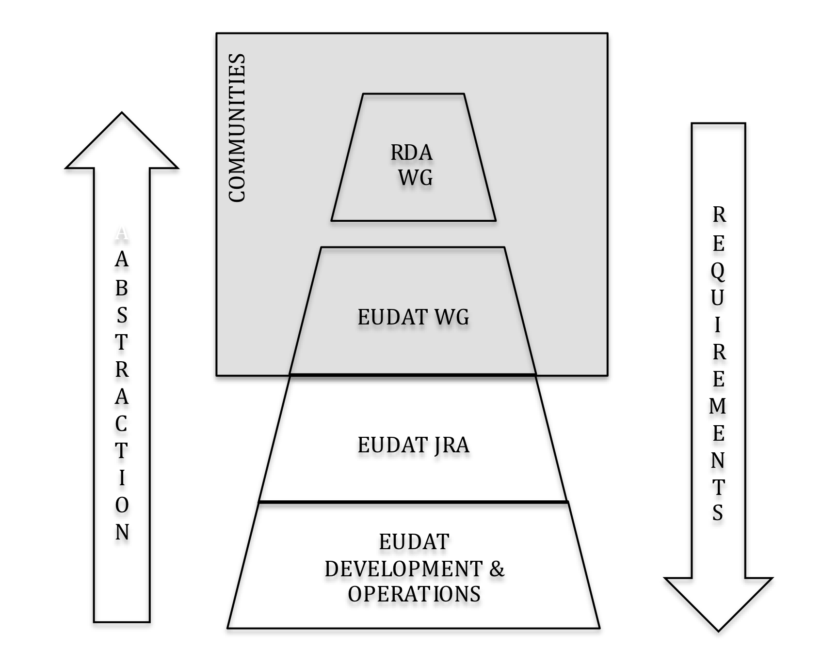
Engaging with communities outside EUDAT
We are part of a bigger picture
EUDAT Working Groups are actively soliciting community expertise in and outside EUDAT
Contribution to Research Data Alliance WGs and IGs
Both can use contributions of new community experts
Notes:
55 EUDAT persons active in RDA

Slide 21

Communities and the CDI
The CDI is dynamic – new technologies and services are designed and introduced as they mature into the scope of the CDI.
Currently via the EUDAT Working Groups, in the future common development projects could be funded through the EC or others.
Such activities are important channels for interaction between general service providers and research communities at large
Notes:
Refer to Damien’s introduction, EUDAT future is the future of the CDI

Slide 22
Questions

