Slide 1
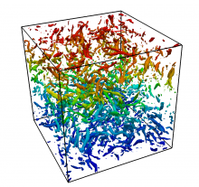
DATATURB Direct simulation data of turbulent flows

Slide 2
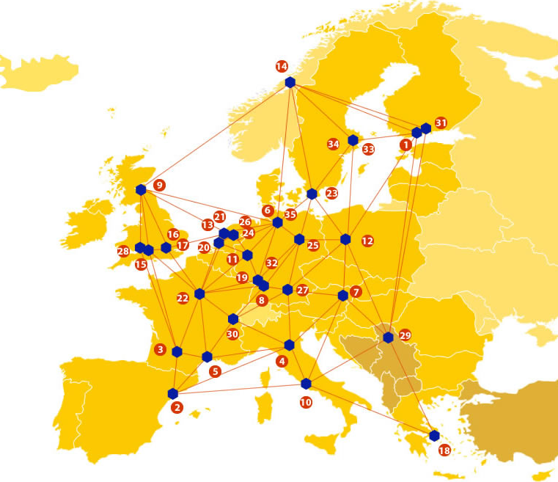
EUDAT: A truly pan-European Infrastructure
EUDAT offers common data services to both research communities and individuals through a network of 35 European organisations.
EUDAT wants to enable European researchers from any discipline to preserve, find, access, and process data in a trusted environment, as part of a Collaborative Data Infrastructure.
European infrastructures
Technology Providers
Research Communities

Slide 3
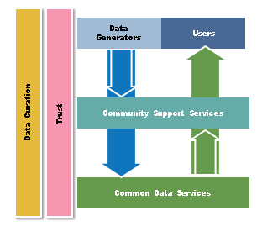
EUDAT Vision & Mission
Vision: Data is shared and preserved across borders and disciplines thereby enhancing the value and quality of research at large.
Mission: To enable data stewardship within and between European Research Communities through a Collaborative Data Infrastructure, a common model and service infrastructure for managing data spanning all European research data centres and community data repositories.

Slide 4
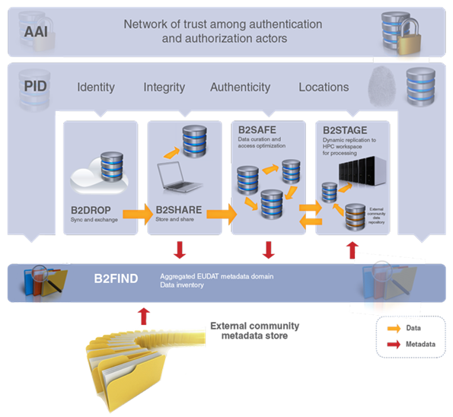
B2 Service Suite
Covering both access and deposit, from informal data sharing to long-term archiving, and addressing identification, discoverability and computability of both long-tail and big data, EUDAT services seek to address the full lifecycle of research data
https://www.eudat.eu/services
Notes:
B2FIND
stores metadata as well through other EUDAT services such as B2SHARE to provide access to data object within the EUDAT CDI
is used in inter-service use cases, e.g. to select links to data to be transferred to HPC platforms through B2STAGE

Slide 5
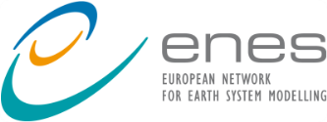
Building solutions with the communities
EUDAT services (B2 Service Suite) are designed, built and implemented together with user communites.
Common Language Resources and Technology Infrastructure (CLARIN)
European Network for Earth System Modelling (ENES)
Distributed infrastructure for life-science information (ELIXIR)
European Plate Observing System (EPOS) - Solid Earth sciences Research Infrastructure
Integrated Carbon Observation System (ICOS) to quantify & understand greenhouse gas balance
Long-Term Ecosystem Research (LTER) in Europe

Slide 6
The Challenge
Direct simulation of turbulent flows produces large amounts of data that can be used for multiple purposes and multiple researchers besides those originating them.
The community has come to expect that to be done, since large simulations are too expensive to be repeated by everybody, but there have been up to now few programs specifically dedicated to data preservation and sharing.

Slide 7
Pilot Overview
Turbulence is a relevant field in science and engineering nowadays, as countless industrial and technical applications rely on fundamental research for better performance and efficiency.
Our group has been using DNS of turbulence for 30 years, and probably owns at the moment the largest public data base of turbulence data. New challenges arise as the amount of data to store, preserve and share increase with larger simulations.

Slide 8
EUDAT Service Uptake
Repository for shareable digital objects - B2share services will allow us to enlarge the pool of users that we already have and to provide standardized meta-data extensions and user-friendly interfaces to increase the impact of our activity in the turbulence research community.
Data replication and long term preservation - We require a reliable, safe and robust way to preserve and access our turbulence database now and in the future. Also to guarantee long-term persistence of data is an important feature of EUDAT services as this will allow the data to be accessible and available for a longer time beyond research periods

Slide 9
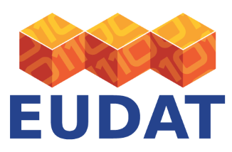
Contact
EUDAT
Web – eudat.eu
Twitter - @EUDAT_EU
Javier Jiménez
Alberto Vela-Martín
Aeronautics, U. Politécnica
Madrid, Spain
jimenez@torroja.dmt.upm.es
alberto@torroja.dmt.upm.es

