Slide 1
Enriching Europeana Newspapers Data Pilot EUDAT Comunity on Social Sciences and Humanities

Slide 2
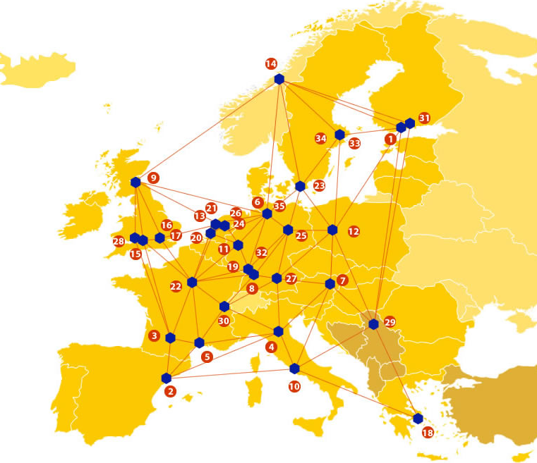
EUDAT: A truly pan-European Infrastructure
EUDAT offers common data services to both research communities and individuals through a network of 35 European organisations.
EUDAT wants to enable European researchers from any discipline to preserve, find, access, and process data in a trusted environment, as part of a Collaborative Data Infrastructure.
European infrastructures
Technology Providers
Research Communities

Slide 3
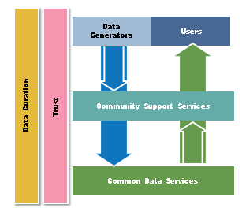
EUDAT Vision & Mission
Vision: Data is shared and preserved across borders and disciplines thereby enhancing the value and quality of research at large.
Mission: To enable data stewardship within and between European Research Communities through a Collaborative Data Infrastructure, a common model and service infrastructure for managing data spanning all European research data centres and community data repositories.

Slide 4
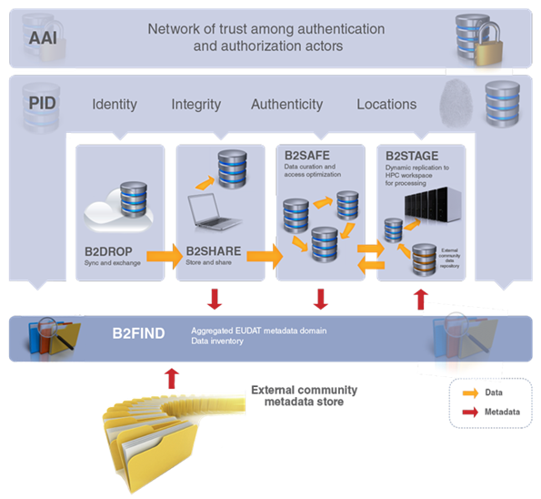
B2 Service Suite
Covering both access and deposit, from informal data sharing to long-term archiving, and addressing identification, discoverability and computability of both long-tail and big data, EUDAT services seek to address the full lifecycle of research data
https://www.eudat.eu/services
Notes:
B2FIND
stores metadata as well through other EUDAT services such as B2SHARE to provide access to data object within the EUDAT CDI
is used in inter-service use cases, e.g. to select links to data to be transferred to HPC platforms through B2STAGE

Slide 5
Building solutions with the communities
EUDAT services (B2 Service Suite) are designed, built and implemented together with user communites.
Common Language Resources and Technology Infrastructure (CLARIN)
European Network for Earth System Modelling (ENES)
Distributed infrastructure for life-science information (ELIXIR)
European Plate Observing System (EPOS) - Solid Earth sciences Research Infrastructure
Integrated Carbon Observation System (ICOS) to quantify & understand greenhouse gas balance
Long-Term Ecosystem Research (LTER) in Europe

Slide 6
Overview of Enriching Europeana Newspapers
The pilot aims to expose the full text aggregated as part of the Europeana Newspapers project.
This corpus contains over 11 million pages of full text of historic newspapers
Mainly from the 19th century
Drawn from national and research libraries across Europe.
The pilot aims to expose and improve the text for more data driven usage)

Slide 7
The Challenges
The Generic Challenge
How to facilitate the re-use of Cultural Heritage language resources for research purposes
… by exploiting the existing and emerging European research infrastructure
How can the resources be discovered
How can the resources be shared in practical ways for researchers
How can advanced computation be applied to these Cultural Heritage datasets
How can the resources and datasets be cited and referenced in research
How can the Cultural Heritage institutions re-use the outcomes of research
The Specific Challenges of the Pilot
Creating best practice guidelines for the publication, citation and impact measurement of cultural heritage data
Enriching the corpus of historic newspapers via information extraction
Showcasing the value of the enrichment by a quantitative analysis
Working collaboratively between cultural heritage organizations and researchers from computer science

Slide 8
Enriching Europeana Pilot: the partners
The European Library/Europeana Foundation
Centrum Wiskunde & Informatica
Staatsbibliothek zu Berlin – Preußischer Kulturbesitz

Slide 9
Enriching Europeana Pilot
Purpose: to expose the existing corpora of historic newspapers created as part of the Europeana Newspapers project, including enrichments of these corpora in the form of detected topics and named entities.
Pilot’s activities:
Publishing the historic newspapers full text corpus via the EUDAT infrastructure
Creating best practice guidelines for the publication, citation and impact measurement of cultural heritage data.
Enriching the dataset, via the automatic extraction of topics and named entities
Showcasing the value of the enrichment by a quantitative analysis of the occurrence of topics/entities over time and across borders.

Slide 10
EUDAT service uptake
The Enriching Europeana Newspaper Pilot will rely on the following EUDAT services:
Research data storage and sharing (B2SHARE): as to undertake the enrichment of the datasets as well as, more generally, expose them for re-use by other academics, particularly those outside the digital humanities
Persistent Identification Service (B2HANDLE): Persistent identification of the main objects of the full-text corpus: the newspapers titles and individual issues
Multi-disciplinary joint metadata catalogue (B2FIND): so that scientists will be able to
obtain the full corpus for machine processing
select just a portion of the corpus benefitting from the enrichment of article-level annotations with named entities and topics

Slide 11
For additional information
http://www.eudat.eu/
Nuno Freire, Europeana Foundation/The European Library nfreire@gmail.com
Clemens Neudecker, Staatsbibliothek zu Berlin, Clemens.Neudecker@sbb.spk-berlin.de

