Slide 1
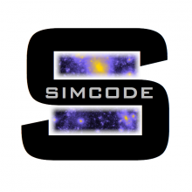
SIMCODE-DS

Slide 2
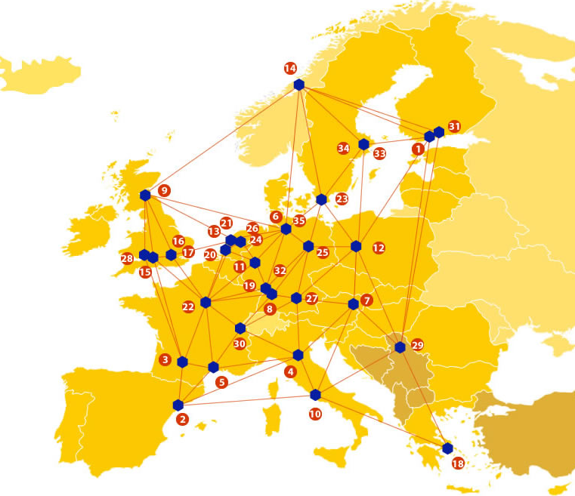
EUDAT: A truly pan-European Infrastructure
EUDAT offers common data services to both research communities and individuals through a network of 35 European organisations.
EUDAT wants to enable European researchers from any discipline to preserve, find, access, and process data in a trusted environment, as part of a Collaborative Data Infrastructure.
European infrastructures
Technology Providers
Research Communities

Slide 3
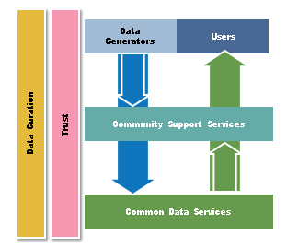
EUDAT Vision & Mission
Vision: Data is shared and preserved across borders and disciplines thereby enhancing the value and quality of research at large.
Mission: To enable data stewardship within and between European Research Communities through a Collaborative Data Infrastructure, a common model and service infrastructure for managing data spanning all European research data centres and community data repositories.

Slide 4
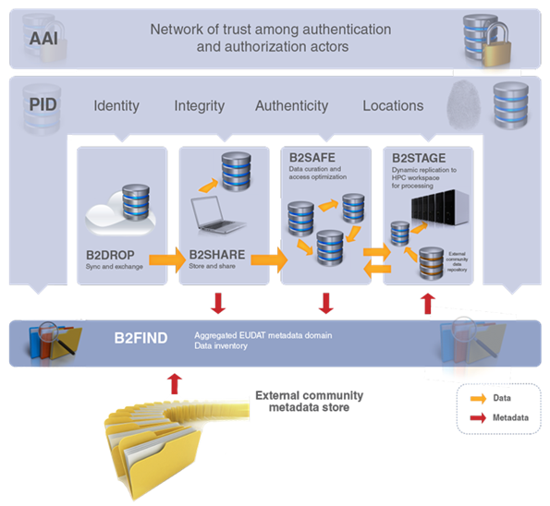
B2 Service Suite
Covering both access and deposit, from informal data sharing to long-term archiving, and addressing identification, discoverability and computability of both long-tail and big data, EUDAT services seek to address the full lifecycle of research data
https://www.eudat.eu/services
Notes:
B2FIND
stores metadata as well through other EUDAT services such as B2SHARE to provide access to data object within the EUDAT CDI
is used in inter-service use cases, e.g. to select links to data to be transferred to HPC platforms through B2STAGE

Slide 5
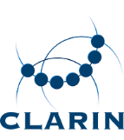
Building solutions with the communities
EUDAT services (B2 Service Suite) are designed, built and implemented together with user communites.
Common Language Resources and Technology Infrastructure (CLARIN)
European Network for Earth System Modelling (ENES)
Distributed infrastructure for life-science information (ELIXIR)
European Plate Observing System (EPOS) - Solid Earth sciences Research Infrastructure
Integrated Carbon Observation System (ICOS) to quantify & understand greenhouse gas balance
Long-Term Ecosystem Research (LTER) in Europe

Slide 6
The Challenge
High-quality data produced will require a large number of cosmological simulations, the community will face in the next years a serious issue of big data storage and sharing.
The main limitation will be determined by data handling rather than by computational resources.
The main idea behind the project is that various types of simulations can be safely stored on a central long term repository and their content made easily available through metadata and indexing procedures to the community at large

Slide 7
Pilot Overview
The SIMCODE-DS project deals with the need of high resolution simulations in view of the advent of what is known as the epoch of “Precision Cosmology”.
The latter term indicates the huge quality leap in the accuracy of observational data expected for the next decade (mostly through large galaxy surveys as the European satellite mission Euclid) that will allow tests of the cosmological model to percent precision.

Slide 8
EUDAT Service Uptake
Repository for shareable digital objects
Data replication and long term preservation
Long-term data storage, data handling and indexing, and data sharing over broad communities of users.
Storage provided by supercomputing infrastructures is getting progressively less suitable for this purpose as data size increases since the scratch areas of computing clusters need to be periodically cleaned up to leave room for running applications.
This makes it always a struggle to “park” finished simulations in a safe place where they can reside for a sufficiently long time to allow a full exploitation and a thorough post-processing analysis.

Slide 9
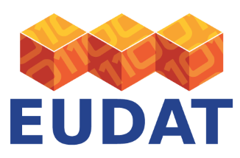
Contact
EUDAT
Web – eudat.eu
Twitter - @EUDAT_EU
PI: Marco Baldi
(marco.baldi5@unibo.it)
Presenter: Matteo Nori
(matteo.nori3@unibo.it)
Physics and Astronomy Department
Bologna University

