Slide 1
EUDAT
Services
Mark van de Sanden, EUDAT Service Manager
EUDAT User Meeting, 22-23 June 2016
Barcelona

Slide 2

History of the EUDAT CDI
Common Services for heterogeneous communities
  Science data rates are exploding and will likely become continue to do so
  Building bespoke services for new communities is not cost effective
Initial Set of Services developed as result of community needs
  Beyond the original ‘core’ communities
  New services and specific community issues highlighted
Notes:
Not just ‘big’ experiments such as LHC and SKA, but the number of communities

Slide 3
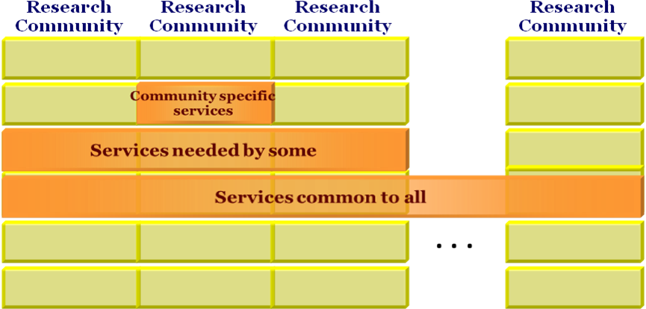
If there are hundreds of Research Infrastructures, how many different data management systems can be sustained?
www.eudat.eu
3

Slide 4
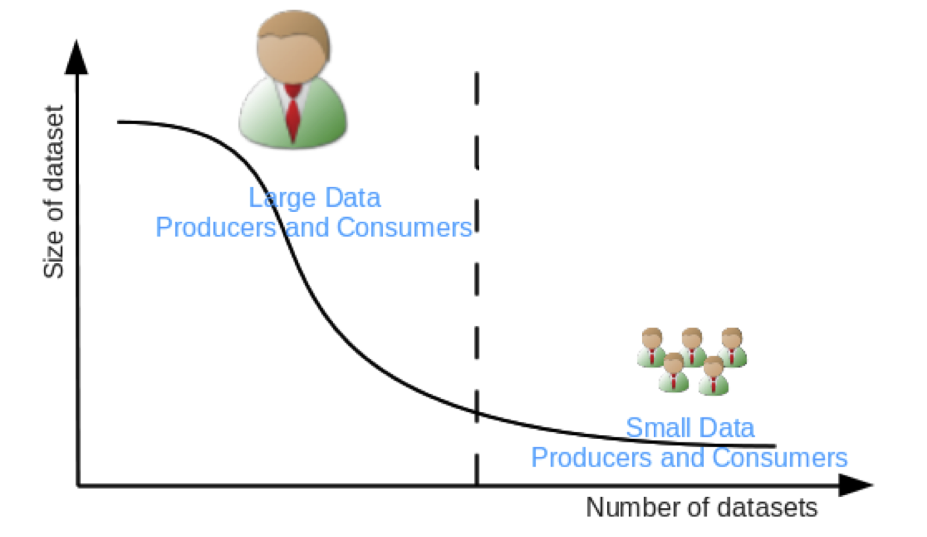

Where Does EUDAT Fit In?
Scientists personal data
Homeless scientists
Citizen scientists
Community repositories
Institute repositories
Notes:
Into the data model

Slide 5

Where Does EUDAT Fit In?
User functionalities, data capture & transfer, virtual research environments
Data
Generators
Users
Data discovery & navigation, workflow generation, annotation, interpretability
Data Curation
Community Support Services
Trust
Persistent storage, identification, authenticity, workflow execution, mining
Common Data Services
Notes:
Diagram based on High Level Expert Group (HLEG) on Scientific Data

Slide 6
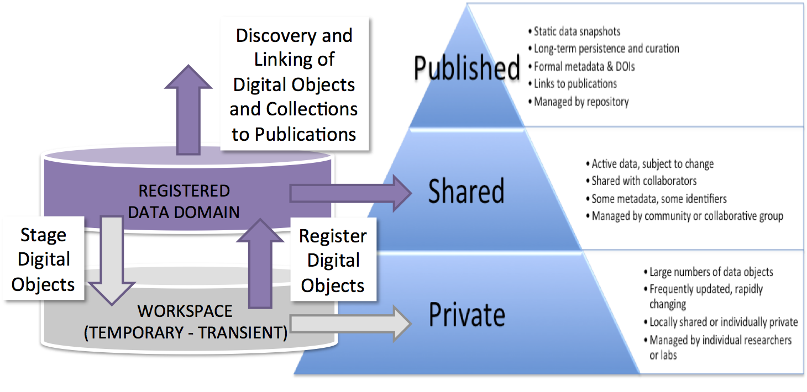
EUDAT Data Domain
EUDAT Data Domain modeled on the ANDS¹ Data Curation Continiuum
1. Australian National Data Service organization – www.ands.org.au

Slide 7

EUDAT Collaborative Data Infrastructure
EUDAT generic data service provider storage, workflows, processing, archive
deposit
Community Repositories
(thematic data centres)
access
deposit

Slide 8



Who can use EUDAT service
Single researcher
Team
Community
Upload and download
Upload, add metadata, share
Periodic transfers, quality checks …
Different strategies for different usage scenarios

Slide 9

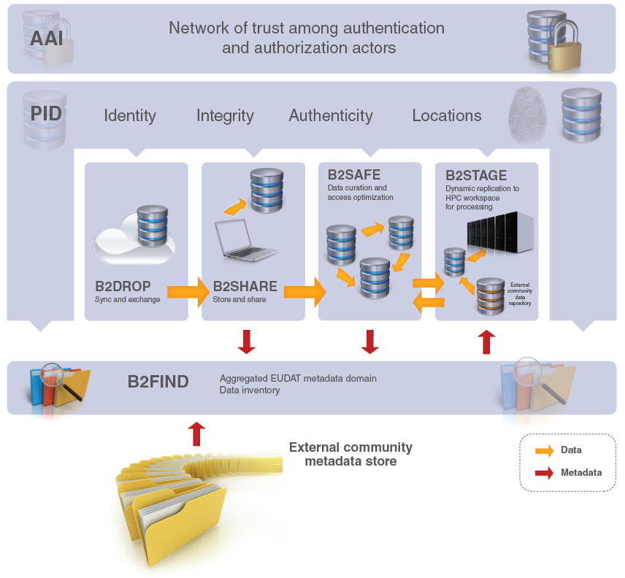






B2 Service Suite
B2ACCESS
B2Handle

Slide 10

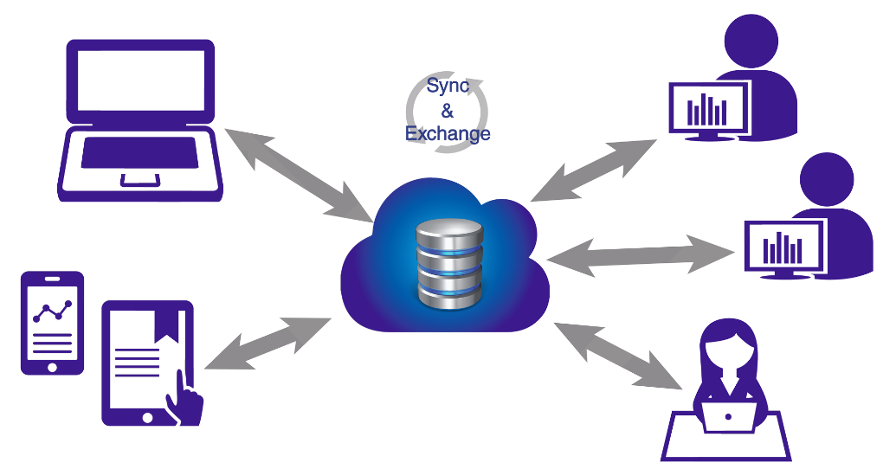
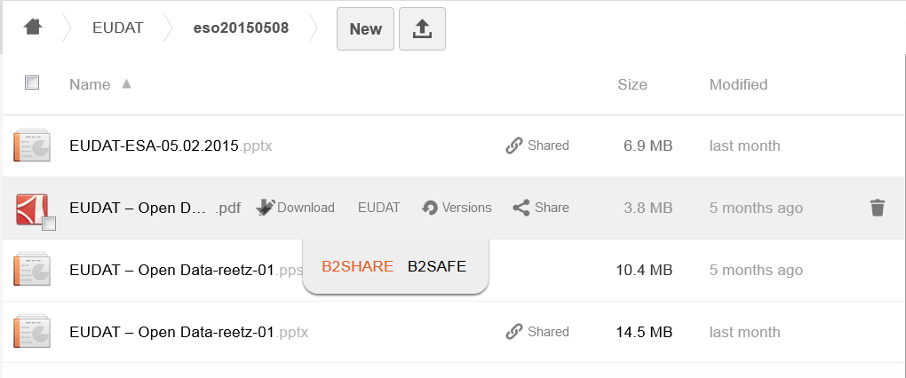


Who
  Citizens Scientists and small teams
What
  Store and exchange data
  Synchronize multiple versions
  Ensure automatic desktop synchronization
Why
  Ease of Use
  Trusted European Service
EUDAT2020
Further integration with EUDAT CDI (e.g. B2SHARE)
Integration with B2ACCESS to enable access by many different Identity Providers
Cloud Storage Federation, collaboration with GEANT in OpenCloudMesh
Assess B2DROP as workspace area to computing facilities
Notes:
Based on ownCloud, open source (GNU AGPLv3)
access and manage permissions to files from any device and any location, via browser, desktop, mobile apps and WebDAV
up to 20GB of storage space for research data
simple to use and open to all researchers, scientists (e.g. self-registration)
synchronize and exchange data with one or multiple users
users decide with whom to exchange data, for how long and how

Slide 11
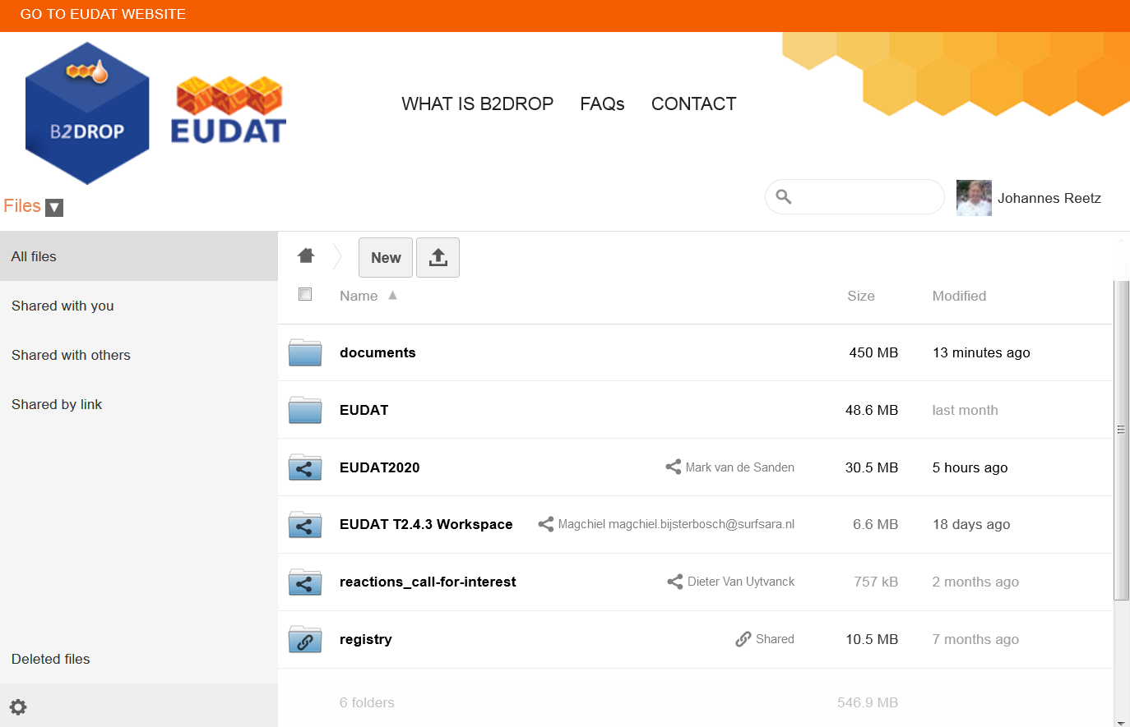

Slide 12
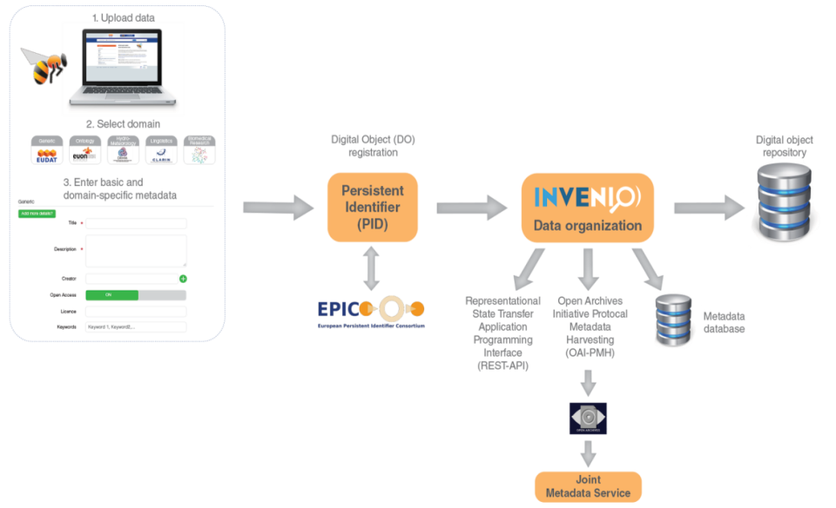
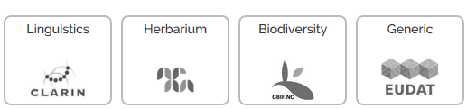
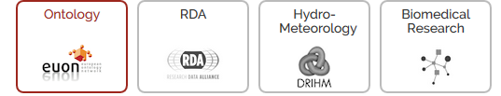
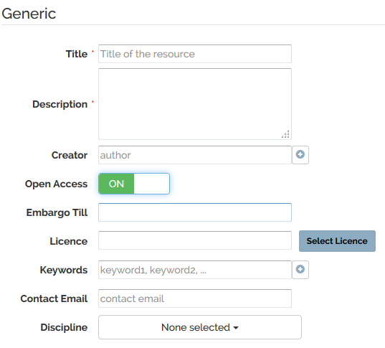
Who
  Small to Medium Teams
What
  Store data (incl. software) and add domain meta data
  Share registered research data worldwide
  Preserve (small-scale) research data for long-term
Why
  Register Data for Publications
  Make known to wider community
EUDAT2020
Further integration with EUDAT CDI (e.g. B2DROP, B2SAFE)
Integration with B2ACCESS (incl eduGAIN), focus on authorization
Embargo period
Editing of metadata
Data versioning and annotation
Extended HTTP Restful API interface
Easy installable software package
Notes:
Based on Invenio, open source (GPL v3)
Supports 8 community-metadata templates
Data assigned a persistent identifier and a checksum
Access via a HTTP Rest API
Open accessible, user self-registration
Data owner defines access policy
Open access license choose feature
Discipline choose feature
Open harvestable metadata, harvested by B2FIND

Slide 13
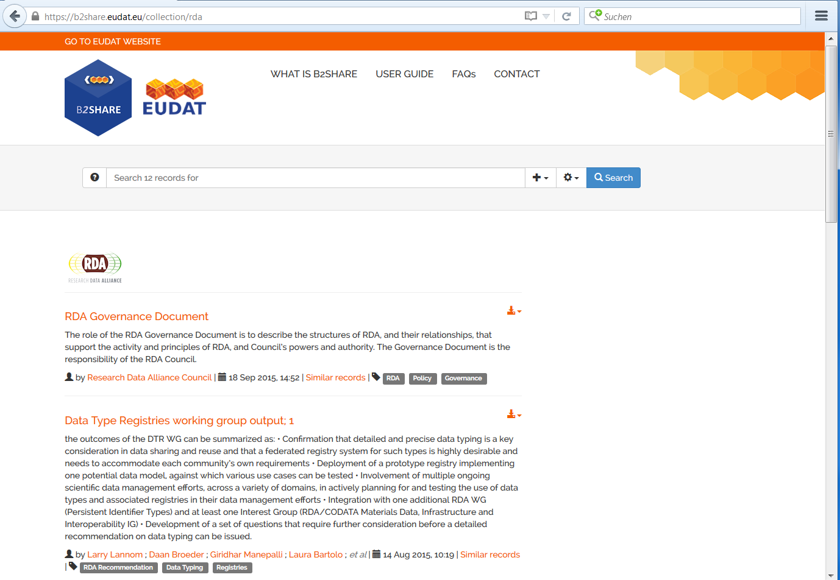
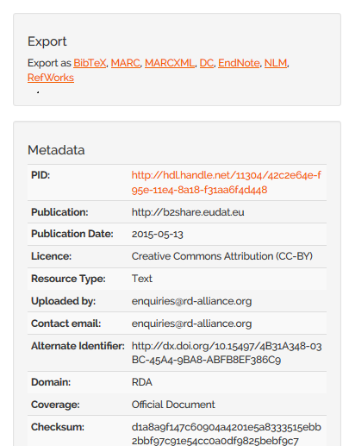
Collection of official RDA documents

Slide 14

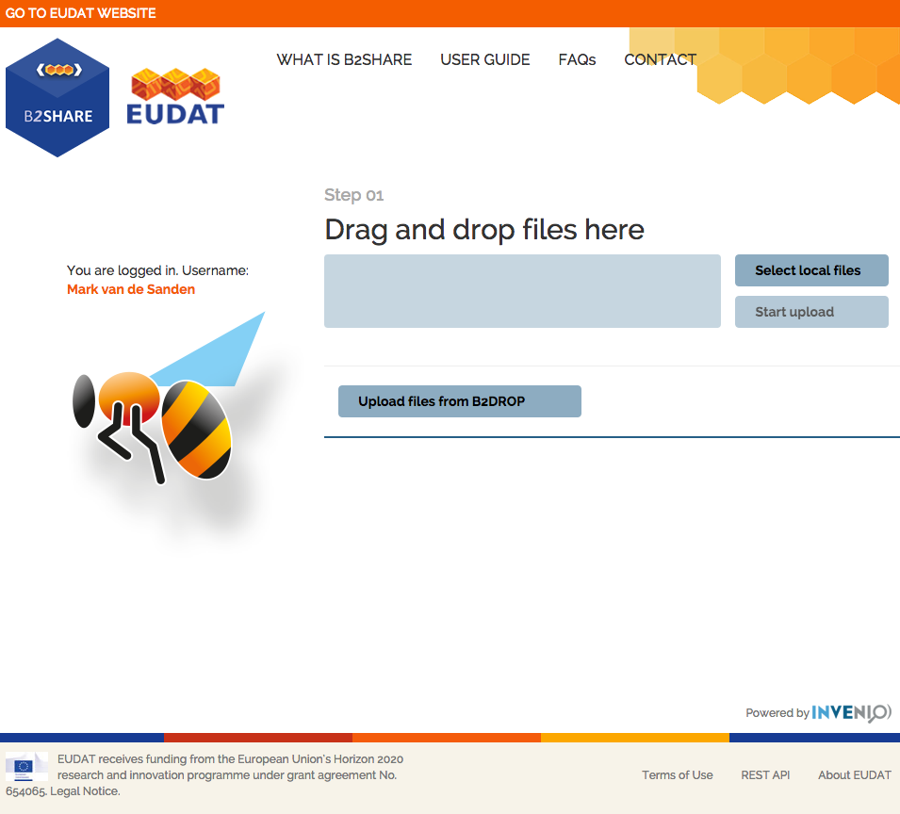
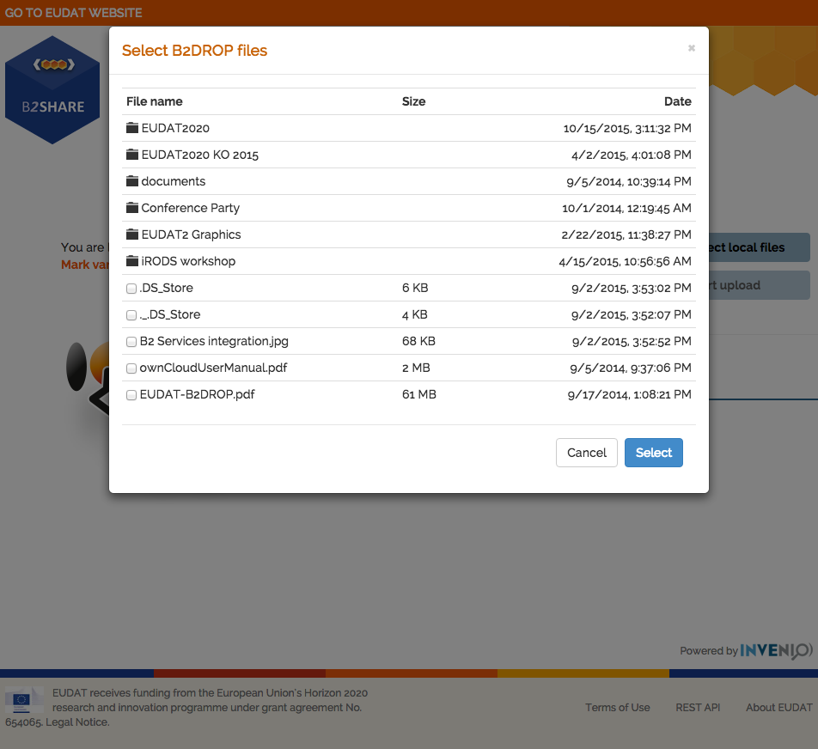
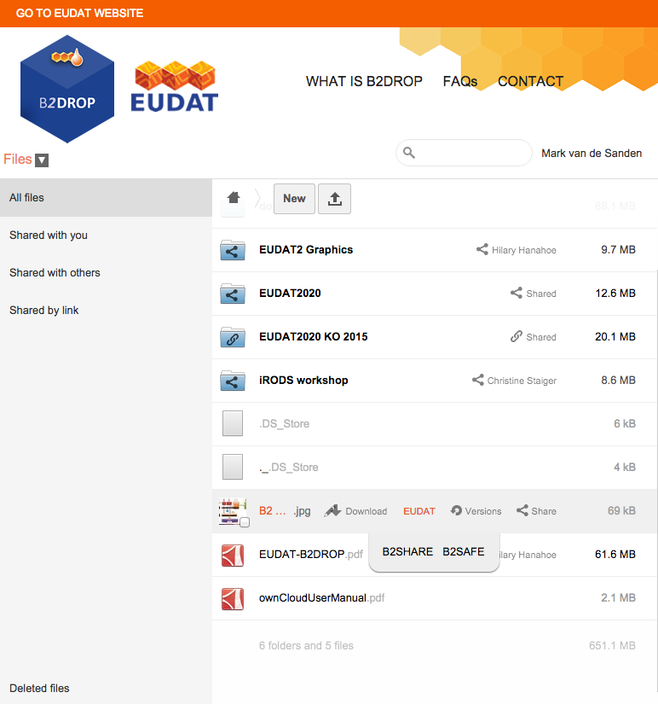
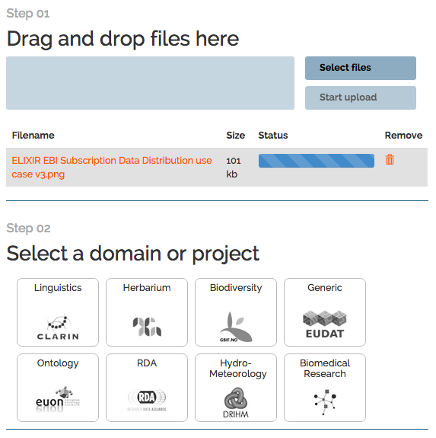
Service Integration
Bidirectional Integration

Slide 15

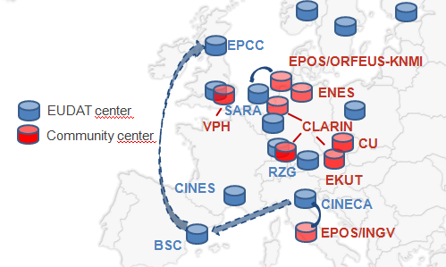
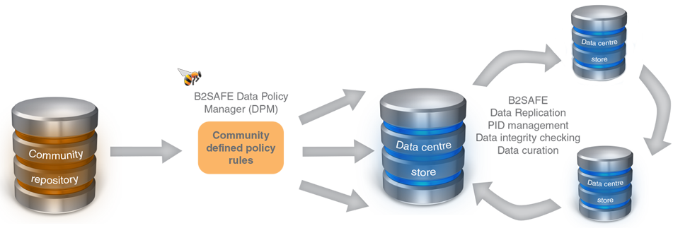
Who
  Community Data Managers
  ‘Sophisticated’ Organisations
What
  Provide an abstraction layer which virtualizes large-scale data resources
  Guard against data loss in long-term archiving and preservation
  Optimize access for users from different regions
  Bring data closer to powerful computers
Why
  Performance
  Replication between trusted sites
  Data Preservation
EUDAT2020
Support iRODS v4
Support metadata
Optimize and extend policies to support data curation and provenance
Further integration with B2ACCESS
Support authorization on basis of community access rules
Assess B2SAFE as workspace area to computing facilities

Slide 16
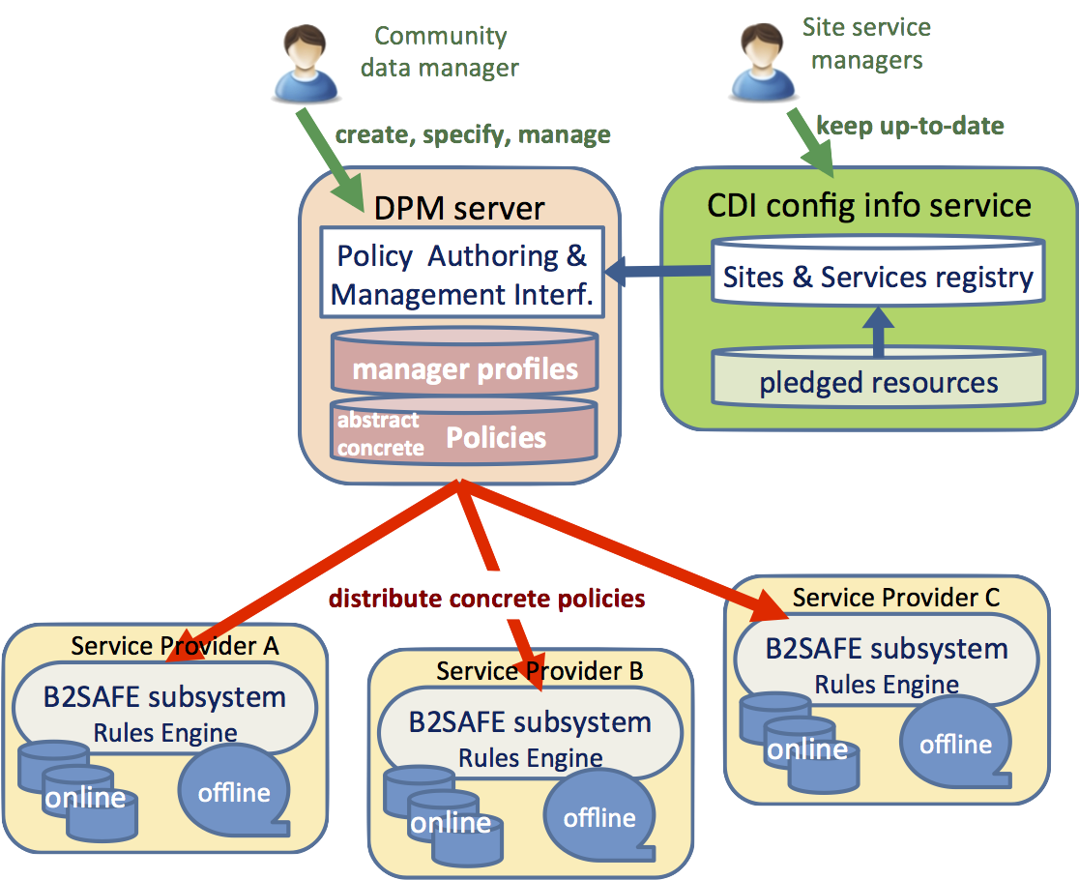
Data Policy Manager
Data policies are centrally managed
Policy rules are implemented and enforced by site-local rule engines
Policies describe in an abstract language
Community data managers must authenticate to provide trust
Support policies for data replication and integrity checking
Central logging for auditable data policies to monitor execution
Active collaboration with the RDA Practical Policy WG
EUDAT2020
Handover to operations
Extend number of policies supported
Focus on data curation and provenance policies
Integrate with B2ACCESS

Slide 17

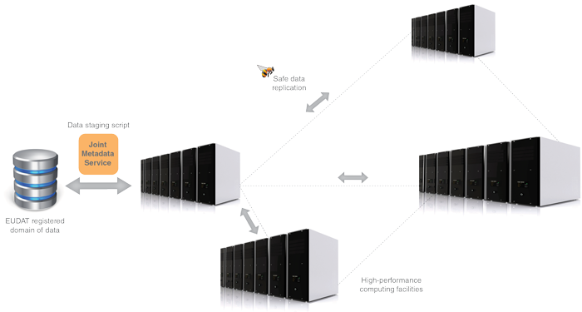
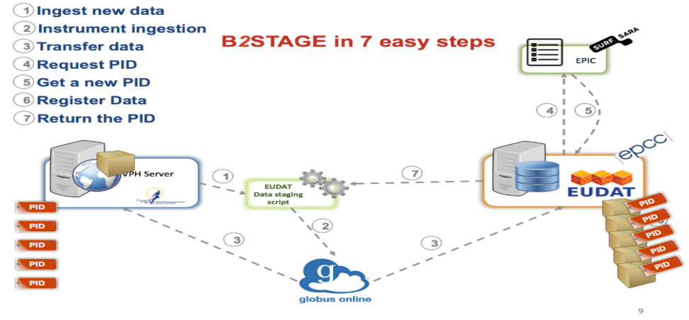
Who
  Users and Communities with Significant Computational Needs
What
  Transfer large data collections from EUDAT storages to external HPC facilities for processing
  Copy large data sets, ingesting them onto EUDAT storage resources
Why
  Integration/Collaboration with PRACE
  Simplify Data Transfer
EUDAT2020
Further develop HTTP to a mature interface and extend functionality to metadata
Native support PIDs within GridFTP transfers
Extend EUDAT client API library to other B2 services (e.g. B2SHARE, B2FIND, PID)
Further integration with B2ACCESS
Notes:
Extension of the B2SAFE and B2FIND services, which allow users to store, preserve and find data
Providing access via GridFTP and basic HTTP
data-staging script facilitates staging, ingestion and retrieval of persistent identifier (PID) information of transferred data
Start development of EUDAT client API library and command line tools
Integrated with EUDAT Federated AAI on basis of X.509 certificates

Slide 18

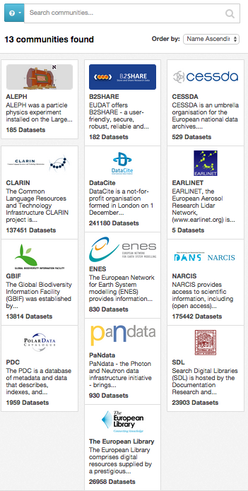
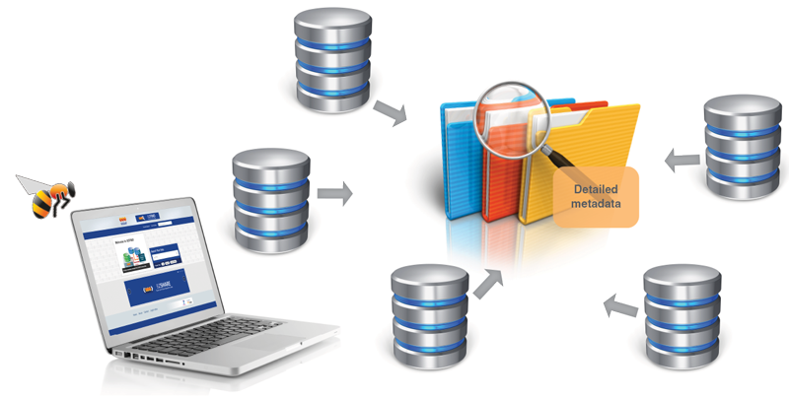
Who
  Anyone
What
  Find collections of scientific data quickly and easily, irrespective of their origin, discipline or community
  Get quick overviews of available data
  Browse through collections using standardized facets
Why
  Unique collection
  Ease of Searching
EUDAT2020
Harvesting of metadata stored in B2SAFE
Community customizations
Annotation of datasets
Further assess RDF and Linked Data
Further assess scalability and performance
Notes:
On the EUDAT1, MDTF/B2FIND community wiki page, 15 additional community repository services are planned or in enabling phase.
At the developers workshop Heinrich and Yann Le Franc talked about the the integration of the B2NOTE service with B2FIND.
Based on CKAN, open source (GNU AGPL v3)
Facetted search (e.g. 10 facets) and full text search, recently added timeline search
Focus on community recommended metadata
13 community repositories harvested, more lined up
Open accessible, no registration needed
Open harvestable metadata
Searchable via Web-based GUI and HTTP RESTful API

Slide 19
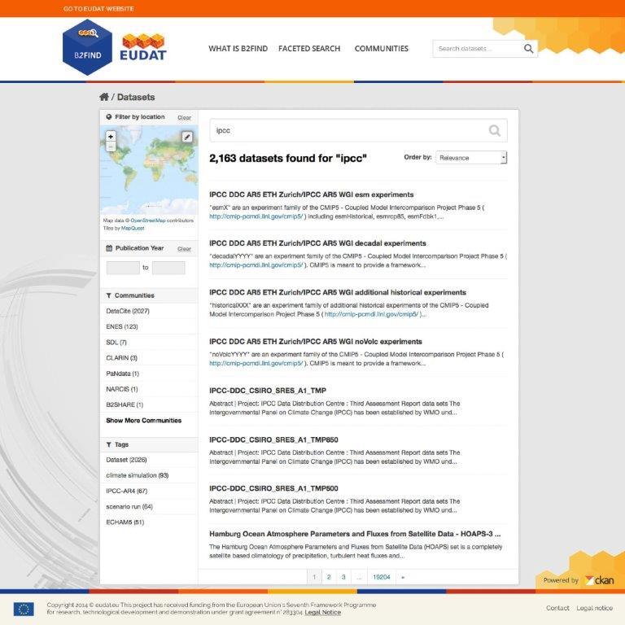
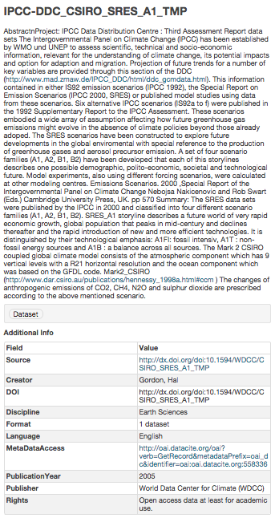

Slide 20
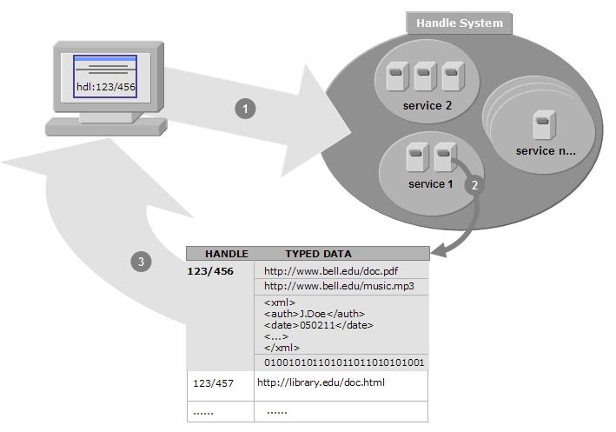
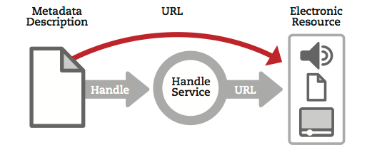
Who
  Groups or Communities who want to make their data citable
What
  Follows policies to register data and make it long term refer- and citable
  Reliability through mutual PID mirroring
  Provides abstraction layer between a globally unique persistent identifier and physical location of data objects
  Machine readable via HTTP RESTful API
Why
  Simple integration
  Technology Agnostic
Development plan
Develop the policies for the B2HANDLE service (e.g. PID namespace mngmt)
Migrate service from Handle v7 to v8
Harmonizing PID record structure
Integrate with Data Type Registry service
B2HANDLE API library
Consolidation with EUDAT API library

Slide 21

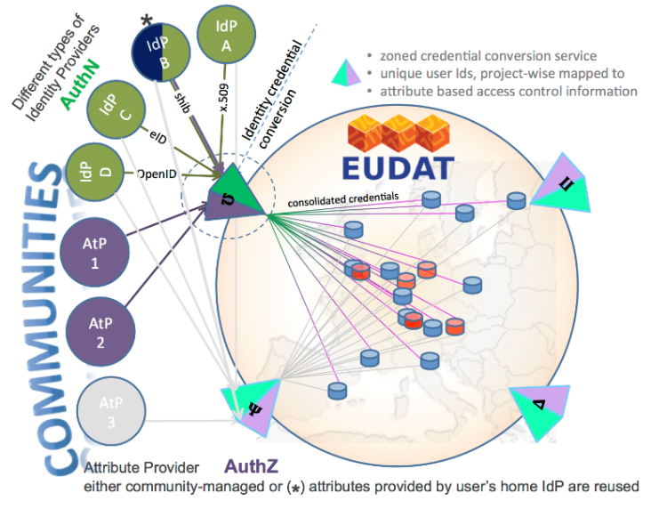
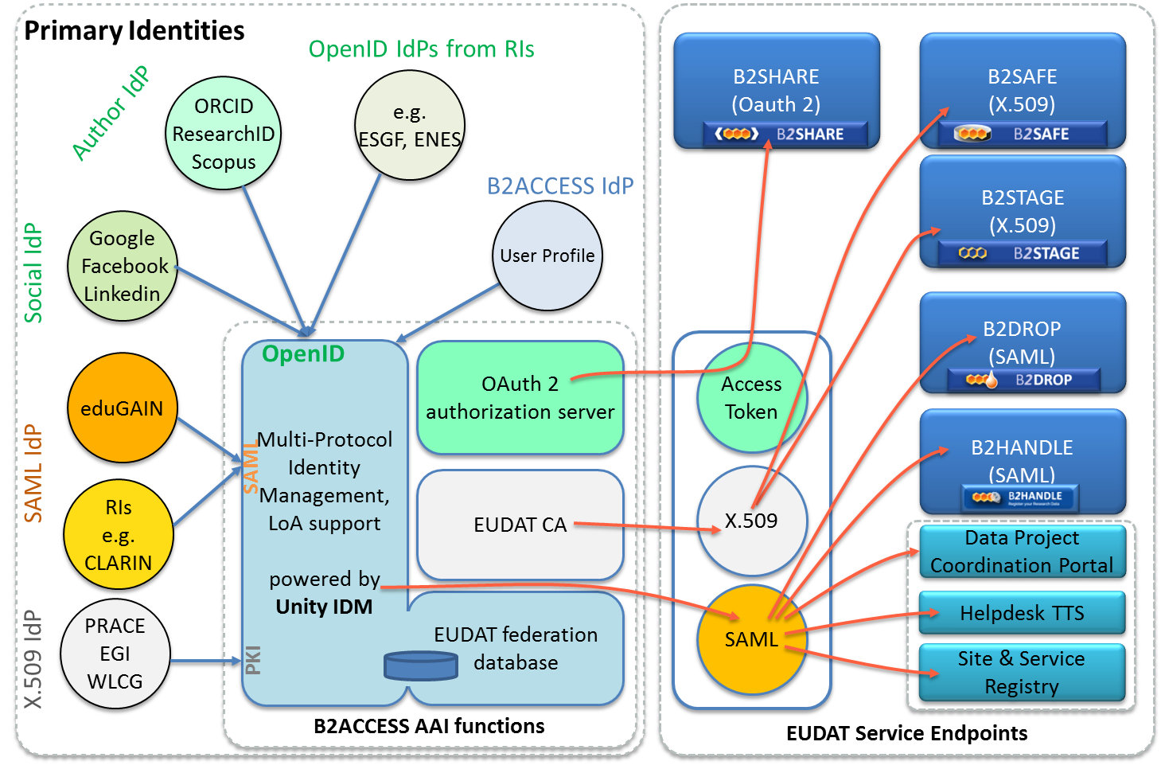
Who
  Anyone wanting to use the B2 Services
What
  Complies with community ownerships and access rights, basis of trust
  Credential conversion approach (e.g. SAML, OpenID, X.509, Username/password)
  Identity provider for citizen scientists
Why
  Use your own ID in federated environment
EUDAT2020
Integration with operational and B2 services
B2SHARE B2DROP B2STAGE
B2SAFE DPM CREG
HTTP API GRIDFTP
Integration with community IdP domains and portal environments
Enabling access via eduGAIN Social IdPs ORCID
Focus on authorization

Slide 22
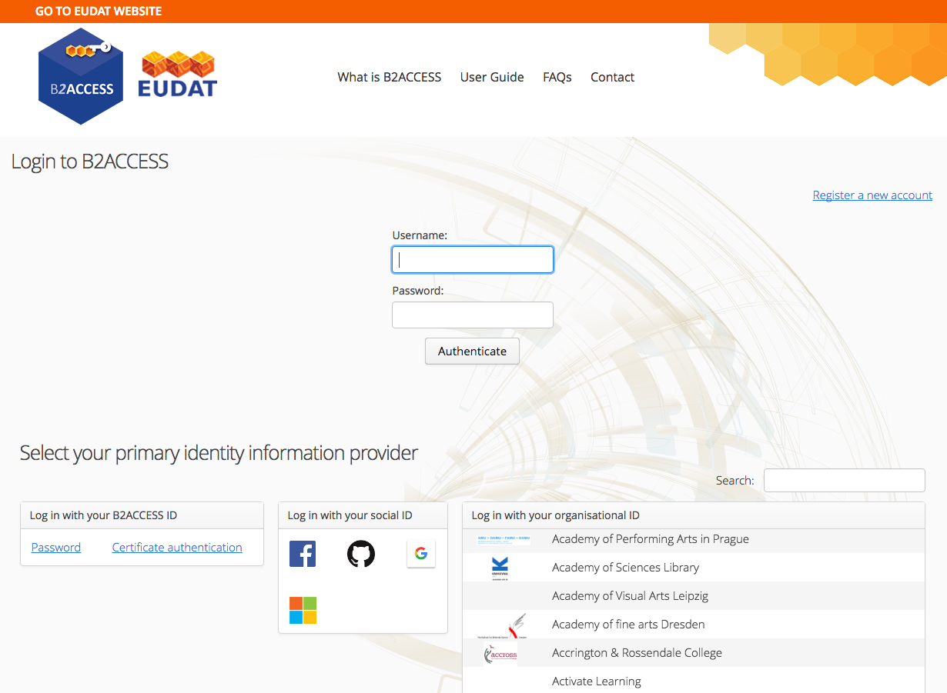
Notes:
B2ACCESS

Slide 23



New Services in Development

Slide 24
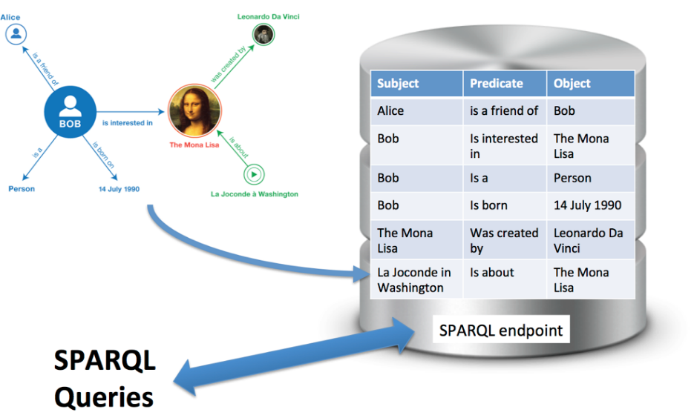
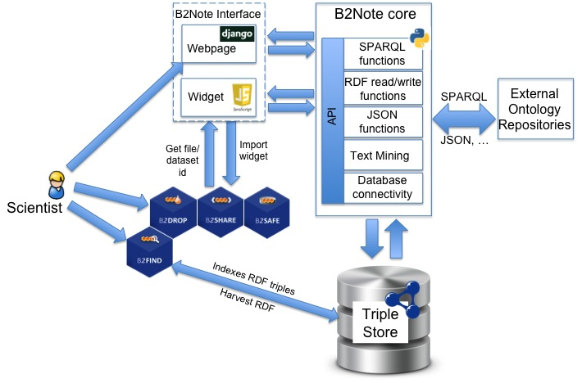
Features
Creation RDF triples
Harvests information from ontology repositories
Supports semi-automatic annotation using text mining
Supports manual data annotation
Easy to use user interface
Integrates with the different B2 services
Development plan
UI for manual annotation, initial focus on annotation of metadata
Setup and test Triple store
Develop harvesting chain for ontologies
Integration with B2SHARE and B2FIND
Assess the use of Graph technologies
24

Slide 25
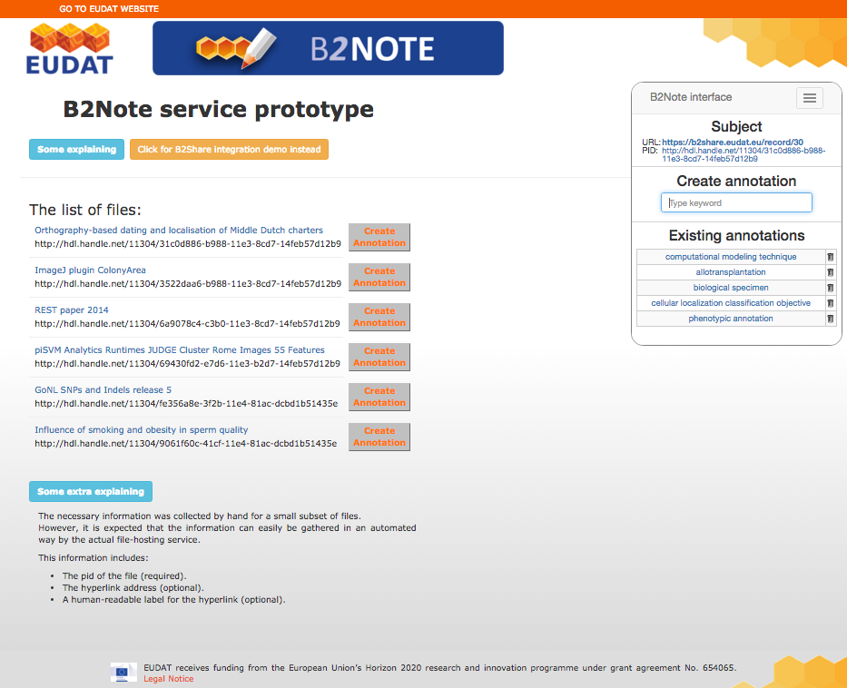

Slide 26
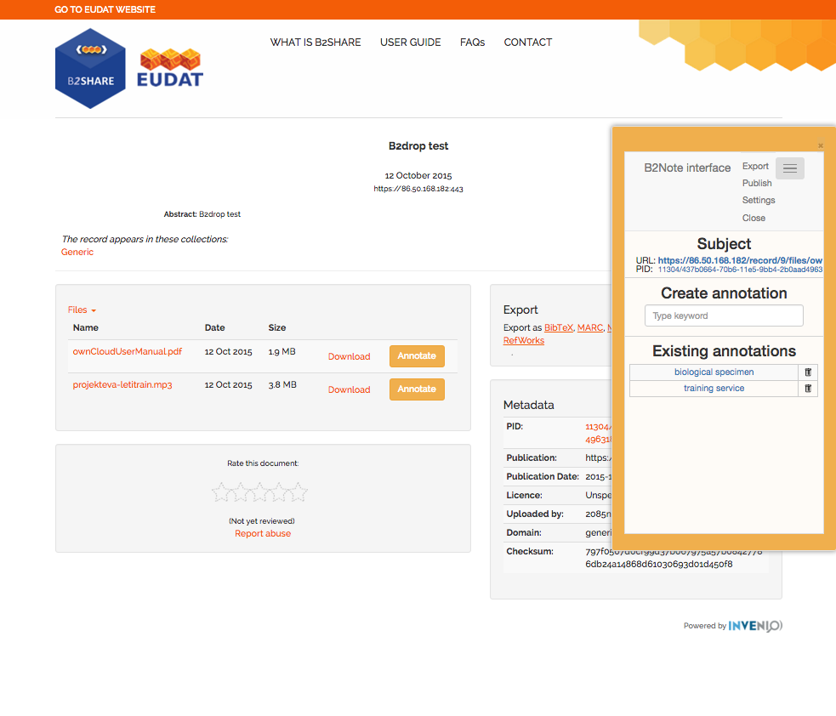
Service Integration

Slide 27

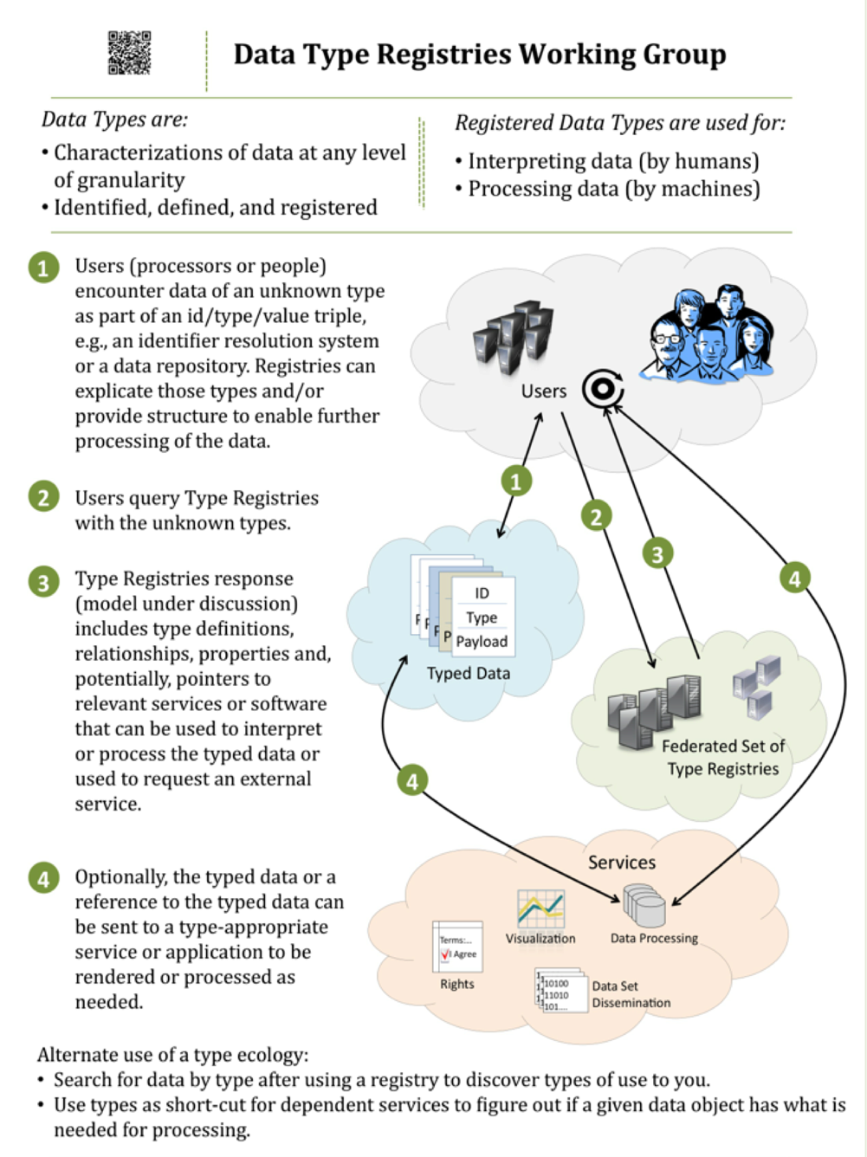
Requirements
Registration of data type and metadata definitions
Provide persistent references
Human and machine interpretable
Integratable within community infrastructure and services
Integratable within the EUDAT CDI
Easy to use HTTP API interface
Development plan
Uptake of RDA output
Assessment of the CNRI Cordra technology
Provide test instance to evaluate usage with communities
Define EUDAT PID and metadata structures according to DTR
Integration with B2 services (e.g. B2SHARE, B2FIND, PID)
27

Slide 28
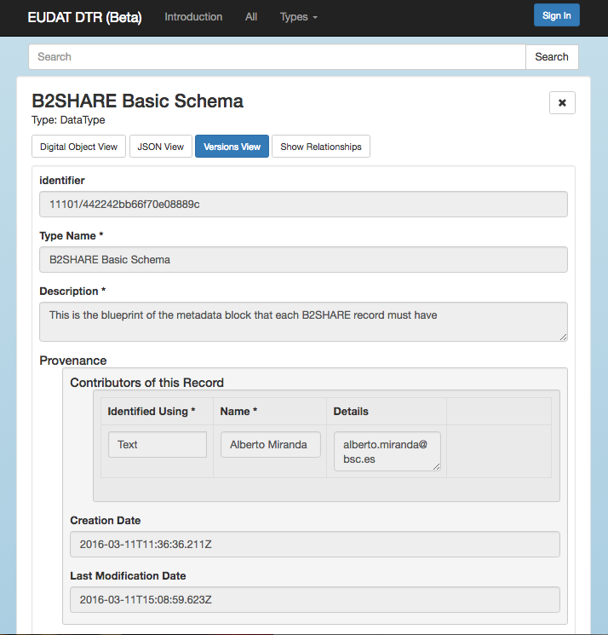
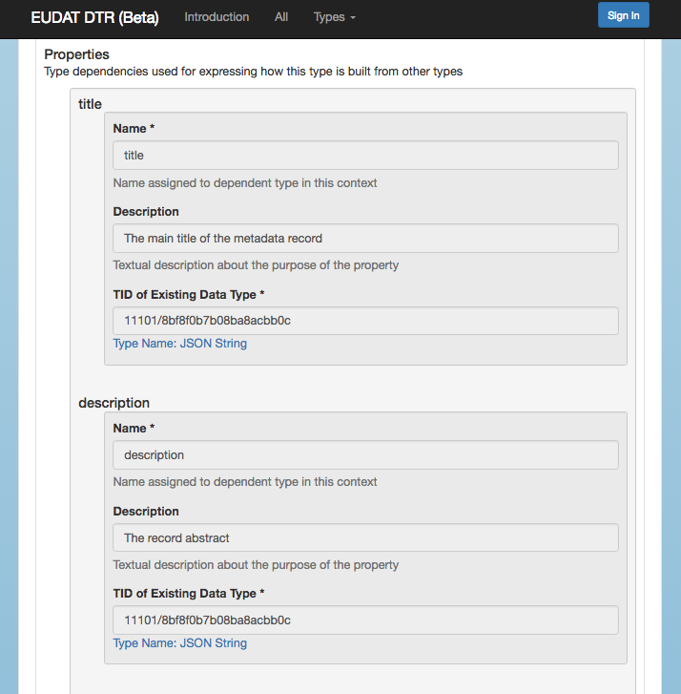

Slide 29

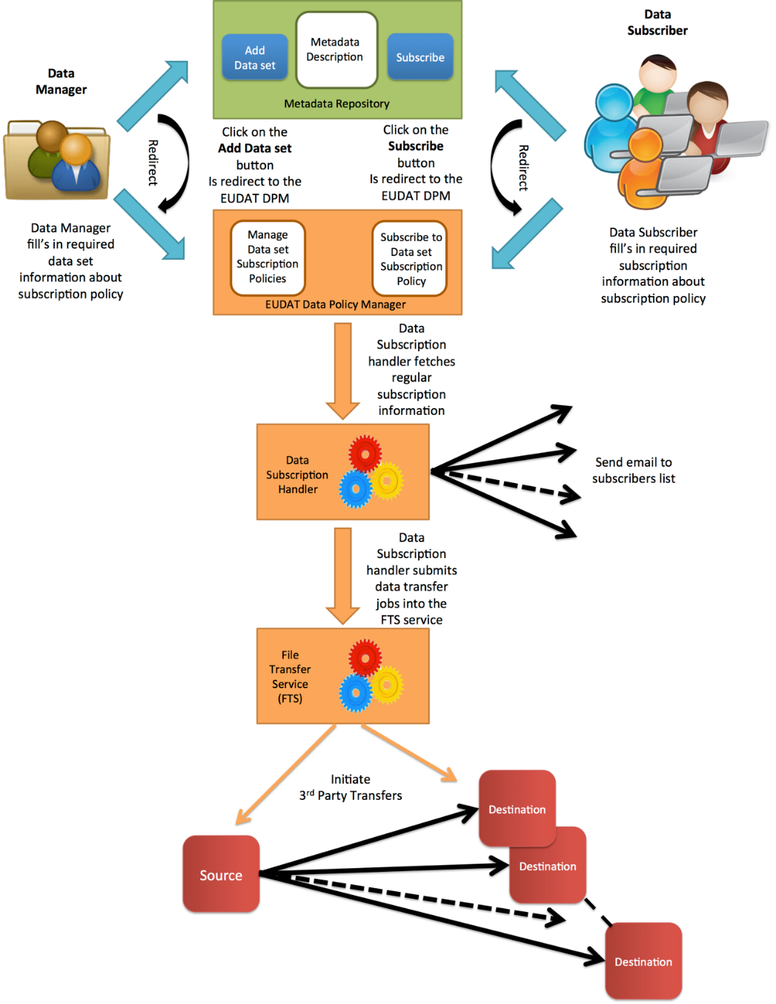
Use Case
Comes from ELIXIR and Euro/Argo, solution must be generic
Automatic (re-)distribution of updatable data to data storage providers
Data storage providers are inside and outside the EUDAT CDI domain
Data owner must be able to mark data as subscribeable
Data storage providers and individual users must be able to subscribe to data
Data transfers and notifications are triggered by metadata updates
Development plan
Evaluate FTSv3 service for data distributions
Assessing subscription policy within B2SAFE DPM service
Integration of subscription mechanism within metadata repository
Assess technologies for subscription processing
29

Slide 30

Questions…

