Slide 1
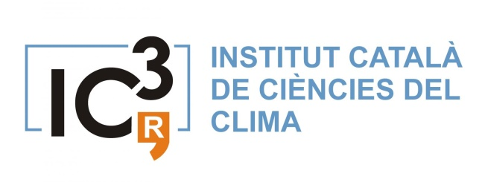
Support to scientific research on seasonal-to-decadal climate and air quality modelling

Slide 2
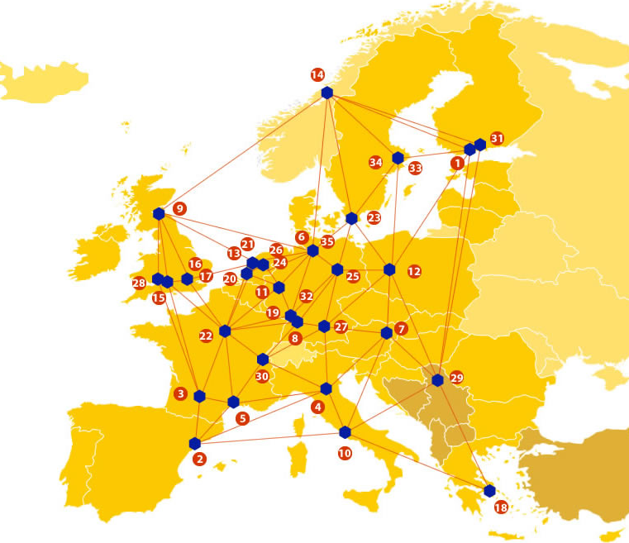
EUDAT: A truly pan-European Infrastructure
EUDAT offers common data services to both research communities and individuals through a network of 35 European organisations.
EUDAT wants to enable European researchers from any discipline to preserve, find, access, and process data in a trusted environment, as part of a Collaborative Data Infrastructure.
European infrastructures
Technology Providers
Research Communities

Slide 3
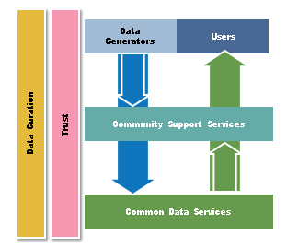
EUDAT Vision & Mission
The vision: Data is shared and preserved across borders and disciplines thereby enhancing the value and quality of research at large.
The mission: To enable data stewardship within and between European Research Communities through a Collaborative Data Infrastructure, a common model and service infrastructure for managing data spanning all European research data centres and community data repositories.

Slide 4
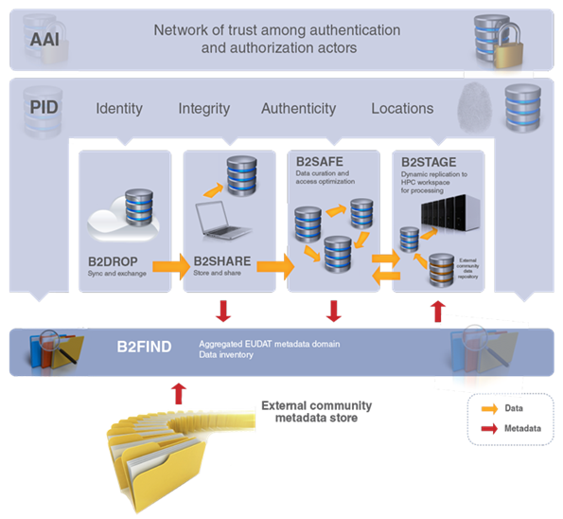
B2 Service Suite
Covering both access and deposit, from informal data sharing to long-term archiving, and addressing identification, discoverability and computability of both long-tail and big data, EUDAT services seek to address the full lifecycle of research data
https://www.eudat.eu/services
Notes:
B2FIND
stores metadata as well through other EUDAT services such as B2SHARE to provide access to data object within the EUDAT CDI
is used in inter-service use cases, e.g. to select links to data to be transferred to HPC platforms through B2STAGE

Slide 5
Building solutions with the communities
EUDAT services (B2 Service Suite) are designed, built and implemented together with user communites.
Common Language Resources and Technology Infrastructure (CLARIN)
European Network for Earth System Modelling (ENES)
Distributed infrastructure for life-science information (ELIXIR)
European Plate Observing System (EPOS) - Solid Earth sciences Research Infrastructure
Integrated Carbon Observation System (ICOS) to quantify & understand greenhouse gas balance
Long-Term Ecosystem Research (LTER) in Europe

Slide 6
The Challenge
There is a need to cope with an exponential growth in the volume of data for example, one year of a typical experiment can occupy 1TB, knowing that in a climate experiment, hundreds of years are simulated for each experiment.
The data then needs to be shared across 30+ research institutes across the world. Sharing and multiple transfer of the data is a huge technical challenge
The challenge of indexing the data and making it discoverable is also a difficulty for scientists due to the sheer amount of data produced

Slide 7
Pilot Overview
The aim is to “better simulate” climate change at seasonal to decadal time scale and forecast air quality using both existing and locally developed models EC-Earth (global circulation model, GCM) and NMMB-BSC (air quality model).
By “better simulate” it means to make better use of the huge amount of data generated by the models.
That includes data transfer between the different research institutes using the data that are disseminated all over the world, but also curation, and data discovery on portals where different projects store their data.

Slide 8
EUDAT Service Uptake
Secure and trusted cloud storage – Will allow the data to be centralised increasing the velocity of data transfer
Data staging service – enabling offline diagnostics to be carried out where intensive computations are required.
Multi-disciplinary joint metadata catalogue – enabling our scientists to locate the specific data they require through this service.

Slide 9
Contact Information
Pierre-Antoine Bretonnière-
pierre-antoine.bretonniere@bsc.es
Francesco Benincasa IC3-BSC - Spain
francesco.benincasa@bsc.es
http://www.eudat.eu/
www.eudat.eu/communities/support-to-scientific-research-on-seasonal-to-decadal-climate-and-air-quality-modelling

