Slide 1
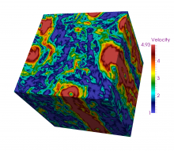
TURBASE-DNS: A DATA BASE OF DIRECT NUMERICAL SIMULATIONS OF TURBULENT FLOWS

Slide 2
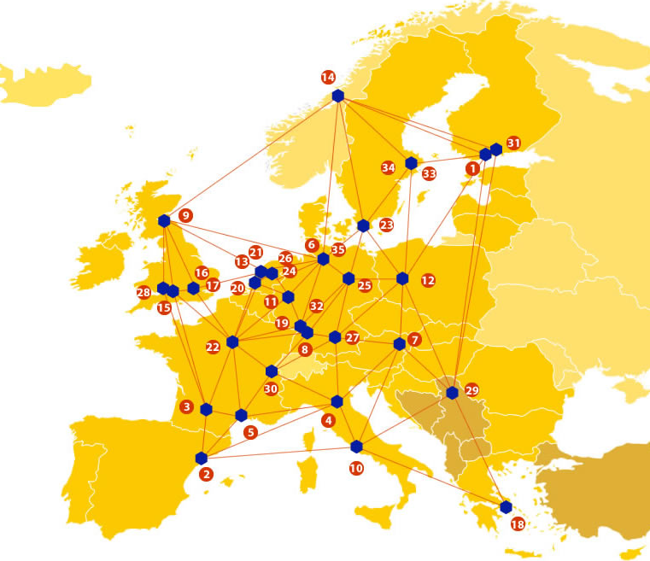
EUDAT: A truly pan-European Infrastructure
EUDAT offers common data services to both research communities and individuals through a network of 35 European organisations.
EUDAT wants to enable European researchers from any discipline to preserve, find, access, and process data in a trusted environment, as part of a Collaborative Data Infrastructure.
European infrastructures
Technology Providers
Research Communities

Slide 3
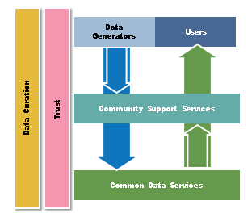
EUDAT Vision & Mission
Vision: Data is shared and preserved across borders and disciplines thereby enhancing the value and quality of research at large.
Mission: To enable data stewardship within and between European Research Communities through a Collaborative Data Infrastructure, a common model and service infrastructure for managing data spanning all European research data centres and community data repositories.

Slide 4
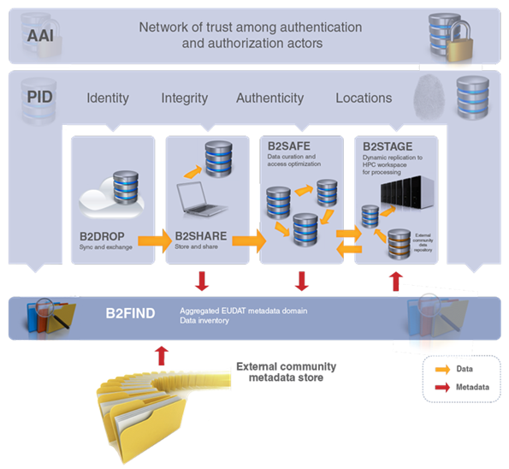
B2 Service Suite
Covering both access and deposit, from informal data sharing to long-term archiving, and addressing identification, discoverability and computability of both long-tail and big data, EUDAT services seek to address the full lifecycle of research data
https://www.eudat.eu/services
Notes:
B2FIND
stores metadata as well through other EUDAT services such as B2SHARE to provide access to data object within the EUDAT CDI
is used in inter-service use cases, e.g. to select links to data to be transferred to HPC platforms through B2STAGE

Slide 5
Building solutions with the communities
EUDAT services (B2 Service Suite) are designed, built and implemented together with user communites.
Common Language Resources and Technology Infrastructure (CLARIN)
European Network for Earth System Modelling (ENES)
Distributed infrastructure for life-science information (ELIXIR)
European Plate Observing System (EPOS) - Solid Earth sciences Research Infrastructure
Integrated Carbon Observation System (ICOS) to quantify & understand greenhouse gas balance
Long-Term Ecosystem Research (LTER) in Europe

Slide 6
The Challenge
The Computational Fluid Dynamics (CFD) community is facing more and more the problem of data preservation, data standardization and data analysis.
It is therefore mandatory to develop user friendly supports and optimal interfaces to make the data available and useful for a long period of time.
The availability of these large data sets is potentially crucial for a much wider audience of theoretical and applied scientists working in different cross-disciplinary domains, who do not intend --or cannot do—numerical simulations on their own.

Slide 7
Pilot Overview
Our project is meant to preserve and standardize a first set of state-of-the-art numerical datasets in computational fluid dynamics.
Data-sets include both Eulerian and Lagrangian data, i.e. snapshot of the velocity field and trajectories of particles affected by the flow.
All data are of potential interest for a vast community of researchers, mostly in Europe and in the USA, in the fields of theoretical physics, geophysics, meteorology, chemical and bio-engineering.

Slide 8
EUDAT Service Uptake
Data staging service - to maintain, analyse and standardize the data produced by several PRACE projects about Rotating Turbulence, Turbulence under Shear, Turbulence at changing the dimension of the embedding Fourier dynamics and micro-control of droplet formation in T- and Y-junctions.
Multi-disciplinary joint metadata catalogue - standardization and classification of the data-sets will produce useful metadata that can be used by B2FIND for correctly/easily browse the data, which will promote the dataset usage among a wider community.
Repository for shareable digital objects - the comparison and standardization will allow us to reach new scientific targets concerning the common physical problems shared by all our numerical applications. to create strongly coherent datasets to be preserved and refined with valuable metadata information

Slide 9
Contact
Luca Biferale¹
luca.biferale@roma2.infn.it
Fabio Bonaccorso¹
fabio.bonaccorso@roma2.infn.it
¹ University of Rome, Tor Vergata & INFN, Rome, Italy
EUDAT
Web – eudat.eu
Twitter - @EUDAT_EU

