Slide 1

EISCAT & EUDAT Collaboration

Slide 2
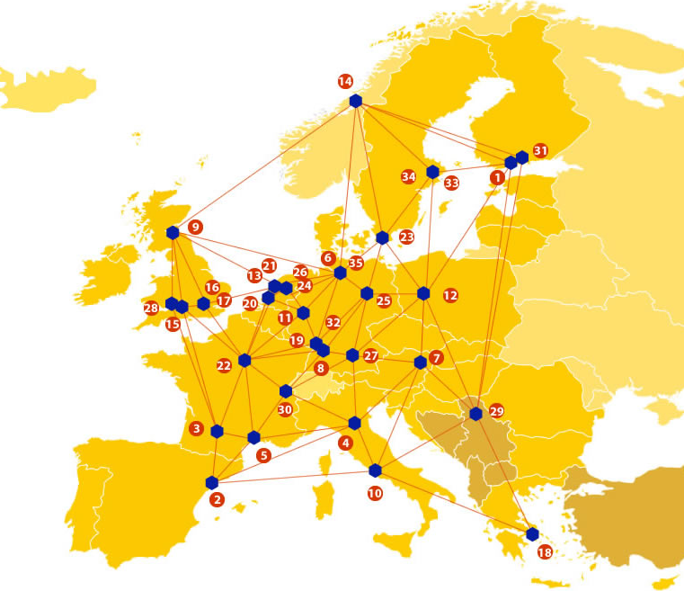

EUDAT: A truly pan-European Infrastructure
EUDAT offers common data services to both research communities and individuals through a network of 35 European organisations.
EUDAT wants to enable European researchers from any discipline to preserve, find, access, and process data in a trusted environment, as part of a Collaborative Data Infrastructure.
European infrastructures
Technology Providers
Research Communities

Slide 3

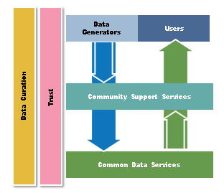
EUDAT Vision & Mission
Vision: Data is shared and preserved across borders and disciplines thereby enhancing the value and quality of research at large.
Mission: To enable data stewardship within and between European Research Communities through a Collaborative Data Infrastructure, a common model and service infrastructure for managing data spanning all European research data centres and community data repositories.

Slide 4
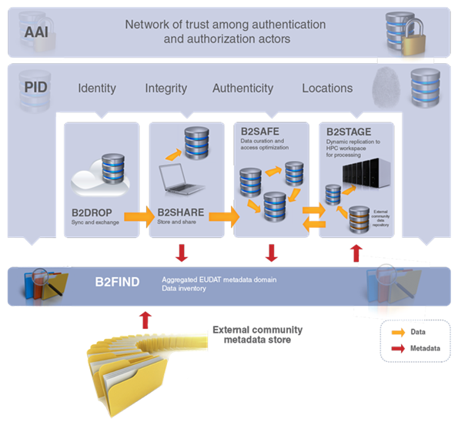














B2 Service Suite
Covering both access and deposit, from informal data sharing to long-term archiving, and addressing identification, discoverability and computability of both long-tail and big data, EUDAT services seek to address the full lifecycle of research data
https://www.eudat.eu/services
Notes:
B2FIND
stores metadata as well through other EUDAT services such as B2SHARE to provide access to data object within the EUDAT CDI
is used in inter-service use cases, e.g. to select links to data to be transferred to HPC platforms through B2STAGE

Slide 5






Building solutions with the communities
EUDAT services (B2 Service Suite) are designed, built and implemented together with user communites.
Common Language Resources and Technology Infrastructure (CLARIN)
European Network for Earth System Modelling (ENES)
Distributed infrastructure for life-science information (ELIXIR)
European Plate Observing System (EPOS) - Solid Earth sciences Research Infrastructure
Integrated Carbon Observation System (ICOS) to quantify & understand greenhouse gas balance
Long-Term Ecosystem Research (LTER) in Europe

Slide 6
The Challenge
EISCAT_3D data structure is similar to the present EISCAT data, but the data volumes will be considerably larger due to the volumetric data at extreme bandwidths.
The present archives of EISCAT data at level 2 and 3 are completely separate and use different systems for access. The proposed pilot is intended to unify the access to data at these two levels
An authentication system must be implemented in order to grant access to EISCAT users following the data policy, regardless of their geographical location at the moment of data download.
The need for data archiving, indexing and staging and then making data discoverable and searchable

Slide 7
Pilot Overview
The European Incoherent Scatter Scientific Association (EISCAT) operates three incoherent scatter radars, instruments probing the Earth’s ionosphere
EISCAT are now developing the next generation radar, EISCAT_3D.
Use EUDAT services to establish a unified archival and data search system for the existing EISCAT incoherent scatter radars.
The outcome will be used to explore whether and how EUDAT services can be customised for data archival and discovery for the future EISCAT_3D radar system.

Slide 8
EUDAT Service Uptake
Data replication and long term preservation - B2SAFE extracts and associates technical metadata from the level 2 dataset with the dataset making it harvestable by B2FIND.
Multi-disciplinary joint metadata catalogue - a researcher queries datasets by giving a set of conditions. The researcher assesses the datasets by reviewing the dataset description. The entitled researcher can reuse the dataset
Repository for shareable digital objects - After the datasets has been processed and analysed, the researcher sends a resulting level 3 dataset to B2SHARE. Alternatively, the resulting level 3 dataset can be sent to B2SHARE by an automatic process through the B2SHARE API.

Slide 9

Contact
Ingemar Häggström
EISCAT Scientific Association
Sweden
ingemar@eiscat.se
EUDAT
Web – eudat.eu
Twitter - @EUDAT_EU

