Slide 1
The Data Type Registry:
Describing & Sharing Scientific Datasets
Alberto Miranda
Barcelona Supercomputing Center (BSC-CNS)
EUDAT User Forum (Rome)
Notes:
Hello everyone.
My name is Alberto Miranda and I work as a post-doc in the Storage Systems Research Group for the Barcelona Supercomputing Center.
Today I want to talk a bit about a new Data Type Registry service that we are currently developing for EUDAT’s CDI, that aims to solve some of the interoperability problems that exist when attempting to share, access and process scientific datasets.

Slide 2

The Problem
Understanding scientific data and metadata is hard
  Researcher 1: “Could you tell me what column 12 means in the CSV file you referenced in paper A from 5 years ago?”
  Researcher 2: “Uh, I believe it’s a number”
  R1: “I can see that. Could it be a temperature?”
  R2: “Probably”
  R1: “Fahrenheit? Celsius?”
  R2: “Maybe Kelvin or Rankine?”
  R1: “Kelvin?”
  R2: “On second thought, maybe
  it’s not really a temperature”
  R1: “…”
Notes:
One of the main problems that arises when trying to access the information contained within a dataset that we know nothing of, is that discovering the meaning behind each piece of information is hard:
The creator of the dataset may have forgotten the details on how the dataset was created, what tools he used to do so, what it contains, and even how to read it.

Slide 3
The Problem
Automatically analyzing and processing scientific data and metadata is even harder
  What is sequence “00010101010001001011110”?
  It could be an integer → how many bits?
  It could be a floating point number → precision?
  It could be a string → encoding?
  Even if we knew: What does it represent?
Notes:
This problem becomes even harder for automatic processes. Even if as humans we can infer some assumptions about the data from the context of the dataset, an automated process simply has no idea if a certain binary sequence should be read as an integer, a real number or a text. Or how many bits are used for the representation, its precision or its encoding. But the real problem is that, even if it knew that, it wouldn’t know the meaning behind the information that the original scientist intended to record with that piece of information.

Slide 4
The Problem
Data producers don’t always specify certain implicit assumptions of the data
  Measurement units, reference coordinate systems, variable names, …
Notes:
Thus, the key problem lies in that the producers of the datasets don’t always specify the implicit assumptions behind the packaged data, like its measurement units, reference coordinate systems or the variable names, among others.

Slide 5
The Problem
Data producers don’t always specify certain implicit assumptions of the data
  Measurement units, reference coordinate systems, variable names, …
But sharing requires data can be parsed, understood, and reused by external people and/or applications
  For documents MIME formats often enough, e.g. PDF
  Doesn’t work well with data: what does number 42 mean in cell L36?
Notes:
Thus, the key problem lies in that the producers of the datasets don’t always specify the implicit assumptions behind the packaged data, like its measurement units, reference coordinate systems or the variable names, among others.

Slide 6
The Problem
Data producers don’t always specify certain implicit assumptions of the data
  Measurement units, reference coordinate systems, variable names, …
But sharing requires data can be parsed, understood, and reused by external people and/or applications
  For documents MIME formats often enough, e.g. PDF
  Doesn’t work well with data: what does number 42 mean in cell L36?
Thus, a systematic approach is needed to precisely define, specify and record these assumptions
  Accessible by users not involved in data production
Notes:
Thus, the key problem lies in that the producers of the datasets don’t always specify the implicit assumptions behind the packaged data, like its measurement units, reference coordinate systems or the variable names, among others.

Slide 7
What is a Data Type Registry?
A DTR is a low-level service/infrastructure with the ability to record and disseminate “Data Type Records”

Slide 8
What is a Data Type Registry?
A DTR is a low-level service/infrastructure with the ability to record and disseminate “Data Type Records”
But, What is a Data Type?

Slide 9
What is a Data Type?
A Data Type is a characterization of data at any level of granularity
  From small individual observations to large structured datasets
Must include information about structural organization, contexts and assumptions in the data
  Cell A3 is a number, but is it a temperature? Celsius?
  It’s a dataset, but what are the variable names?
  Is it packed as CSV/NetCDF? A single unit? A collection?
Must be permanently linked to the described data
Should be standardized, unique and discoverable

Slide 10
What is a Data Type Registry?
A DTR is a low-level service/infrastructure with the ability to record and disseminate “Data Type Records”
Minimum requirements:
  Should assign unique and resolvable identifiers to created/stored Data Type records
  Should enforce and validate a common data model for describing Data Types and their structure
  Should allow interoperability between multiple instances
  Should offer a UI for human use
  Should offer an API for machine use

Slide 11
EUDAT’s DTR: Current Features
Based on CNRI’s Digital Object Repository and Registry software CORDRA + EPIC handles
  Well-tested, active, stable and open source
Definition of primitive and derived Data Types (via composition of primitive types)
Data Types are assigned unique and resolvable EPIC handles for persistent identification and retrieval
Data Types are validated against pre-configured JSON schemas
Data Types are indexed to allow content-based queries

Slide 12
EUDAT’s DTR: Current Features
Access control policies to allow highly-controlled sharing and access restriction
Data Type versioning
REST API over HTTP and DOIP interface over TCP for machine-to-machine communication
Web UI for humans to create, retrieve, update, delete, and search records using web browsers
Federates Data Types across other Cordra instances while honoring access control policies

Slide 13
Data Type Example
General:
identifier: “11314.3/6debc53338e99ff15731”
name: “Stream Gauge”
description: “Information that defines stream discharge at a specific location and time interval. Useful for the geosciences community.”
Standards:
issued by: “ISO”; name: “4375:2000”; nature of applicability: “depends”
Provenance:
contributors:
identified using: “Text”; name: “Mostafa Elag”; details: “Researcher in the geosciences community”
identified using: “Text”; name: “Giridhar Manepalli”; details: “Data infrastructure expert from CNRI”
creation date: “2014-08-07T04:25:10.798Z”
last modification date: “2014-09-06T20:06:28.410Z”
Expected Uses:
“Used for comparing outputs of surface runoff discharge models as applied to data pertaining to a specific watershed.”
Representation and Semantics:
expression: “Measurement Unit”; value: “Cubic Meter per Second”
Properties:
name: “value”; identifier: “11314.3/f0f2c4382dcf8d257462”; Type: Discharge
name: “coordinate”; identifier: “11314.3/4102c3ebe68bed21d644”; Type: GPS Coordinate
name: “timestamp”; identifier: “11314.3/6386f4ebd23e9baace50”; Type: Time Segment

Slide 14
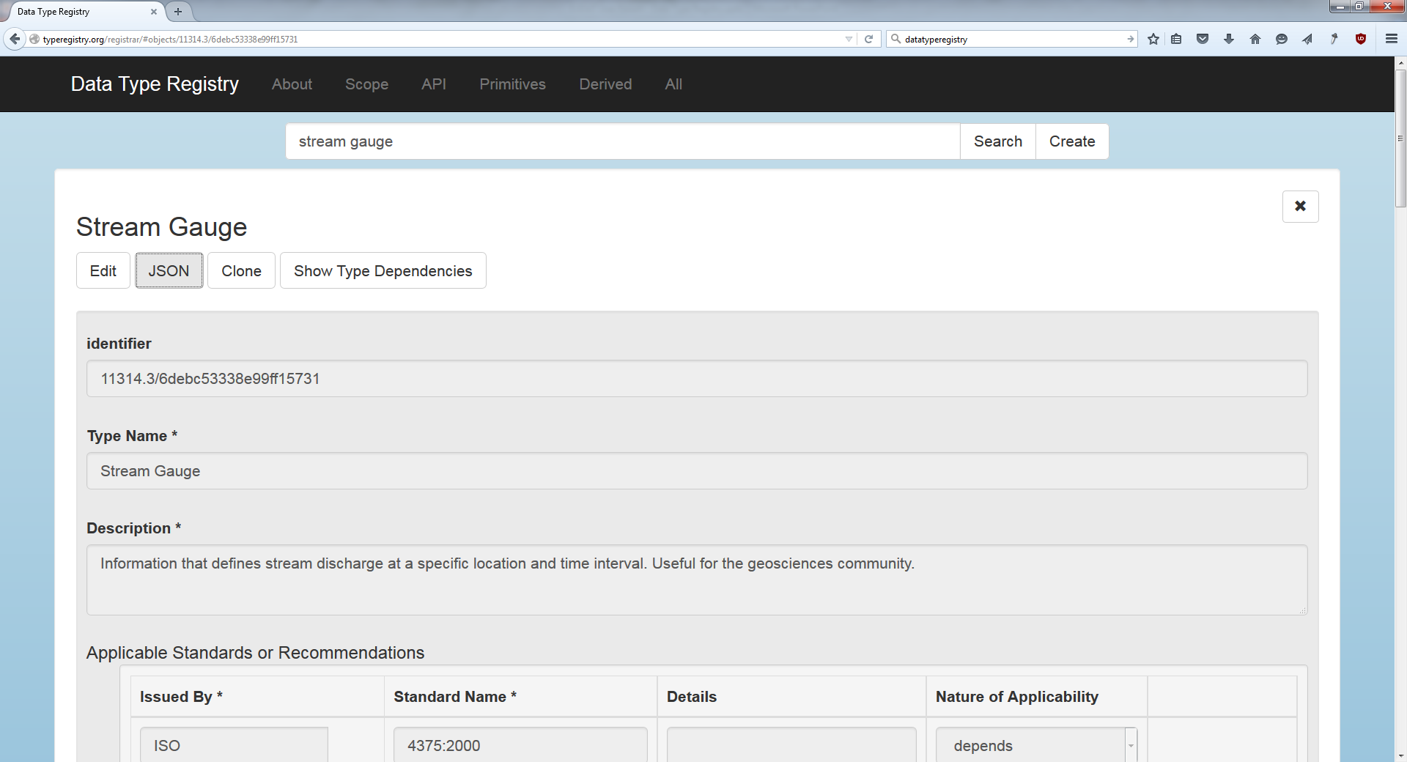
hdl.handle.net/11314.3/6debc53338e99ff15731

Slide 15
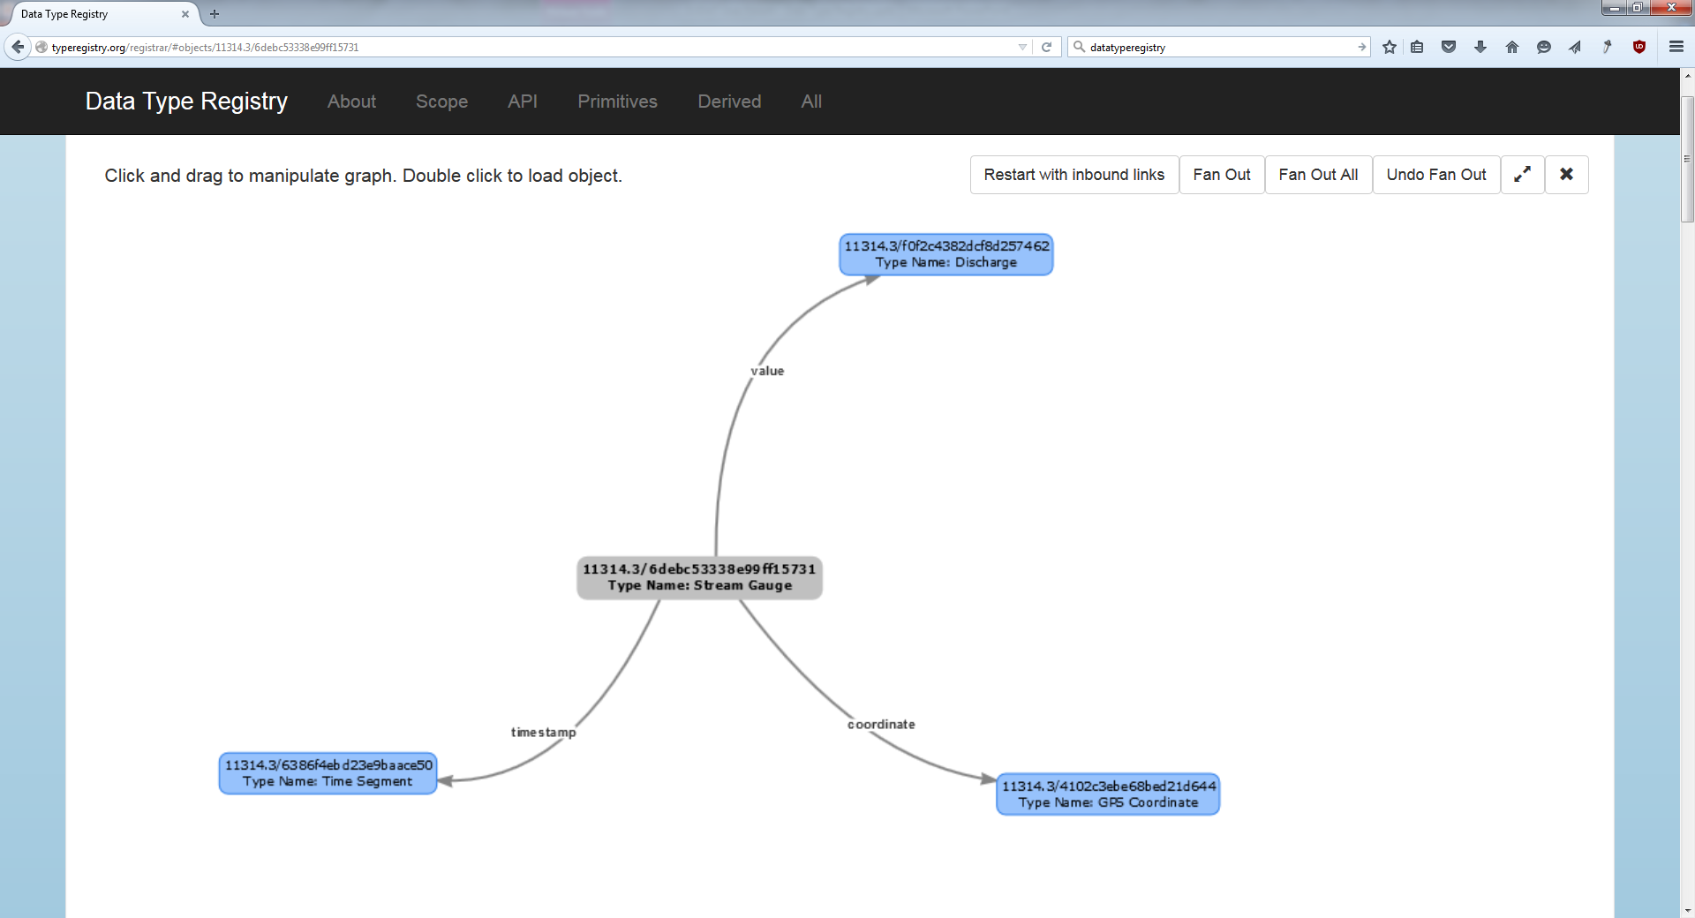
hdl.handle.net/11314.3/6debc53338e99ff15731

Slide 16
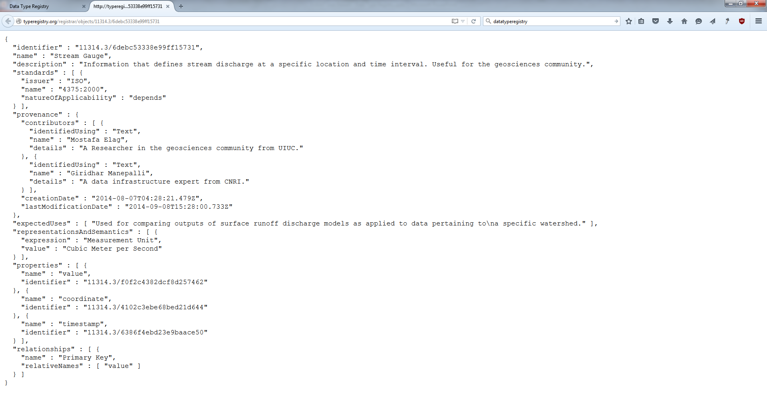
hdl.handle.net/11314.3/6debc53338e99ff15731

Slide 17




DTR Examples: Processing Use Case
3
Users
2
Federated Set of Type Registries
1
4
ID
ID
ID
ID
4
Terms:…
Type
ID
Type
ID
I Agree
Type
Type
10100
11010
101….
Visualization
Payload
Payload
Type
Type
Payload
Payload
Rights
Payload
Payload
Data Set
Dissemination
Data Processing
Typed Data
Services
1
Clients (processes or people) encounter an unknown type
2
The Type is resolved to the Data Type Registry
3
Response includes type definitions, relationships, properties, and possibly service pointers. Response can be
used locally for processing, or, optionally …
4
Typed data or references to typed data can be sent to service provider
Source: “Data Types” Giridhar Manepalli, RDA 2nd Plenary

Slide 18
DTR Examples: Discovery Use Case
2
Users
1
Federated Set of Type Registries
3
4
ID
ID
ID
ID
Type
ID
Type
ID
Type
Type
Payload
Payload
Type
Type
Payload
Payload
Payload
Payload
Repositories and Metadata Registries
1
Clients (process or people) look for types that match their criteria for data.
For example, clients may look for types that contain location and temperature information
2
Data Type Registry returns matching types. Weather-type is returned in our example
3
Clients look up in repositories and metadata registries for typed data (about weather-type)
4
Appropriate (weather) typed data is returned
Source: “Data Types” Giridhar Manepalli, RDA 2nd Plenary

Slide 19
EUDAT Plans for the DTR
Ongoing: Testing instance deployed at BSC
  To be used by beta-testers (more on this in a moment)
Ongoing: Produce user/administrative documentation
Starting: Integration with B2ACCESS Authentication/Authorization Infrastructure
Starting: Integration with B2SHARE
  Integrate B2SHARE’s metadata templates/keys in the DTR
  Allow users to include DTR Types within B2SHARE’s interface
  Allow users to refer back to B2SHARE from DTR Types
Starting: EUDAT branding
Future: Depending on beta-testers feedback and CDI evolution (e.g. replace EPIC with B2HANDLE?)

Slide 20
DTR Beta-Testing Instance
DTR’s position in the CDI needs to be precisely defined
  How are communities going to use it?
  How is it going to relate to other services?
  How should use cases evolve to match the CDI?
  How should the CDI evolve to match use cases?
The Data Type Schema needs to evolve to fit use cases from research communities
  We need to know what end-users need
  Initial beta-testers: ICOS and CLARIN
  Some Data Pilots also need Data Typing
  Beta-testers should use the service, provide feedback and help define requirements

Slide 21

More early adopters welcome!

Slide 22
Q&A

