Slide 1

EUDAT User Forum
Hilary Hanahoe, Trust-IT Services & EUDAT Communications, Training & Outreach
h.hanahoe@trust-itservices.com

Slide 2









Why?
Introduce EUDAT, the core communities and data pilots
Discuss and identify common data management challenges and requirements
Explain the EUDAT services area
Encourage networking and cross-fertilisation of knowledge in smaller groups

Slide 4
Data Management Topics
Life Sciences and Biomedical Sciences
  Expert facilitators : Shaun de Witt, STFC
  Subjects: Persistent Identifiers, Metadata
Earth and Environmental Sciences
  Expert facilitators : Willem Elbers, CLARIN-ERIC
  Subjects: Persistent Identifiers, AAI
Physical Sciences & Engineering
  Expert facilitators : Claudio Cacciari, CINECA
  Subjects: Data Repository vs. Long Tail Data sharing
Social Sciences and Humanities
  Expert facilitators: Carl-Johan Håkansson, KTH
  Subjects: Service deployment, Data repository & Long Tail data sharing

Slide 6
Service Areas
10:30 | Coffee Break
11:00 | Data Access and Re-use – CAMPO DEI FIORI | Data Preservation TRINITA DEI MONTI A | Data Processing and Analysis TRINITA DEI MONTI B
 | Carl Johan Håkansson, KTH-PDC | Claudio Cacciari, CINECA | Shaun de Witt, STFC
 | B2DROP Cloud storage, sync & exchange | B2SAFE Policy-driven data management | B2STAGE Data staging service, Roberto Mucci
 | B2SHARE Repository for sharable digital objects | B2SAFE what is it and how it works & next steps: metadata management proposal, authentication, authorization | HTTP API developments and Supporting metadata, Shaun de Witt
 | B2FIND Multi-disciplinary joint MD catalogue | Data Policy Manager: what is it and how it will work | B2NOTE, Semantic Annotation, Yann Le Franc
 | B2ACCESS Federated multi-protocol Identity & Authorisation Management | Persistent Identifiers: B2HANDLE status and plans | Data Type Registry, Alberto Miranda
 | Questions & Answers | Questions & Discussion

Slide 7
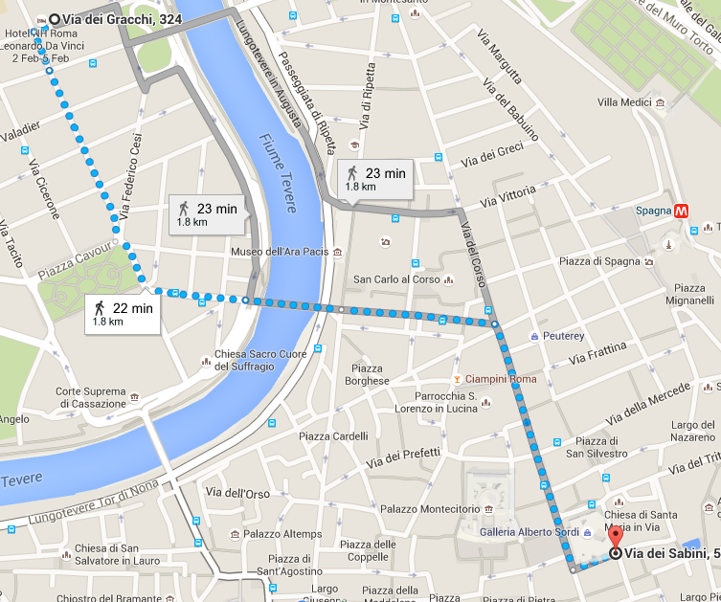
Networking Event – Wed 3rd February 20:30
RISTORANTE GALLERIA
GALLERIA ALBERTO SORDI
VIA DEI SABINI 53
FROM 20:30 …. DINNER, DRINKS & NETWORKING
HOW TO GET THERE:
WALK
METRO
TAXI
DETAILS AT REGISTRATION

Slide 8
EUDAT Fundamentals Training
Friday 5th February
09:00 - 09:05 | Welcome & Introduction | Rene van Horik, DANS
09:05 - 10:00 | B2 Service Suite Overview | Shaun de Witt, STFC
10:00 - 10:15 | Break
10:15 - 11:15 | Demo presentation: Using B2DROP Using B2FIND and Metadata harvesting Procedure | Heinrich Widmann, DKRZ Benedikt von St. Vieth, JSC
11:15 - 11:30 | Break
11:30 - 12:30 | Hands-on session: B2SHARE and B2SHARE API | Carl Johan Håkansson, KTH-PDC
12:30 - 13:30 | Lunch
13:30 - 14:30 | Data Science and EUDAT | Andrea Manieri, Engineering & EDISON
14:30 - 15:00 | Overview of B2SAFE and B2STAGE | Shaun de Witt, STFC
15:00 - 15:15 | Wrap-up | Rene van Horik, DANS

Slide 9
European Open Science Cloud Workshop
Friday 5th February
9:00 - 9:45 | Plenary Session: The European Open Science Cloud: What and for Whom? European Commission Insight from the EOSC High Level Expert Group | Jean-Claude Burgelman, EC DG RTD Barend Mons, HLEG
10:15 | Networking Coffee
10:30 - 12:00 | Panel: The Research Infrastructures in the EOSC: expectations and requirements Cross-Disciplinary/cross-infrastructure use cases Large scale research facilities | Massimo Cocco, EPOS Sanna Sorvari, ENVRI Franciska de Jong, CLARIN Juan Bicarregui, STFC
12:00 - 13:00 | Panel: Support for the whole research process in the EOSC An integrated view from EUDAT/EGI/OPENAIRE/GEANT/LIBER | Kimmo Koski, EUDAT Tiziana Ferrari, EGI Susan Reilly, LIBER Natalia Manola, OpenAire Valentino Cavalli, GÉANT
13:00 | Networking Lunch
13:45 - 15:00 | Plenary & Panel: From vision to implementation Governance and stakeholder influence in the EOSC: Standards: interoperability and integration Providers Users Funders Customers | Jean-Claude Burgelman, EC DG RTD Bas Cordewener, Knowledge Exchange Peter Wittenburg, RDA Jurry de la Mar, T-Systems
15:00 | Workshop ends - Networking Coffee

Slide 10
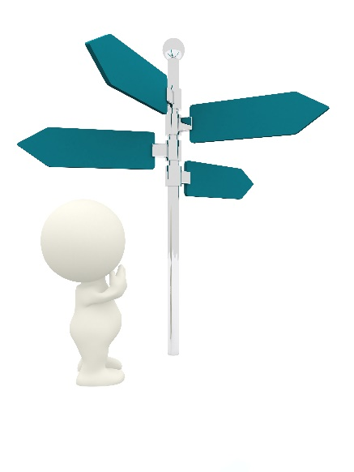
Next Sessions
Life Sciences and Biomedical Sciences
  Trinita dei Monti A (behind registration)
Earth and Environmental Sciences
  Campo dei Fiori (this room)
Physical Sciences & Engineering
  Trinita dei Monti B (behind registration)
Social Sciences and Humanities
  Campidoglio (downstairs)

Slide 11

Network ….

