Slide 1
EUDAT- Towards a Collaborative Data Infrastructure
EUDAT User Forum, Rome, 3-4 February 2016
D. Lecarpentier, CSC ~ EUDAT Project Director

Slide 2
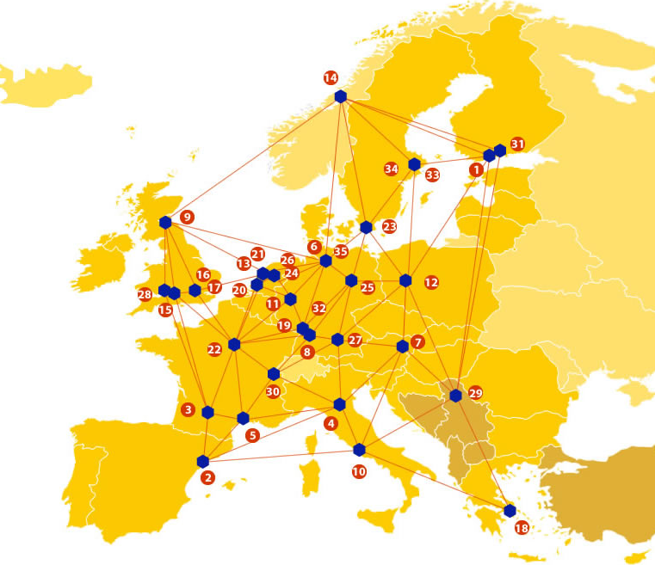

EUDAT: A pan-European Infrastructure
EUDAT offers common data services to individuals, research infrastructures & communities and service providers through a network of 35 European organisations.
EUDAT enables European researchers from any discipline and any geographic location to preserve, find, access, and process data in a trusted environment.
European infrastructures
Technology Providers
Research Communities

Slide 3
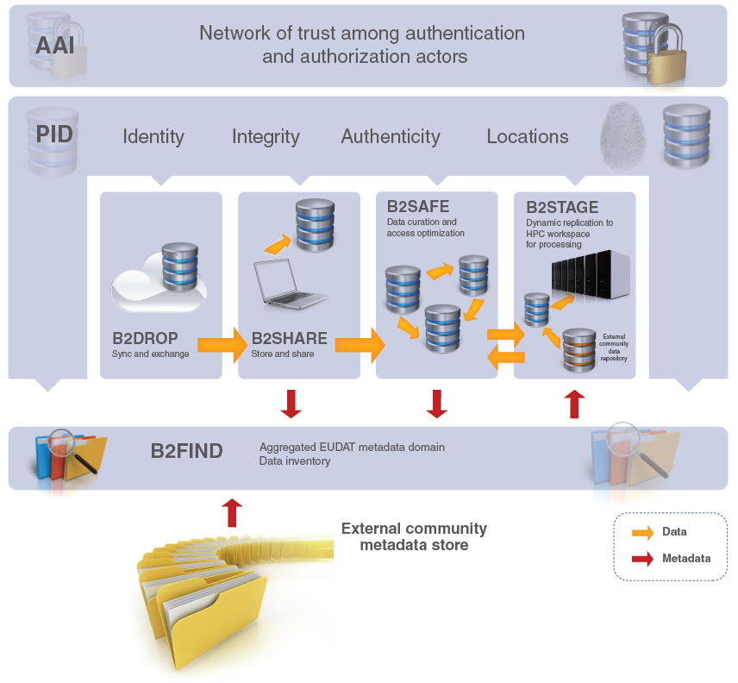
Integrated Suite of Services

Slide 5

















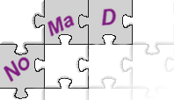












Community-Driven Solutions
EUDAT services (the so called B2 Service Suite) are designed, built and implemented based on user community requirements.
ENVIRONMENTAL SCIENCES
BIOMEDICAL & MEDICAL SCIENCES
MATERIALS & ANALYTICAL FACILITIES
MAPPER
SOCIAL SCIENCES & HUMANITIES
PHYSICAL SCIENCES
& ENGINEERING
Notes:
EUDAT aims at providing horizontal services applicable to a number of communities, and to allow easy integration of EUDAT services into community workflows where they exist. These communities have a direct influence on, and contribute to, the development of these services. The size of the communities involved range from a few tens to hundreds of researchers. Services are defined not just by researchers in the EUDAT collaboration, but we elicit additional communities to ensure our services are as generic and applicable to as wide an audience as possible.
MP: The graphic in the slide does not represent the size of the communities, but the space the logos of the organizations need to fit in. Perhaps we could develop a new one, less dependent on the size / number of logos?
MP: this slide at the beginning or at the end of the presentation?
SG: The logos do not have nothing to do with the size of the communities – bigger logos correspond to the eudat core communities see here http://eudat.eu/eudat-communities – the size of the hexagon is just to allow all the logos to fit in

Slide 6

Calls for Data Pilots

Slide 7
Data Pilot call Highlights
24 applications, of which
  7 = Earth sciences, energy and environment,
  6 = Biomedical and life sciences,
  6 = Social Sciences and Humanities
  5 = Physical Sciences and Engineering
potential user audience = 40,000 users
cumulative storage resource request of up to 4.3PB

Slide 8
Service Areas covered
Data synchronization & exchange (11/24)
Data repository and (long tail) data sharing (18 / 24)
Data replication and preservation (13/24)
Data staging for analysis and processing (12/24)
Data typing & visualization (9/24)
New services or tools in the area of Big Data Analytics (5/24)
New services or tools in the area of Semantic web (5/24)

Slide 9
Earth sciences, energy and environment Pilots
Support to scientific research on seasonal-to-decadal climate and air quality modelling.
DataPublication@UPorto: multi-disciplinary data description and deposit linking the Dendro staging platform with the EUDAT European Infrastructure
Unified access to EISCAT radar
DATA SPHINX ( DATA Storage and Preservation of HIgh resolutioN climate eXperiments )
Public access to fine-grained city air quality data from roving sensors
Web Coverage Service for sharing of tailored global atmospheric composition model results
SIMCODE-DS

Slide 10
Biomedical & life sciences Pilots
West-Life Data Pilot
IST DataRep
Herbadrop : an innovative approach to long-term preservation and analysis of digitised herbarium specimens
The use of the EUDAT repository to store clinical trials in a secure and compliant way
Use case for handling large scale medical data: prediction and diagnosis of cervix cancer and diabetes type 2.
An EUDAT-based FAIR Data Approach for Data Interoperability

Slide 11
Physical Sciences and Engineering Pilots
Tokamak data mirror for JET and MAST data – moving towards an open data repository for European nuclear fusion research
TURBASE-DNS: A DATA BASE OF DIRECT NUMERICAL SIMULATIONS OF TURBULENT FLOWS
NFFA-EUROPE Information and Data Management Repository Platform for nano-science in Europe.
Direct simulation data of turbulent flows
Linked data service pilot for EUDAT

Slide 12
Social Sciences and Humanities Pilots
Research data repository for students' own results
Enriching Europeana Newspapers
Cloudy Culture: A study of EUDAT shared services to measure the potential of using cloud-like services to improve the preservation of digital cultural heritage
Aalto Research Data Management Suite Pilot
Connecting B2ACCESS to the CLARIN user store.
Ancient OCR: Storing, Cataloging, Relating, and Exposing OCR Objects from the Open Philology Project

Slide 13
What do we mean by call for collaboration?
CALL CONCEPT
Provide data management solutions, storage
resources, and consortium expertise:
to support multi-national research
communities and their centres to collaboratively tackle their data challenges.
to engage pan-European research communities to develop and implement data management policies which support the H2020 Digital Agenda.
to further develop existing EUDAT services & identify new ones

Slide 14
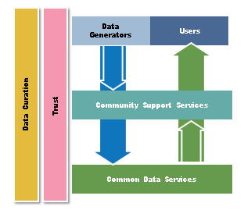
Towards a Collaborative Data Infrastructure (CDI)

Slide 15
What is the EUDAT CDI?
The EUDAT CDI is a collaboration between Service Providers and Research Communities working as part of a common framework for developing and operating an interoperable layer of common data services
  Generic Service Providers have regional, organisational or national mandates to support scientific research, usually from different disciplines.
  Thematic Service Providers are (discipline-specific) organisations mandated to support a well-defined scientific community or group of users.

Slide 16

Using or Joining the CDI
Using services supplied by EUDAT or deployed at specific sites that are part of the CDI
Users benefit from the common services deployed at the sites and the common service management approach followed by the CDI service providers
Community/Data Providers
Community
Center/Service Provider
EUDAT CDI

Slide 17

Using or Joining the CDI
Joining the CDI as an interoperable, or integrated node.
Being part of the CDI backbone and possibly providing one or several EUDAT services as part of the CDI to a specific community
Requires commitment to some rules and behaviors to ensure CDI coherence → CDI Partnership Agreement.
Community
Center/Service Provider
Community
EUDAT CDI

Slide 18
Integration
Integration (EUDAT CDI)
  compose & combine EUDAT technical services
  ➜ “B2 Integrated Suite
Integration (European e-infrastructure)
  agree protocols, interfaces, identity management with HPC, cloud, and networks
  ➜ open EU data/compute platform for research
Integration (European Research)
  agree policies, API, and methods with universities, libraries, digital publication actors, and service companies
  ➜ open science

Slide 19
Sustainability
Sustainable (EUDAT CDI)
  create partnership of sustainable organizations and develop it
  ➜ allow for different degrees of integration
Sustainable (Financial)
  ensure multiple revenue streams for the CDI and for the partners and partnership
  ➜ open EU data/compute platform for research
Sustainable (Societal)
  follow policies of governments, universities, libraries, digital publication authorities and research communities
  ➜ open science, open society

Slide 20
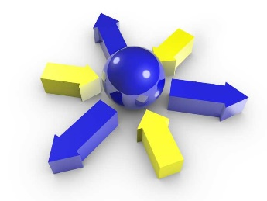
User Forum Objectives
Engaging with EUDAT stakeholders to raise awareness & consolidate service uptake:
Review and discuss status of uptake plans
Support the “Calls for Data Pilots” process, informing potential users on:
  benefit of EUDAT services & offer uptake
  specific requirements for EUDAT services & CDI
Providing a platform for users to exchange experiences and connect to EUDAT experts
Prepare for pilot implementation

Slide 21
What timing is involved for the Calls?
Activity | Call 1
Call Open | May-October 2015
Call Evaluation & Negotiation | October-December 2015
Pilot Activities / Operations | Jan 2016 – June 2017
Pilot Interim Assessments | June & Dec 2016
Pilot Final Results / Output Presentation | June 2017

Slide 22
Get On Board!
Join EUDAT2020 as Associate Partner (2016-2018)
  Memorandum of Understanding – lightweight process
  Based on agreed pilot activities – described in MoU, including resources allocated and joint work plan
  Benefits: Be part of the consortium, first hand access to all info and expertise, participate to the discussions, including service and policy developments
Participate to the Consultation of Stakeholders and consolidation of Agreement (Feb 2016 – April 2016)
  Interviews with all stakeholders (Feb-March - led by WP2)
  Consolidated Agreement, including Service Management Framework and clear instructions how to “join” by 30 April 2016 and membership fee structure
  Formal launch of Partnership June 2016
Shape the future of the Collaborative Data Infrastructure and be an active member within it!

Slide 23
And Enjoy Rome!

