Slide 1
Rooms for today & tomorrow*
*Room VS206 (22/06) - VS 208 (23/06) - UC#1: Transferring data from community repository to B2SHAREv
Room VS218 - UC#2 Publishing metadata in B2SAFE and B2FIND
Room VS219 - UC#3 Annotating data content with B2NOTE
Room VS218 - UC#4 B2STAGE and HTTP API
Room VS217 - Interview Tracks
Garden – Coffee & Lunch

Slide 2
Please take some time to provide your feedback …
Slides will be added to the agenda…
Evaluation form on-line @ https://eudat.eu/evaluation-form-for-the-eudat-user-meeting-22-23-june-in-barcelona

Slide 3
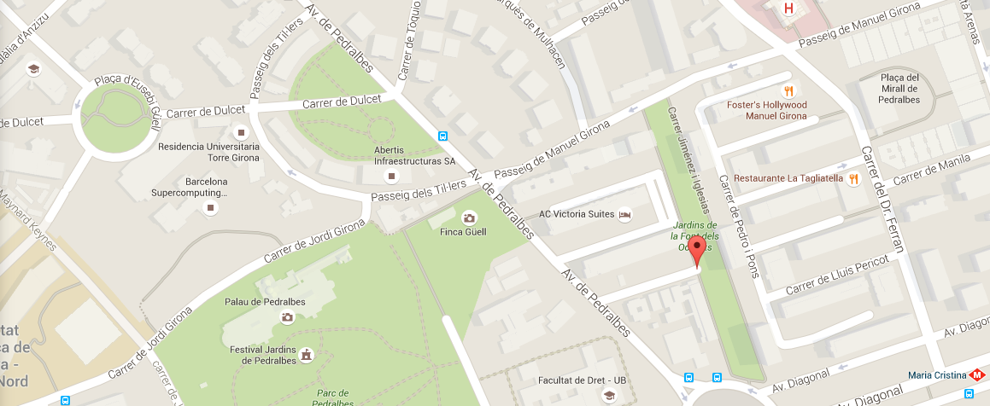
Social Dinner 22 June 2016 @ 20:00
Santa Clara Restaurant, Calle Jiménez e Iglesias 11-13, 08034, Barcelona, metro stop Maria Cristina L3.

