Slide 1
Collaboration with other e-Infrastructures (PRACE, EGI)
EUDAT User Forum
Stéphane Coutin, CINES
Giuseppe Fiameni, CINECA

Slide 2
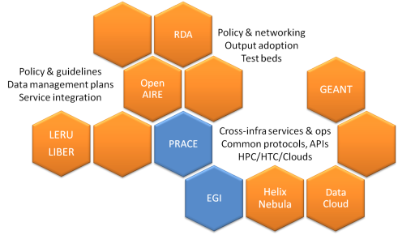
Objectives
Ensure the interoperability of EUDAT with other public and private e-Infrastructures, lowering technical and policy barriers by piloting concrete use cases with user communities
Provide European researchers with seamless access to data and computing resources for cross-utilization use cases
Pave the way towards the
interoperability of e-Infrastructure
tools and services beyond H2020

Slide 3
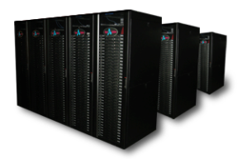
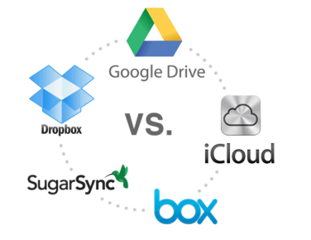
Interoperability
Commercial stakeholders
Joint Access to Data and HPC Services
Joint Access to Data, HTC and Cloud Computing Resources
Collaboration with Commercial Stakeholders

Slide 4
Areas of harmonization
Technical
Cross-utilization use cases, e.g. data transfer, workflow execution, data discoverability and provenance (PID), federated AAI, etc.
Policy
Harmonization of access policy fostering the uptake of services on the long-term
Operational
Harmonization and cross-fertilization of operational tools, technologies, practices and policies
Security for Collaboration among Infrastructures (https://www.eugridpma.org/sci/)

Slide 5
Collaboration within the HPC domain (PRACE)
Respond to the user’s demand of interoperability between HPC and Data resources through focusing on two main objectives:
enable PRACE users stage data from EUDAT storage systems to HPC systems for further processing or as input for simulations;
enable PRACE users replicate data generated on HPC systems onto EUDAT storage systems for sharing and long-term preservation.

Slide 6
PRACE calls offering data services
Conditions :
One PB storage capacity offered (approx. 150TB per awarded project)
Storage space at one or more of the 12 EUDAT sites for at least 24 months after the end of the PRACE grant, free of charge
PRACE Tier-0 Call 11 (closed on July 2015)
4 proposals, none of them was awarded :(
PRACE Tier-1 DECI 13
10 proposals (4 accepted)
Pilots implementation to start between April and May 2016

Slide 7
PRACE pilot details
Project Name | Field | Data requirements in TB after the PRACE project | PRACE Site | EUDAT Site
Hybrid 3D simulations of turbulence and kinetic instabilities at ion scales in the expanding solar wind | Astro Sciences | 140 TB | SurfSARA | CINECA
Multiscale simulations of nanoparticle suspensions | Engineering | 30 TB | MPCD | CINECA
High Resolution EC-Earth Simulations | Earth Sciences | 150TB | KTH | EPCC
Effect of rotation and surface roughness on heat transport in turbulent flow | Engineering | 10TB for 24 months 1TB for long-term storage and publication | EPCC | SurfSARA

Slide 8
Collaboration within the HTC/Cloud domain
Enable researchers seamlessly access data and high-throughput resources for post-processing purposes
Four community pilots funded by respective projects (use cases under definition):
ICOS and ELIXIR ← EUDAT2020
EISCAT-3D and BBMRI ← EGI-Engage
EPOS, ENVRI+, …
Currently working on an interoperability solution demonstrating the coupling of EUDAT and EGI resources
ability to process data stored onto EUDAT resources using EGI FedCloud computational capacity

Slide 9
Data and HTC/Cloud
1
Select data
PID
Retrieve location
PID
2
PID
1
PID
PID
3
Stage data
PID
4
Execute computation
5
Produce results
6
Register results
3
2
3
3
PID
PID
6
PID
PID
4
PID
5
PID
6

Slide 10
Thanks for your attention

