Slide 1
Data Preservation
B2SAFE, B2HANDLE
Data Preservation team:
Claudio Cacciari (Cineca)
Tobias Weigel (DKRZ)
Maarten Hoogerwerf (DANS)

Slide 3
B2SAFE
B2SAFE is a robust, safe and highly available service which allows community and departmental repositories to implement data management policies on research data across multiple administrative domains in a trustworthy manner.
Data Management Policies team:
Claudio Cacciari (Cineca)
Robert Verkerk (SurfSARA)
Elena Erastova (MPCDF)
Javier Quinteros (GFZ)
Adil Hasan (SIGMA)

Slide 4
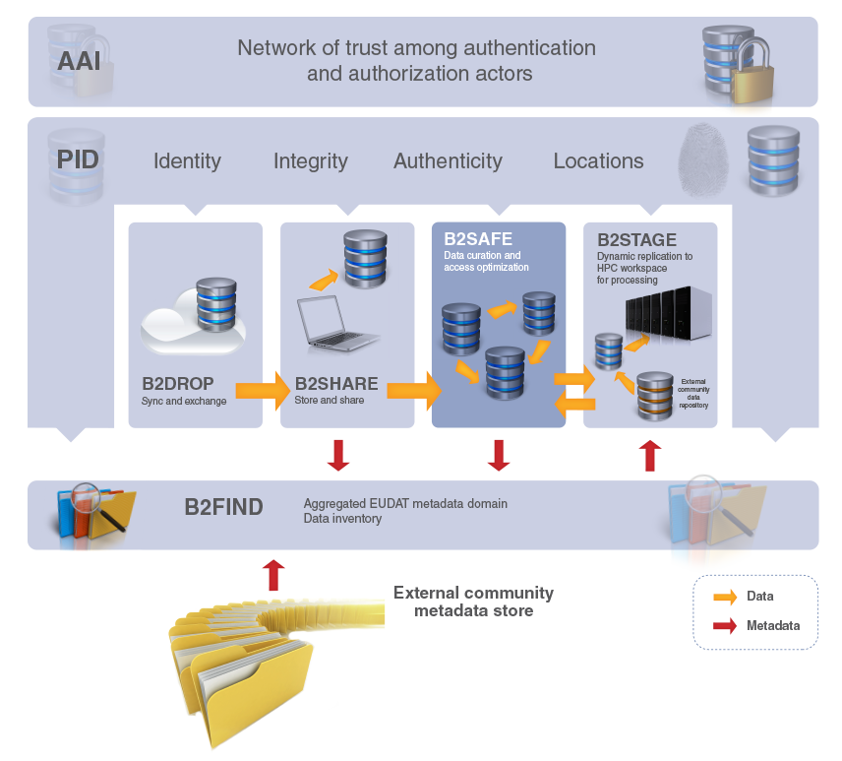
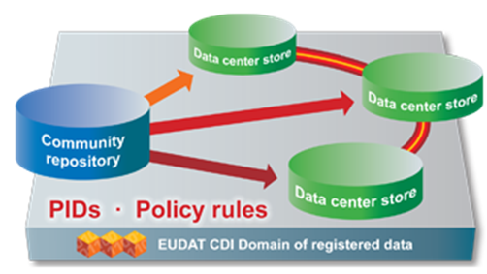
The ideal solution for communities with no facility for archival to:
replicate research data into secure data stores
archive and preserve research data in the long-term
bring data close to powerful compute resources
co-locate data with different communities
benefit from economies of scale
Features:
large-scale storage
robust and highly available
permanent PIDs

Slide 5
Who benefits
Repositories lacking the capacity and / or funding to offer reliable storage and access services over longer periods of time
Repositories without adequate compute capacity for data-intensive computational services based on their data
Data producers who need to be sure that trusted centres are taking care of their data
Consumers wishing to access optimized services on data sources of interest to them
Consumers who wish to apply interdisciplinary data-intensive methods using data collected from various communities
http://eudat.eu/b2-service-suite

Slide 6
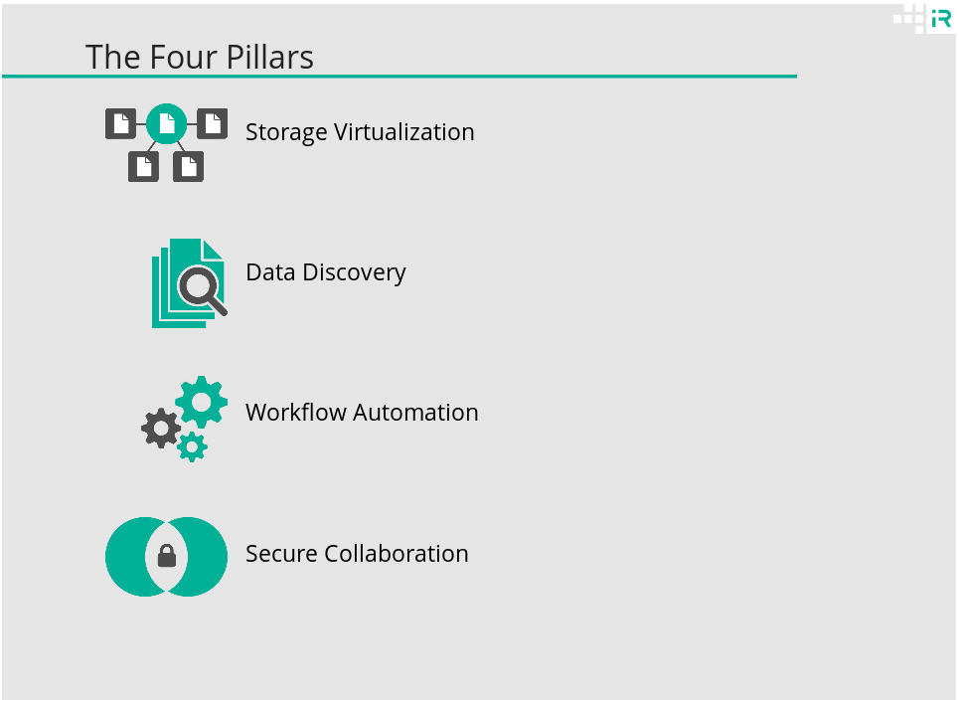
How is it implemented?
The service relies on iRODS technology
http://slides.com/irods/sc15-overview

Slide 7
Storage Virtualization

Slide 8
Storage Virtualization - clients

Slide 9
Storage Virtualization - namespace

Slide 10
Distributed system

Slide 11
Metadata

Slide 12
Federation

Slide 13
How it works?
EUDAT has built an additional layer on top of iRODS to streamline the processes which supports the replication and long term data archiving.
iRODS +
EUDAT B2SAFE package +
back-end storage =
B2SAFE service
http://eudat.eu/services/userdoc/configure-b2safe
https://github.com/EUDAT-B2SAFE/B2SAFE-core

Slide 14
EUDAT B2SAFE package
EUDAT B2SAFE package = rules + scripts

Slide 15
Data ingestion

Slide 16
Data replication

Slide 17
Data replication and asynchronous responses

Slide 18
Persistent Identifier registration

Slide 19
How you can use it? Exploiting remote services
You can connect to the service using one of the available clients and upload your data sets
GridFTP
Web clients
webDAV

Slide 20
How you can use it? Integrating via API
You can connect your existing framework or tools via API
EUDAT API are work in progress (HTTP API)
B2SAFE API (iRODS)
EUDAT HTTP API
iRODS HTTP REST API
iRODS Java API
iRODS C API
iRODS Python API

Slide 21
How you can use it? Joining the federation
The community deploy a local instance of the B2SAFE service and join the EUDAT federation
EUDAT
data center B
EUDAT
data center A
Community
data center X

Slide 22
What’s next?
Authentication
Authorization
Domain specific metadata

Slide 23
Authentication Federated approach

Slide 25
Authorization
Some principles that we will follow:
To reflect the permissions and roles of the community
To be, as much as possible, interoperable with existing tools
User Roles
User Attributes
Authorization service
(XACML)

Slide 26
xacml
http://www.axiomatics.com/pure-xacml.html
https://www.oasis-open.org/committees/tc_home.php?wg_abbrev=xacml

Slide 27
Domain specific metadata
The current B2SAFE implementation is able to manage system metadata.
The next version will be aware of every kind of metadata (descriptive and domain specific)
The approach to support the domain specific ones will be progressive:
Initially will just be supported the ingestion of metadata so that the B2SAFE service is aware of them
Later they will be indexed and made discoverable

Slide 28
Roadmap
The next B2SAFE release 3.1.0 is expected by April.
It will include the support to the federated authentication approach of the EUDAT infrastructure.
And the support to metadata ingestion.
Authorization and metadata indexing will require more time.

Slide 29
Usage Patterns
Register a PID for a DO
Register PIDs for a whole collection recursively
Replication
Replication with asynchronous PID registration
Integrity check between a DO and its replica
Recover failed transfers from the logging system's queue
Update the location of a DO in the PID record
Update the checksum of a DO in the PID record

Slide 30
Preserve my data for 10 years
DATA SETS
Register PIDs for a whole collection recursively
Replication
Recover failed transfers from the logging system's queue
Data management
policy
Integrity check between a DO and its replica
Update the location of a DO in the PID record
Update the checksum of a DO in the PID record

Slide 31
Data Policy Manager: what is it?
The Data Policy Manager is a tool to
define policies for data management, like for example: replicate the data set A from repository X to repository Y and keep the two replicas in sync with a sync frequency of six hours.
Validate the policies.
Distribute policies among the data centers.
Collect back the status of the policies

Slide 32
Data Policy Manager: how it works?

Slide 33
B2Handle
PID services for EUDAT and user communities
B2HANDLE Development Team:
Tobias Weigel, Merret Buurman (DKRZ)
Robert Verkerk (surfSARA)
Christos Kanellopoulos, Nicolas Liampotis, Themis Zamani (GRNET)

Slide 34
Notes:
PID services – used across services; but still, B2SAFE is most important user

Slide 35
Challenges in object management
Object locations change over time
Objects can migrate between repositories
Object access may be costly or restricted
Object management needs to be scalable and efficient
Object management must become independent from storage concerns

Slide 36
Sophisticated use of PIDs can address these challenges
Persistent Identifiers provide a means to access objects over time and through changes in location and ownership
EUDAT uses Handle System PIDs (Handles)
Minimal metadata (PID/Handle records) can facilitate management tasks, enable access and information tools and increase end-user value
Identifier: 11098/abcdef
Object
(black box)
LOCATION: ...
CHECKSUM: ...
REPLICA: ...

Slide 37
Exemplary use cases for PIDs
Persistent Identifiers for...
Any kind of domain data object (e.g. audio files, spreadsheets, ...)
Metadata objects (e.g. XML documents uploaded by users, metadata harvested from catalogs)
Specific usage includes...
Linking data with metadata
Linking different copies of the same data object (replica linking)

Slide 38
Handle structure
A Handle consists of a prefix and a suffix:
Prefix: administrative namespace hosted on a specific server
Suffix: usually generated by the service managing the object and can have any form
EUDAT follows a best practice to use UUID-based suffixes
prefix/suffix:
11098/B41B295C-C39E-11E2-BC56-5A4013FEDFA4

Slide 39
Handle System organizational aspects
The DONA foundation administrates the global Handle System namespaces (prefixes)
DONA has approved an initial set of Multi-primary Prefix Administrators (MPAs):
CNRI
GWDG
Coalition for Handle Services – China
MPAs have the right to issue new prefixes.
http://www.dona.net

Slide 40
ePIC: Persistent Identifiers for eResearch
A community of practice for PID services
An organizational framework through which ePIC members can acquire Handle prefixes
GWDG acts as the MPA for ePIC
Contracts between ePIC members and GWDG
ePIC is concerned with the quality of Handle services
Rules for prefix assignment and basic policies for PID management
http://www.pidconsortium.eu

Slide 41
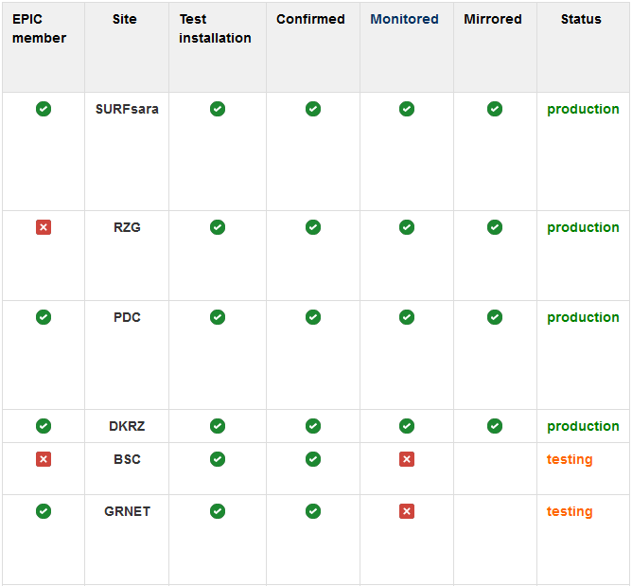
B2HANDLE operations: EUDAT Handle Server sites
You do not have to be an ePIC member to be a B2HANDLE server site.
WP6 operations contact: Dejan Vitlacil (vitlacil@kth.se)

Slide 42
The B2HANDLE Python library
b2handle: A Python library for interaction with EUDAT Handle services
setuptools-enabled Python package
Requires contact to one of the EUDAT Handle server sites
Stable state; official release of v1.0 also for use by EUDAT user communities mid February

Slide 43
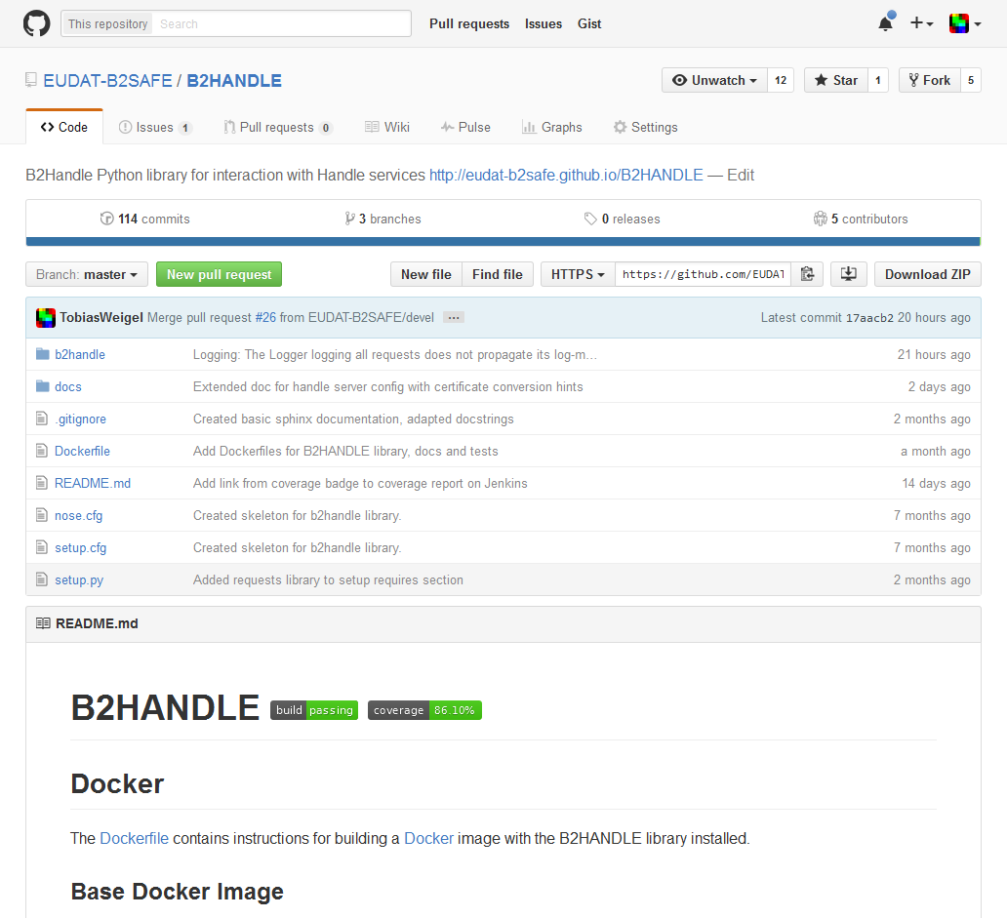
B2HANDLE: Available at GitHub
Code repository: https://github.com/EUDAT-B2SAFE/B2HANDLE

Slide 44
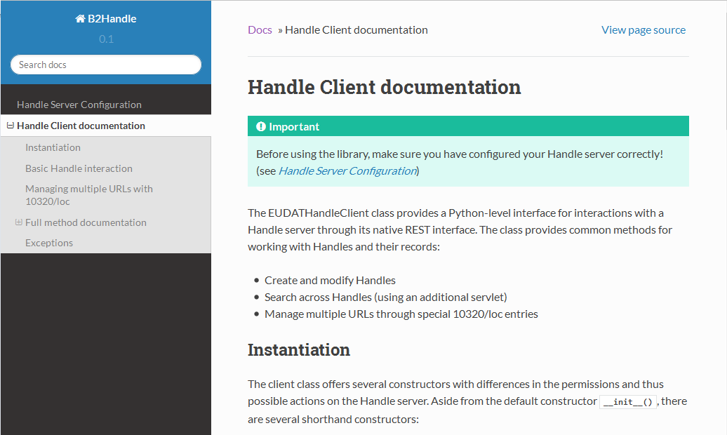
B2HANDLE documentation
Technical documentation: http://eudat-b2safe.github.io/B2HANDLE

Slide 45
B2HANDLE library features
Methods to read, create, modify Handles and their records
Queries against native Handle REST interface
Support for multiple locations per object (10320/loc entries)
Automatic management of Handle value indexes
Support for Handle reverse-lookup via additional Java servlet

Slide 46
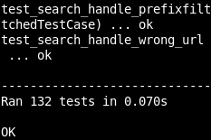
Quality Assurance for B2HANDLE
Continuous Integration (CI):
132+ tests written, covering >86% of code
Tests automatically run upon every commit (GRNET Jenkins instance)
Technical documentation built and published on every change to master
Continued support and improvement
Patching and release process supported by CI
Possible future split into stand-alone pyhandle library published on PyPI

Slide 47
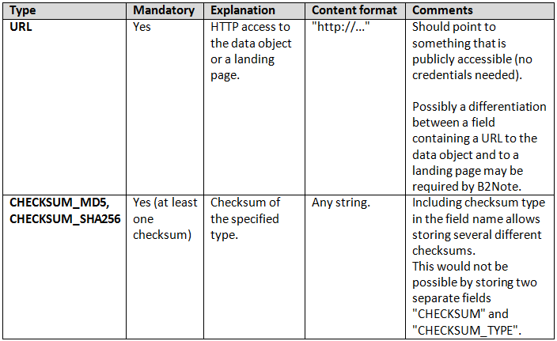
Unifying PID records across EUDAT
All EUDAT PIDs should follow the same record structure, use the same keys and encodings
Picking up ideas from the RDA PIT Working Group
Normative descriptions in a growing document

Slide 48
EUDAT PID policies initiative: Motivation
The key element for PIDs is trust: Users need to trust the identifiers, which falls back onto the organizations managing them
DOIs are citable due to policies and trust in them
Traditional use of PIDs (e.g. citable DOIs) does not match EUDAT data management requirements
Different models for object life cycles
Objects may have a limited life span

Slide 49
EUDAT PID policies intiative: First suggestions
Build trust by enabling third parties to verify the PID service quality
Agreed and controlled Quality of Service (QoS)
Transparent business processes for management of nodes, prefixes, PIDs and objects
Ensure that no PID is lost (never delete PIDs)
Address user needs and sustain added value
Support for several object life cycle models (temporary objects, long-term archival, migration)
Introduce governance and support mechanisms
... PID policy document up for community review!

Slide 50
Questions?

