Slide 1
EUDAT Working Groups
Daan Broeder
Meertens Institute & CLARIN ERIC
EUDAT User Forum, Feb 3,4 Rome

Slide 2
EUDAT Working groups
Part of EUDAT WP4, task leader Peter Wittenburg
The purpose of the EUDAT working groups is to investigate new technologies and consider their applicability for the EUDAT CDI
The WGs are populated with EUDAT experts but also with external experts that we actively engage
EUDAT WG work on / discuss about
  Development of standards & best practices
  Prototype building
  Testing
Results should be:
  Evaluation of data management technologies/services/practices
  Plans for development or implementation plans handed over to WP8 (JRA) and/or WP5

Slide 3
Who does the work?
Some EUDAT partners are funded to take part with experts in the WGs
Extra resources are available for engaging the external high-level experts (traveling costs etc.)
Some resources are available for small work by experts

Slide 4
EUDAT Working Groups History
The previous EUDAT1 project initiated working groups engaging also community experts from outside EUDAT and covered subjects some now JRA subjects:
  Dynamic Data
    How can we efficiently identify (using PIDs) dynamic data, store it and process it
  Scientific Workflows
    The General Execution Framework, bring computation to data
  Semantics
    B2NOTE: semantic annotation of data

Slide 5
EUDAT2020 Working groups
At the start of EUDAT2020 we asked: what is worthwhile to continue and what new subjects are interesting.
Now after discussion with data management and community experts new subjects were discussed:
  Semantics
  Federated Data Mining
  Time-series data bases or Array Data Bases
  Reproducible data-science
Involve experts and consultancy from outside EUDAT
EUDAT working group event was organized in Barcelona Nov. 12,13 with high level community experts.

Slide 6
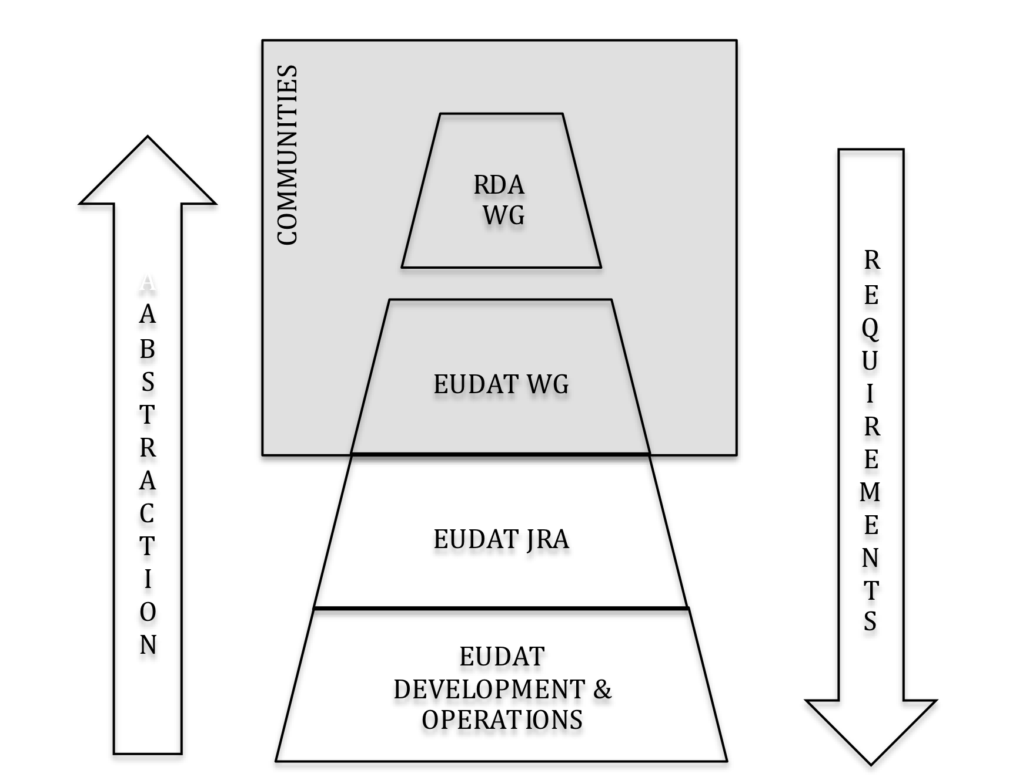
EUDAT WG / RDA positioning
Notes:
The EUDAT project proposal asks for complementarity between the activities of the WG and WPackages

Slide 7
Distributed Data Mining
Chairs: Peter Wittenburg, Daan Broeder
Data sets distributed over multiple sites and the computational processes need to be similarly distributed
  Sensitive data may not leave an institute
  Too large data volumes
We saw use-cases from different communities such as Human Brain Project, Health, Astronomy, Linguistics and Library
Outcome:
  Ideas for protected data in the BioMed disciplines
  Planning EUDAT collaboration with NDS and MPCDF concerning interoperability via DDM of the NDS Materials Data Facility and NoMaD repository (Wittenburg/Plante)

Slide 8
Array Data Bases
Chairs: Peter Baumann, Mark van de Sanden
Array Data Bases (rasdaman) are a recent development and should be able to make managing and retrieval of array type data as for instance spatio-temporal sensor data easier
  Special SQL/MDA SQL variant
Communities present: Earth Observation, Seismology, Humanities; communities targeted: + Astronomy, Human Brain, Fluid Dynamics
Actions proposed: EUDAT to host Array DB instances and communities EPOS,ICOS to provide data and test usefulness

Slide 9
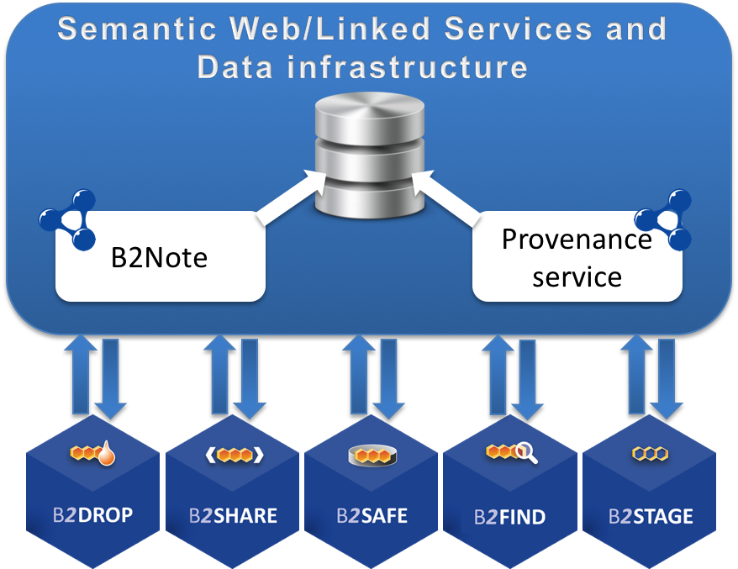
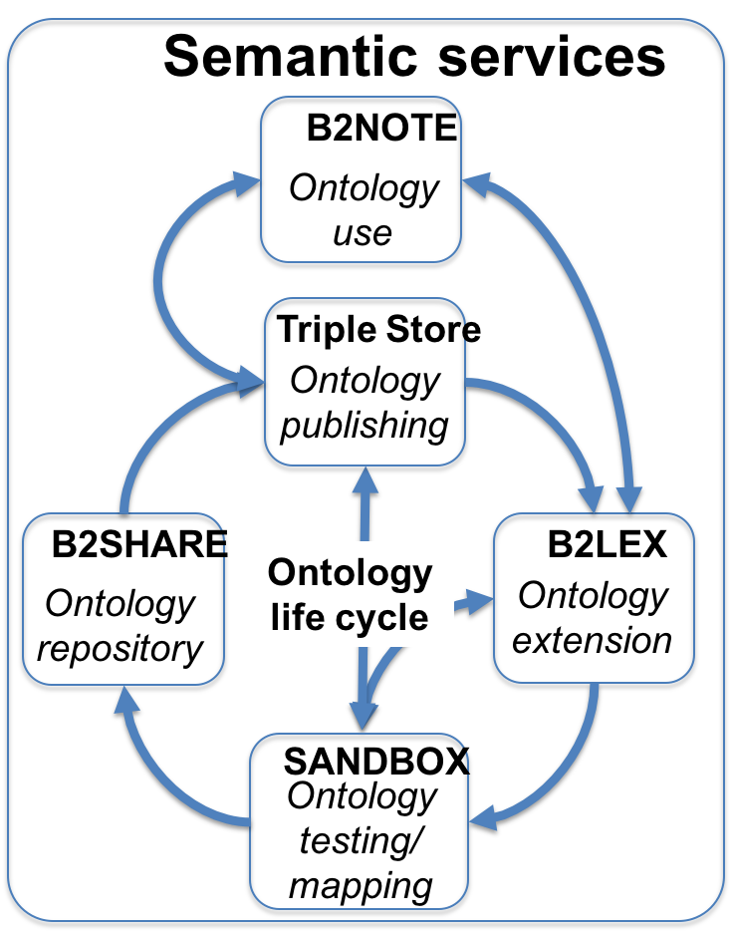
Semantics
Chairs: Yann Le Franc, Johannes Peterseil
Semantic Web infrastructure: how to build a reliable and scalable infrastructure?
Ontology Life Cycle: coupling a data annotation process with the ontology design
Semantics in Data: Use of the DTR in different scenarios describing of data e.g. as part of an ontology e.g. DCO or separately as in a material science use-case
  DTR type proliferation, scope and governance are issues
HTTP signposting: resolving resources described by PIDs and DOIs: going beyond the landing page

Slide 10
Working Group Future
Can you join?
  We should be glad to get new experts in
  Contact the chairs
Can we have more WGs?
  In principle yes, but we need a good case!
  with and outlook on useful EUDAT services
  Activities complementary to RDA and EUDAT WGs esp. WP5 & WP8

Slide 11
Questions

