Slide 1

LTER- Europe & EUDAT Collaboration
www.lter-europe.net/

Slide 2
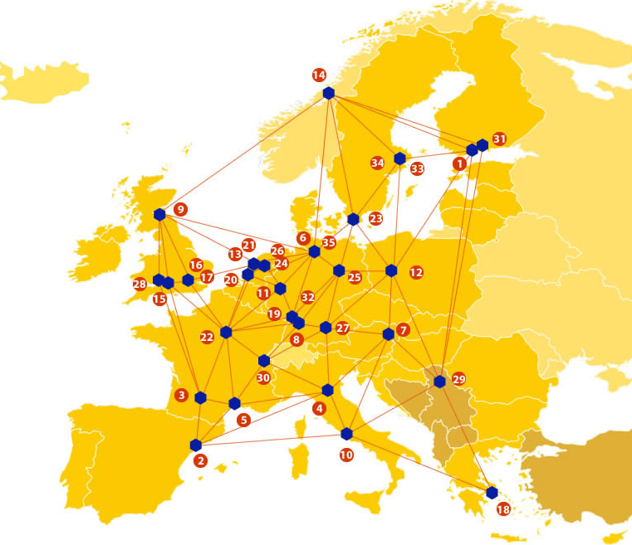

EUDAT: A truly pan-European Infrastructure
EUDAT offers common data services to both research communities and individuals through a network of 35 European organisations.
EUDAT wants to enable European researchers from any discipline to preserve, find, access, and process data in a trusted environment, as part of a Collaborative Data Infrastructure.
European infrastructures
Technology Providers
Research Communities

Slide 3

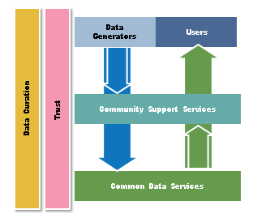
EUDAT Vision & Mission
Vision: Data is shared and preserved across borders and disciplines thereby enhancing the value and quality of research at large.
Mission: To enable data stewardship within and between European Research Communities through a Collaborative Data Infrastructure, a common model and service infrastructure for managing data spanning all European research data centres and community data repositories.

Slide 4
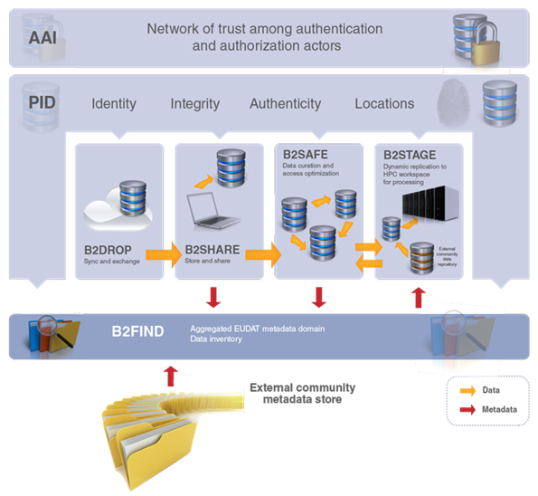














B2 Service Suite
Covering both access and deposit, from informal data sharing to long-term archiving, and addressing identification, discoverability and computability of both long-tail and big data, EUDAT services seek to address the full lifecycle of research data
https://www.eudat.eu/services
Notes:
B2FIND
stores metadata as well through other EUDAT services such as B2SHARE to provide access to data object within the EUDAT CDI
is used in inter-service use cases, e.g. to select links to data to be transferred to HPC platforms through B2STAGE

Slide 5






Building solutions with communities
EUDAT services (B2 Service Suite) are designed, built and implemented together with user communites.
Common Language Resources and Technology Infrastructure (CLARIN)
European Network for Earth System Modelling (ENES)
Distributed infrastructure for life-science information (ELIXIR)
European Plate Observing System (EPOS) - Solid Earth sciences Research Infrastructure
Integrated Carbon Observation System (ICOS) to quantify & understand greenhouse gas balance
Long-Term Ecosystem Research (LTER) in Europe

Slide 6


LTER- Europe EUDAT Service Uptake
Sharing Research Data (B2SHARE)
        LTER Europe will evaluate the use of B2SHARE as repository for shareable digital objects and evaluate the option as central data repository for LTER data objects / files.
        Fully integrate within DEIMS metadata editor to upload files to B2SHARE within DEIMS and create related metadata.
Semantic Annotation (B2NOTE)
        semantic annotation of data for the LTER community metadata and data

Slide 7


LTER- Europe EUDAT Service Uptake
Multi-disciplinary joint metadata catalogue (B2FIND)
        to deliver metadata to broader communities
        evaluate options for community based MD integration & harmonisation (currently geonetwork in discussion)
Data replication and long term preservation (B2SAFE)
        For data replication of the virtual nodes in order to ensure data availability
        For replication and distribution of virtual machines

Slide 8


For More Information
LTER Europe
Web –lter-europe.net
Twitter- @eLTER_EU
EUDAT
Web – eudat.eu
Twitter - @EUDAT_EU

