Slide 1
CLARIN EUDAT2020 uptake plan
Dieter Van Uytvanck
CLARIN ERIC
dieter@clarin.eu
2016-02-03
EUDAT User Forum, Rome

Slide 2
CLARIN?
Common Language Resources and Technology Infrastructure
European (ESFRI) Research Infrastructure – ERIC since February 2012
aims at providing easy and sustainable access for scholars in the humanities and social sciences
  to digital language data (in written, spoken, video or multimodal form)
  to advanced tools to discover, explore, exploit, annotate, analyse or combine them

Slide 3
CLARIN architecture
A distributed architecture: (http-accessible) files, web applications and web services spread all over Europe
Some of them password-protected (licenses, privacy, …)
User base: also spread over Europe (and rest of the world)

Slide 4
Organisation CLARIN
Members:
  Austria • Bulgaria • Czech Republic • Denmark • Dutch Language Union • Estonia • Finland • Germany • Greece • Italy • Lithuania • Netherlands • Norway • Poland • Portugal • Slovenia • Sweden • United Kingdom (observer)
Nodes in the network: centres (http://clarin.eu/centres)

Slide 5
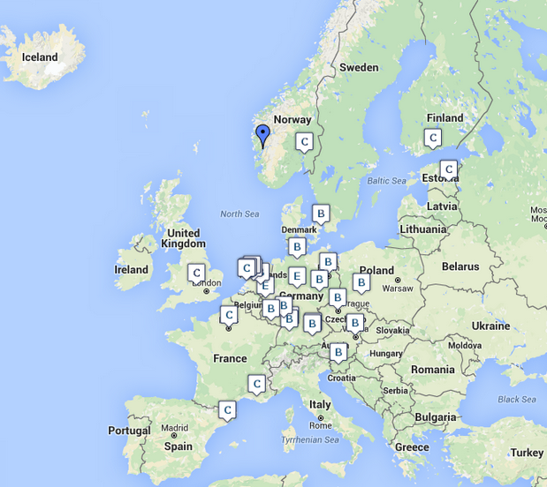
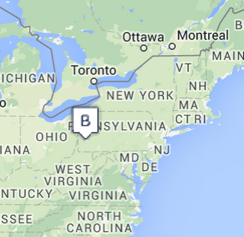
The 33 CLARIN centres

Slide 6
Services
Resources & Services provided (http://clarin.eu/services):
  Access to language resources (including federated login when needed)
  Access to language resource processing applications/services Depositing services
  Metadata catalogue: Virtual Language Observatory
  “Glue components” like the Virtual Collection Registry (http://clarin.eu/vcr)
  Consulting services
  (+ a whole set of technical services behind the scenes)

Slide 7
Uptake plan in a nutshell
Estimated storage involved
  50TB
Estimated users involved
  1000
EUDAT services involved
  B2SAFE, B2DROP, B2ACCESS, GEF

Slide 8
Uptake overview
B2SAFE:
  extend existing implementation
B2DROP:
  connect it to CLARIN user base + applications (LR switchboard, but also read/write to workspaces, user delegation)
B2SHARE:
  connect it to CLARIN user base + applications (LR switchboard)
B2ACCESS:
  connect it to CLARIN Identity Provider, Service Provider Federation

Slide 9
B2SAFE (1)
Extension of the deployment of B2SAFE at CLARIN centres (use B2SAFE)
B2SAFE training: https://www.clarin.eu/event/2015/clarin-b2safe-workshop
Charles University/LINDAT: Updating their DSpace plugin for B2SAFE (multiplication effect)
Original targets from the project plan:
  B2SAFE deployments at a total of 4 CLARIN centres while investigating using B2SAFE light versus B2SAFE/iRODS
  Policies for all replicated data and testing access to the replicated data

Slide 10
B2SAFE (2)
Centre | Size (TB) | iRODS already installed? | Training participation | Planned
SOAS | 58 | no | yes | Feb-16?
CLARIN-AT | 5 | no | yes | Jun-16
CELR | 13 | no | yes | Nov-16
Meertens | 12 | no | yes | Sep-16
TLA | 90 | yes, v3 | yes | Feb-16
Språkbanken | 10 | (yes) | yes | Mar-16

Slide 11
B2SAFE (3)
Candidates in the waiting room:
  CLARIN-PL
  CMU
  CSC

Slide 12
B2DROP
Integration of CLARIN workspaces with the EUDAT B2DROP service.
Targets are:
  Data retrieval and storage from CLARIN community services as WebLicht and Federated Content Search from B2DROP
  Investigate the mounting of B2DROP workspaces on file systems using the CLARIN preferred FIM based AAI

Slide 13
B2SHARE
Harvesting of community metadata and inclusion into the Virtual Language Observatory (clarin.eu/vlo): done
Test-drive the functionality by ingesting new data sets

Slide 14
B2ACCESS
Enable access to the EUDAT services via
  user accounts in the CLARIN Identity Provider
    for B2DROP this requires an LDAP connection
  federated login at the academic organisations in the Service Provider Federation (clarin.eu/spf)

Slide 15
Generic Execution Framework
Integration of CLARIN workflows with the EUDAT infrastructure by:
  Allow interaction between CLARIN workflows with data retrieval and storage from B2SHARE and B2DROP
  Allow CLARIN WebLicht workflows to be executed on the Generic Execution Framework (GEF) being developed in EUDAT

Slide 16
Expected impact
Better safety and high availability of the data stored at the CLARIN Centres.
This proposal focuses on connecting existing components from the CLARIN infrastructure to the EUDAT B2 services and vice versa. This should result in:
  synergy effects by re-using existing modules rather than re-inventing them
  closer integration of the infrastructure landscape
  increased uptake of EUDAT services among the CLARIN centres
  in general increased and improved services for humanities and social sciences researchers

Slide 17
Partners involved
CLARIN ERIC:
  service uptake definition, liaison with other CLARIN centres
  software development and integration expertise (AAI, iRODS and metadata)
EKUT:
  service integration, focus on workflows software development and repository
MPCDF:
  Project enabling, replication site

Slide 18
Thank you for your attention!
For more details:
http://clarin.eu

